Slide 1
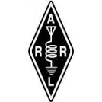

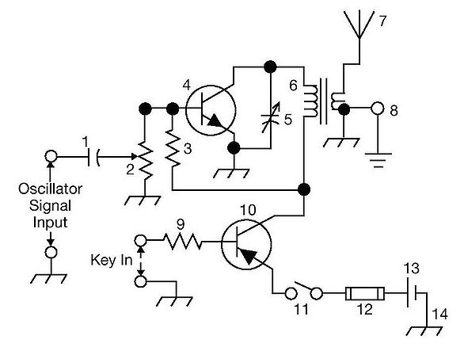
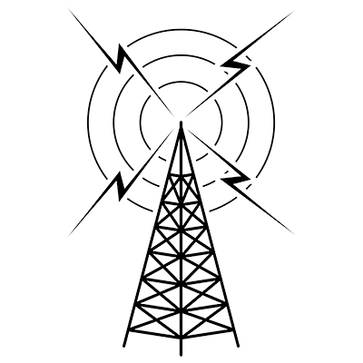
THE
ARRL
TENTH EDITION
GENERAL CLASS
LICENSE COURSE
FOR
HAM RADIO
All You Need to Pass Your General Class Exam!

Slide 2
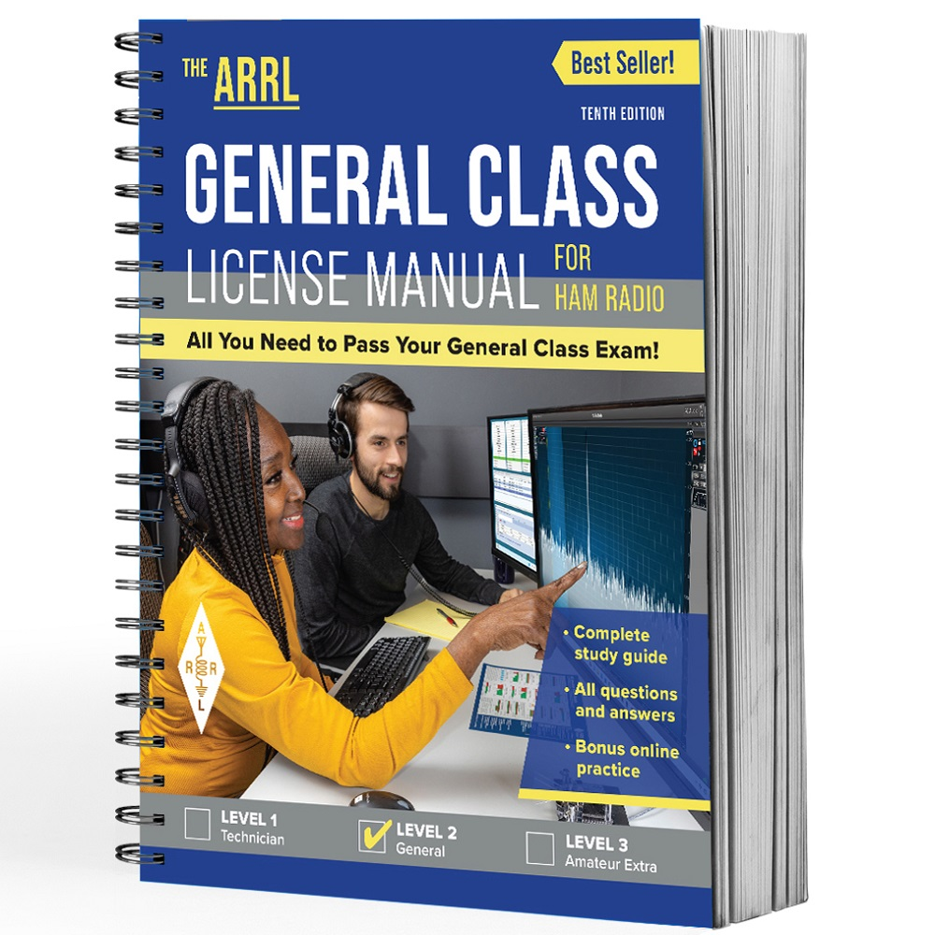
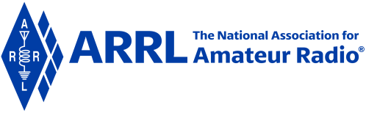
Resource & Reference
www.arrl.org/shop/Licensing-Education-and-Training

Slide 3
Chapter 2 Part 1 of 1
ARRL General Class
Procedures and Practices
Sections 2.1, 2.2
HF Operating Techniques, Emergency Operation

Slide 4
Section 2.1
HF Operating Techniques
Technician class operators focus skills for VHF and higher bands
  Although 10 meters (voice) and 80, 40, and 15 meters (CW) are HF options for technicians
General class operators have the advantage of using HF
  A General license opens up many more frequencies, modes, and activities
Almost everything you know about operating courtesy and good practices from VHF and UHF can be applied to HF

Slide 5
Selecting a Frequency
RECOMMENDED SIGNAL
SEPARATION
CW: 150-500 Hz
SSB: 2-3 kHz
RTTY: 250-500 Hz
PSK31: 150-500 Hz
Check FCC Part 97 for frequency & mode restrictions
  Refer to Band Plan in Chapter 1
Remember that no group or amateur has priority access to any frequency except in the case of emergency communications
On HF, perfectly clear channels are rare
Goal: Find a frequency that minimizes interference to adjacent stations (and, vice versa) – see recommended signal separation table …

Slide 6
Selecting a Frequency (cont.)
Once a frequency is found, check if another station is using it …
  Listen for 10-20 seconds ... then …
    Voice Mode: Is this frequency in use? This is [your call].
    CW/Digital Modes: QRL? DE [your call].
Frequency selection summary …
  Confirm frequency is authorized for your license privileges
  Follow the band plan under normal circumstances
  Listen to avoid interfering with ongoing communications

Slide 7
Split / Dual Frequency Operation
When a rare or interesting station is on the air with many calling stations, it’s common to operate split …
  Set transceiver to listen on one frequency and transmit on another
  Allows for more orderly/effective operating
  Doesn’t work on all transceivers
  Referred to as a dual-VFO feature on a transceiver

Slide 8
More Info … HF Operating Techniques
HF equipment is designed for continuous tuning
The control used for continuous tuning is called a VFO or Variable Frequency Oscillator
  The minimum frequency change is called step size or step rate
For short-range contacts, use 80 or 40 meters
  Using long-distance bands for short-range contacts needlessly occupies radio spectrum space (signal will be heard over much wider range than you’re using)
Longer range contacts, use 30 through 10 meters

Slide 9
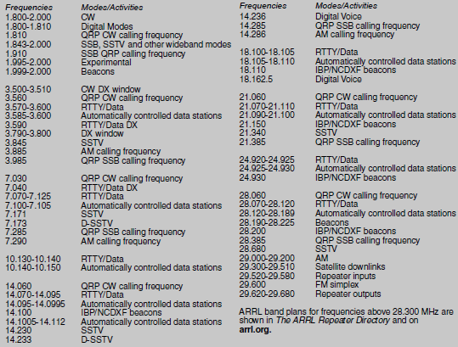
Band-by-Band Frequency Guide
General Class License Manual, Tenth Edition, Page 2-3

Slide 10
Very Common Q Codes
Memorize these!
Code | Meaning
QRL | Are you busy? / I am busy.
QSO | Can you communicate? / I can communicate. (Sometimes “conversation”)
QRP | Shall I decrease transmit power? / Decrease transmit power.
QRO | Shall I increase transmit power? / Increase transmit power.
QSL | Can you receive? / Confirm received.
QRM | Are you bothered by non-natural noise/interference? / I am bothered …
QRN | Are you bothered by natural noise/interference/static? / I am bothered …
QRV | Are you ready to receive? / I am ready …
QRZ | QRZ? (Who is calling me?) / QRZ _ _ _ _ _ (QRZ _ _ _ _ _ is calling you.)
QTH | What is your location? / My location is.

Slide 11
PRACTICE QUESTIONS

Slide 12
Which of the following is true concerning access to frequencies?
Nets have priority
QSOs in progress have priority
Except during emergencies, no amateur station has priority access to any frequency
Contest operations should yield to non-contest use of frequencies
G2B01 (C) [97.101(b), (c)] Page 2-4
12

Slide 13
What is good amateur practice if propagation changes during a contact creating interference from other stations using the frequency?
Advise the interfering stations that you are on the frequency and that you have priority
Decrease power and continue to transmit
Attempt to resolve the interference problem with the other stations in a mutually acceptable manner
Switch to the opposite sideband
G2B03 (C) Page 2-4
13

Slide 14
When selecting a CW transmitting frequency, what minimum separation from other stations should be used to minimize interference to stations on adjacent frequencies?
5 Hz to 50 Hz
150 Hz to 500 Hz
1 kHz to 3 kHz
3 kHz to 6 kHz
G2B04 (B) Page 2-2
14

Slide 15
When selecting an SSB transmitting frequency, what minimum separation should be used to minimize interference to stations on adjacent frequencies?
5 Hz to 50 Hz
150 Hz to 500 Hz
2 kHz to 3 kHz
Approximately 6 kHz
G2B05 (C) Page 2-2
15

Slide 16
How can you avoid harmful interference on an apparently clear frequency before calling CQ on CW or phone?
Send “QRL?” on CW, followed by your call sign; or, if using phone, ask if the frequency is in use, followed by your call sign
Listen for 2 minutes before calling CQ
Send the letter “V” in Morse code several times and listen for a response, or say “test” several times and listen for a response
Send “QSY” on CW or if using phone, announce “the frequency is in use,” then give your call sign and listen for a response
G2B06 (A) Page 2-4
16

Slide 17
Which of the following complies with commonly accepted amateur practice when choosing a frequency on which to initiate a call?
Listen on the frequency for at least two minutes to be sure it is clear
Identify your station by transmitting your call sign at least 3 times
Follow the voluntary band plan
All these choices are correct
G2B07 (C) Page 2-2
17

Slide 18
What does the Q signal “QRL?” mean?
“Will you keep the frequency clear?”
“Are you operating full break-in?” or “Can you operate full break-in?”
“Are you listening only for a specific station?”
“Are you busy?” or “Is this frequency in use?”
G2C04 (D) Page 2-4
18

Slide 19
Which of the following are examples of the NATO Phonetic Alphabet?
Able, Baker, Charlie, Dog
Adam, Boy, Charles, David
America, Boston, Canada, Denmark
Alpha, Bravo, Charlie, Delta
G2D07 (D) Page 2-2
19

Slide 20
Which of the following is a common use of the dual-VFO feature on a transceiver?
To allow transmitting on two frequencies at once
To permit full duplex operation -- that is, transmitting and receiving at the same time
To transmit on one frequency and listen on another
To improve frequency accuracy by allowing variable frequency output (VFO) operation
G4A12 (C) Page 2-4
20

Slide 21
Making Contacts
Calling CQ is rare* on VHF/UHF FM channels, but the method many contacts are initiated on HF
To call CQ on phone/voice …
  “CQ CQ CQ, this is [your call repeated a few times with phonetics]”
    Example (KØILP): CQ CQ CQ, this is kilo-zero-india-lima-papa, kilo-zero-india-lima-papa
  Pause for a response
  If no response, repeat your CQ
To call CQ on CW …
  “CQ CQ CQ DE [your call without phonetics]”
* Calling CQ is rare on VHF/UHF, but acceptable to use.

Slide 22
Making Contacts, CQ Variations
CQ DX (DX means distant stations)
  If you hear CQ DX from a station on the US mainland, it means the person calling is looking for stations outside the lower 48 states
  On HF, it generally refers to any station outside the caller’s country
During CQ contests, you’ll generally hear …
  “CQ Contest”, “CQ test”, or “CQ from special event station”
CQ for stations from certain areas …
  “CQ North America” or “CQ California”

Slide 23
Joining an Ongoing QSO (Contact)
Joining a QSO (also called breaking in) is common
On phone/voice, just say your call sign
On CW / digital modes, send BK (break) followed by your call sign
Same rules apply during contests and competitive events

Slide 24
DX Windows
Originally designed to give operators from countries with restricted privileges band space to make DX contacts outside their countries
Only a few kHz wide on some bands
Now less common with increasing world-wide frequency allocations … but …
50.1 to 50.125 MHz is the place to listen for long-distance contacts outside the contiguous 48 states

Slide 25
Nets & Schedules
There are many on-the-air activities scheduled in advance
  Although no individual has exclusive access to frequencies, we should be courteous and accommodating
Avoid scheduling contacts on national calling frequencies and popular bands
Check contesting calendars on ARRL.org and other sites
If you’re “net control” and discover the net’s chosen frequency to be occupied, find a nearby clear frequency or change to the net’s backup frequency

Slide 26
Logging Contacts
No longer required, but most amateurs keep a log to verify contacts for awards and to record items of interest – see NOTE below
Typical log: time, date, frequency or band, mode of the contact (USB, PSK, etc.), call sign, signal reports, names, and equipment used
Establishes identify of control operator and can be useful in providing info requested by the FCC
NOTE: When operating on 60 meters with an antenna other than a dipole, FCC requires you to keep a record of antenna gain calculations or manufacturer’s data (ensures meeting 100 W ERP restrictions).

Slide 27
Managing Interference
Interference is going to occur on HF …
  Frequencies aren’t channelized
  There are many amateurs using the frequencies
  Occurs due to crowding, propagation, personal choice, atmospheric conditions, and consumer electronics
Learning how to make contacts under these conditions is part of becoming a good operator

Slide 28
Types of Interference
Harmful
  Defined by FCC 97.3(a)(23) as “interference which … seriously degrades, obstructs or repeatedly interrupts a radio communication service operating in accordance with the Radio Regulations”
    It’s not always illegal, but needs to be resolved to keep communicating
Malicious, deliberate or willful
  Specifically forbidden by FCC 97.101(d)

Slide 29
Avoiding Interference
Learn what bands are crowded and when
Learn characteristics of each band (propagation & noise)
Learn how to use your equipment (understand strengths & weaknesses)
Check published calendars for major operating events

Slide 30
Reacting to Interference
Be flexible … no one has a claim to any frequency
Have a back-up plan (especially for scheduled events … nets, etc.)
  Do this in advance!
Keep a cool head … don’t allow harmful interference to turn into deliberate interference!

Slide 31
PRACTICE QUESTIONS

Slide 32
Which of the following is required by the FCC rules when operating in the 60-meter band?
If you are using an antenna other than a dipole, you must keep a record of the gain of your antenna
You must keep a record of the date, time, frequency, power level, and stations worked
You must keep a record of all third-party traffic
You must keep a record of the manufacturer of your equipment and the antenna used
G1C04 (A) [97.303(i)] Page 2-7
32

Slide 33
What is the recommended way to break in to a phone contact?
Say “QRZ” several times, followed by your call sign
Say your call sign once
Say “Breaker Breaker”
Say “CQ” followed by the call sign of either station
G2A08 (B) Page 2-6
33

Slide 34
Generally, who should respond to a station in the contiguous 48 states calling “CQ DX”?
Any caller is welcome to respond
Only stations in Germany
Any stations outside the lower 48 states
Only contest stations
G2A11 (C) Page 2-5
34

Slide 35
What is the voluntary band plan restriction for US stations transmitting within the 48 contiguous states in the 50.1 MHz to 50.125 MHz band segment?
Only contacts with stations not within the 48 contiguous states
Only contacts with other stations within the 48 contiguous states
Only digital contacts
Only SSTV contacts
G2B08 (A) Page 2-6
35

Slide 36
Which of the following is good amateur practice for net management?
Always use multiple sets of phonetics during check-in
Have a backup frequency in case of interference or poor conditions
Transmit the full net roster at the beginning of every session
All these choices are correct
G2B10 (B) Page 2-7
36

Slide 37
Which of the following indicates that you are looking for an HF contact with any station?
Sign your call sign once, followed by the words “listening for a call” -- if no answer, change frequency and repeat
Say “QTC” followed by “this is” and your call sign -- if no answer, change frequency and repeat
Repeat “CQ” a few times, followed by “this is,” then your call sign a few times, then pause to listen, repeat as necessary
Transmit an unmodulated carried for approximately 10 seconds, followed by “this is” and your call sign, and pause to listen -- repeat as necessary
G2D05 (C) Page 2-5
37

Slide 38
Why do many amateurs keep a station log?
The FCC requires a log of all international contacts
The FCC requires a log of all international third-party traffic
The log provides evidence of operation needed to renew a license without retest
To help with a reply if the FCC requests information about your station
G2D08 (D) Page 2-7
38

Slide 39
Which of the following is required when participating in a contest on HF frequencies?
Submit a log to the contest sponsor
Send a QSL card to the stations worked, or QSL via Logbook of The World
Identify your station per normal FCC regulations
All these choices are correct
G2D09 (C) Page 2-6
39

Slide 40
Modes
Amateurs use many different modes of communication. The invention of these various modes is a example of amateur radio fulfilling its mission to “contribute to the state of the radio art.” (per Part 97.1b)
CW (continuous wave) … found in lower ranges for each HF band. However, CW operation is permitted throughout all amateur bands.
AM & SSB (single-side band)
  SSB is the most common voice mode or phone signal
  Has displaced AM as the preferred HF voice modulation method
  SSB signals use less spectrum space than AM (3 kHz vs. 6 kHz … this increases efficiency … results in SSB having a greater range than AM

Slide 41
Modes (cont.)
USB vs. LSB (upper and lower side band)
  Good amateur practices is to use USB above 9 MHz (20 thru 10 meters) and LSB elsewhere except on 60 meters
    USB is used on VHF and UHF
FM is generally not used on HF because higher noise hurts intelligibility
  Exception: FM repeaters can be found on the higher frequencies of 10 meters (above 29 MHz) where cross-continent and DX contacts can be made when the band is open

Slide 42
Modes (cont.)
Digital Voice …
  Relatively new on HF bands
  Operator’s voice converted to and from a digital stream via modem or sound card. Modem connects to a regular SSB transceiver.
  Fidelity comparable to regular SSB signals, but less affected by fading
  Most popular digital voice modes: FreeDV and protocol developed by G4GUO (Charles Brain)

Slide 43
Modes (cont.)
Digital Modes …
  Packet radio common on VHF and UHF to exchange digital data, but also common on HF
  FT8: Most popular
  FT8, PSK63 and PSK31: Effective at low power levels … all widely used
  RTTY: Oldest, and still common (radioteletype)
  PACTOR or WINMOR: Used for semi-automatic and automatic messaging for small files
More info on digital modes in Chapter 6

Slide 44
Modes (cont.)
Image Modes
  Image mode transmissions on HF encode photos & graphics to tones
  These tones are reconstructed as an image on a display
  Allowed on same frequencies as voice, except for 60 meters
  Most common image mode: Slow-scan television (SSTV)
    Called slow because each image takes several seconds
  Fast-scan amateur television (ATV) allows full motion video
    Restricted to 432 MHz and higher frequency bands (due to wide bandwidth)

Slide 45
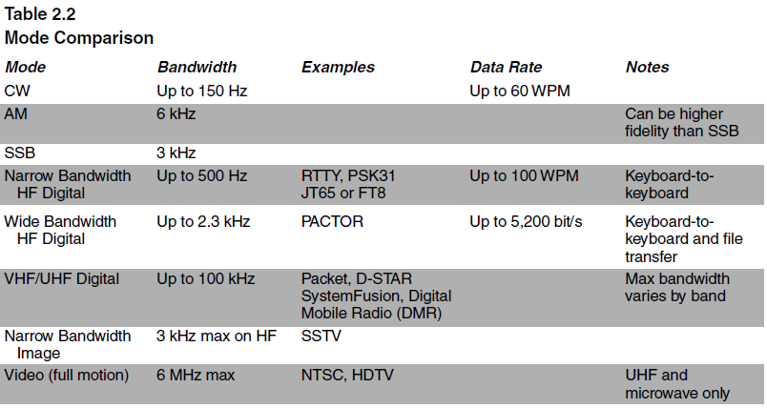
Mode Comparison
More details in Chapters 5 & 6

Slide 46
PRACTICE QUESTIONS

Slide 47
Which mode is most commonly used for voice communications on frequencies of 14 MHz or higher?
Upper sideband
Lower sideband
Suppressed sideband
Double sideband
G2A01 (A) Page 2-10
47

Slide 48
Which mode is most commonly used for voice communications on the 160-, 75-, and 40-meter bands?
Upper sideband
Lower sideband
Suppressed sideband
Double sideband
G2A02 (B) Page 2-10
48

Slide 49
Which mode is most commonly used for SSB voice communications in the VHF and UHF bands?
Upper sideband
Lower sideband
Suppressed sideband
Double sideband
G2A03 (A) Page 2-10
49

Slide 50
Which mode is most commonly used for voice communications on the 17- and 12-meter bands?
Upper sideband
Lower sideband
Suppressed sideband
Double sideband
G2A04 (A) Page 2-10
50

Slide 51
Which mode of voice communication is most commonly used on the HF amateur bands?
Frequency modulation
Double sideband
Single sideband
Single phase modulation
G2A05 (C) Page 2-9
51

Slide 52
Which of the following is an advantage of using single sideband, as compared to other analog voice modes on the HF amateur bands?
Very high-fidelity voice modulation
Less subject to interference from atmospheric static crashes
Ease of tuning on receive and immunity to impulse noise
Less bandwidth used and greater power efficiency
G2A06 (D) Page 2-9
52

Slide 53
Which of the following statements is true of single sideband (SSB)?
Only one sideband and the carrier are transmitted; the other sideband is suppressed
Only one sideband is transmitted; the other sideband and carrier are suppressed
SSB is the only voice mode authorized on the 20-, 15-, and 10-meter amateur bands
SSB is the only voice mode authorized on the 160-, 75-, and 40-meter amateur bands
G2A07 (B) Page 2-9
53

Slide 54
Why do most amateur stations use lower sideband on the 160-, 75-, and 40-meter bands?
Lower sideband is more efficient than upper sideband at these frequencies
Lower sideband is the only sideband legal on these frequency bands
Because it is fully compatible with an AM detector
It is commonly accepted amateur practice
G2A09 (D) Page 2-10
54

Slide 55
HF Receiving
On VHF, FM receivers have 3 basic controls …
  Frequency (channel), squelch, volume
SSB/CW receivers have additional controls to accommodate non-channelized, continuous-tuning operation (must be able to receive signals in the presence of noise and interference from adjacent channels). Examples …
  Selectivity: Ability to discriminate between closely-spaces signals
  Sensitivity: Ability to detect a signal

Slide 56
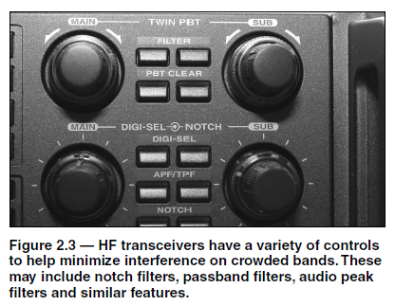
Examples of Additional HF Transceiver Controls
Natural or atmospheric noise (QRN) is much more common on HF than VHF/UHF. This natural noise includes some man-made sources (sparks from motors & generators). Hence, the importance of SELECTIVITY.

Slide 57
Signal Reporting
Exchanged between stations at beginning of a contact (lets stations know how well they’re being received so adjustments can be made)
Most common is RST
  Readability: Scale of 1 to 5 (5 = best)
  Strength: Scale of 1 to 9 (9 = best)
  Tone: Also 1 to 9 scale. Only used for CW and digital mode contacts.
    Indicates signal purity; Values less than 9 indicate transmitter problems
  A C added after RST indicates an unstable signal or chirp

Slide 58
HF Receiving … More Information
HF receivers use sharp filters to reject unwanted signals
Because HF operation is not channelized, you’ll encounter signals close enough in frequency to be audible as low- or high-pitched speech fragments. This is QRM interference.
A steady tone from a station tuning up or a broadcast carrier can be rejected by a notch filter

Slide 59
PRACTICE QUESTIONS

Slide 60
When sending CW, what does a “C” mean when added to the RST report?
Chirpy or unstable signal
Report was read from an S meter rather than estimated
100 percent copy
Key clicks
G2C07 (A) Page 2-12
60

Slide 61
What does the Q signal “QRN” mean?
Send more slowly
Stop sending
Zero beat my signal
I am troubled by static
G2C10 (D) Page 2-11
61

Slide 62
Why are signal reports typically exchanged at the beginning of an HF contact?
To allow each station to operate according to conditions
To be sure the contact will count for award programs
To follow standard radiogram structure
To allow each station to calibrate their frequency display
G2D11 (A) Page 2-11
62

Slide 63
HF Transmitting – PHONE
Putting transceiver into transmit mode is called keying the transmitter
  The PTT (push-to-talk) button works the same as on FM
  Foot switches are often used during busy operating periods
Some HF operators use voice-operated transmit or VOX
  Allows hands-free operation
  Common for mobile operators

Slide 64
HF Transmitting – CW
CW operators use prosigns (2-letter shortcuts)
  Example: A̅R̅ (means End of Message)
Respond to a CQ at the fastest speed you’re comfortable, up to the speed of the CQ (sending station)
  Reply with QRS to request sender slow down (QRQ = speed up!)
As with voice, give call sign every 10 minutes and end of contact

Slide 65
CW (cont.)
Most CW operators begin by using a straight key but most graduate to an electronic keyer
The keyer is operated by a paddle to automatically generate the strings of Morse code elements — dots and dashes
Under some circumstances, it is more convenient to be able to hear what is going on between Morse characters
  Some radios include a full break-in option in which the radio switches between transmit and receive … full break-in is referred to as QSK

Slide 66
CW (cont.)
When communicating, try to match your transmitting frequency with the received signal (called zero beat)
Once you are in contact with another station, the prosign KN is used instead of K to prevent other stations from breaking in during the contact
  “Only the specific station or stations I am contacting should respond.”
  Prosign SK ends the message
Other useful CW Q codes:
  QRV = I’m ready to receive
  QSL = I acknowledge receipt

Slide 67
CW Additional Information
FISTS: www.fists.org
CWOps: www.cwops.org
ARRL: www.arrl.org/cw-mode
Learn CW Online: https://lcwo.net

Slide 68
PRACTICE QUESTIONS

Slide 69
Which of the following statements is true of voice VOX operation versus PTT operation?
The received signal is more natural sounding
It allows “hands free” operation
It occupies less bandwidth
It provides more power output
G2A10 (B) Page 2-13
69

Slide 70
How often may RACES training drills and tests be routinely conducted without special authorization?
No more than 1 hour per month
No more than 2 hours per month
No more than 1 hour per week
No more than 2 hours per week
G2B11 (C) [97.407(d)(4)] Page 2-17
70

Slide 71
Which of the following describes full break-in CW operation (QSK)?
Breaking stations send the Morse code prosign “BK”
Automatic keyers, instead of hand keys, are used to send Morse code
An operator must activate a manual send/receive switch before and after every transmission
Transmitting stations can receive between code characters and elements
G2C01 (D) Page 2-14
71

Slide 72
What should you do if a CW station sends “QRS?”
Send slower
Change frequency
Increase your power
Repeat everything twice
G2C02 (A) Page 2-14
72

Slide 73
What does it mean when a CW operator sends “KN” at the end of a transmission?
No US stations should call
Operating full break-in
Listening only for a specific station or stations
Closing station now
G2C03 (C) Page 2-14
73

Slide 74
What is the best speed to use when answering a CQ in Morse code?
The fastest speed at which you are comfortable copying, but no slower than the CQ
The fastest speed at which you are comfortable copying, but no faster than the CQ
At the standard calling speed of 10 wpm
At the standard calling speed of 5 wpm
G2C05 (B) Page 2-14
74

Slide 75
What does the term “zero beat” mean in CW operation?
Matching the speed of the transmitting station
Operating split to avoid interference on frequency
Sending without error
Matching the transmit frequency to the frequency of a received signal
G2C06 (D) Page 2-14
75

Slide 76
What prosign is sent to indicate the end of a formal message when using CW?
SK
BK
AR
KN
G2C08 (C) Page 2-14
76

Slide 77
What does the Q signal “QSL” mean?
Send slower
We have already confirmed the contact
I have received and understood
We have worked before
G2C09 (C) Page 2-14
77

Slide 78
What does the Q signal “QRV” mean?
You are sending too fast
There is interference on the frequency
I am quitting for the day
I am ready to receive
G2C11 (D) Page 2-14
78

Slide 79
What is the function of an electronic keyer?
Automatic transmit/receive switching
Automatic generation of dots and dashes for CW operation
To allow time for switching the antenna from the receiver to the transmitter
Computer interface for PSK and RTTY operation
G4A10 (B) Page 2-14
79

Slide 80
Section 2.2
Emergency Operation
Amateurs should be familiar with emergency rules and procedures
See Table 2.4 (General Class License Manual, Pages 2-16, 2-17)
  FCC 47 CFR § 97.401 Operating during a disaster
  FCC 47 CFR § 97.403 Safety of life and protection of property
  FCC 47 CFR § 97.405 Station in distress
  FCC 47 CFR § 97.407 Radio amateur civil emergency service

Slide 81
ARES & RACES
Amateur Radio two primary emergency response organizations
ARES = Amateur Radio Emergency Services (sponsored by ARRL)
  Mission: provide communications assistance to local and regional government and relief agencies
  www.arrl.org/ares
RACES (sponsored by FEMA)
  Mission: provide essential communications for State and local governments in time of emergency
  Only a licensed amateur may be the control operator of a RACES station

Slide 82
Distress Calls
If you receive a call for help …
  Immediately suspend your existing contact
  Immediately acknowledge to the station calling for help
  Stand by to receive the location of the emergency and the name of the assistance required
  Relay the info to the proper authorities and stay on frequency

Slide 83
Distress Calls (cont.)
If you’re the station making the distress call …
  On voice mode, say MAYDAY MAYDAY MAYDAY. On CW or digital send SOS SOS SOS followed by Any station come in please.
  Identify the transmission with your call sign
  State your location and the nature of the situation
  Describe the type of assistance required
FCC 47 CFR § 97.405 allows the distress station to use ANY means of communication available, even frequencies, mode, or power level outside your normal privileges

Slide 84
PRACTICE QUESTIONS

Slide 85
What is the first thing you should do if you are communicating with another amateur station and hear a station in distress break in?
Inform your local emergency coordinator
Acknowledge the station in distress and determine what assistance may be needed
Immediately decrease power to avoid interfering with the station in distress
Immediately cease all transmissions
G2B02 (B) Page 2-18
85

Slide 86
Who may be the control operator of an amateur station transmitting in RACES to assist relief operations during a disaster?
Only a person holding an FCC-issued amateur operator license
Only a RACES net control operator
A person holding an FCC-issued amateur operator license or an appropriate government official
Any control operator when normal communication systems are operational
G2B09 (A) [97.407(a)] Page 2-18
86

Slide 87
END OF CHAPTER 2 PART 1 OF 1

Slide 88
Slides created by …
Jerry D. Kilpatrick
KØILP (Amateur Radio)
PGØØØ72373 (Commercial Operator)
K0ILP.NC@gmail.com
Feel free to contact me if you find errors or have suggestions for improvement.

