Slide 1
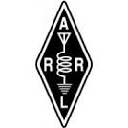

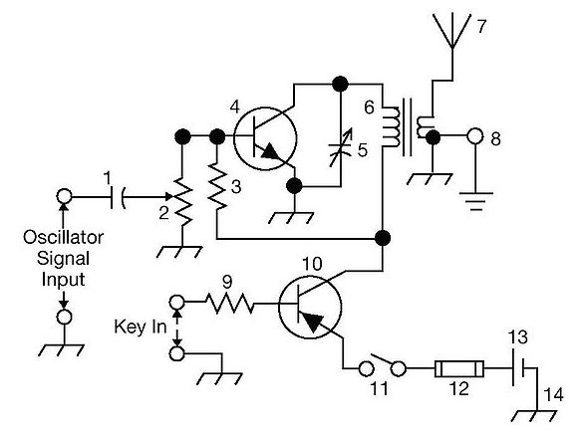

THE
ARRL
TENTH EDITION
GENERAL CLASS
LICENSE COURSE
FOR
HAM RADIO
All You Need to Pass Your General Class Exam!

Slide 2
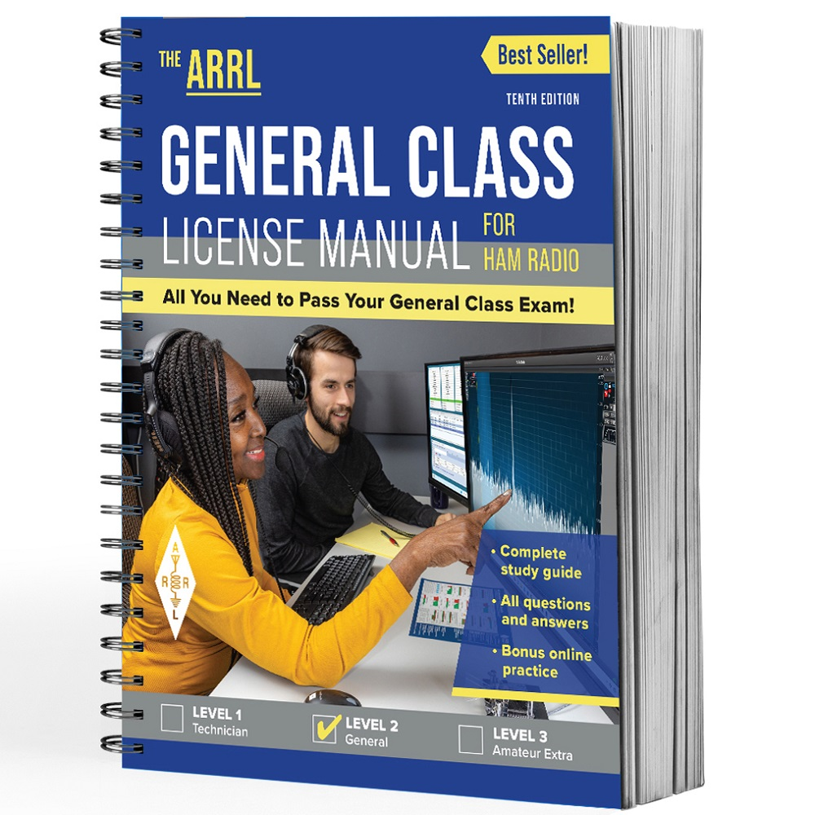

Resource & Reference
www.arrl.org/shop/Licensing-Education-and-Training

Slide 3
Chapter 4 Part 1 of 3
ARRL General Class
Components & Circuits
Sections 4.1, 4.2, 4.3
Power & Decibels, AC Power, Basic Components

Slide 4
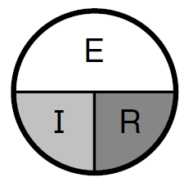
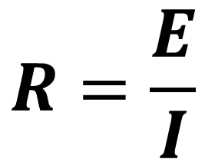
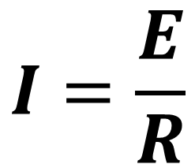
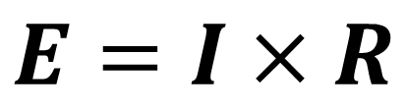
Section 4.1
Power and Decibels
Recall Ohm’s Law from your Technician training
$$E=I×R$$
$$I=\frac{E}{R}$$
E = Voltage
I = Current
R = Resistance
$$R=\frac{E}{I}$$

Slide 5
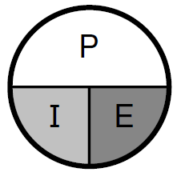
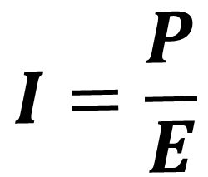
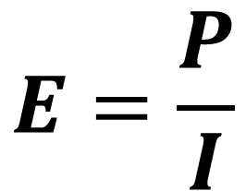
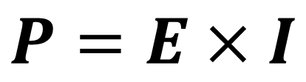
Power and Decibels (cont.)
Similarly …
$$P=E×I$$
$$E=\frac{P}{I}$$
$$I=\frac{P}{E}$$
E = Voltage
I = Current
P = Power

Slide 6
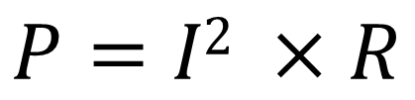
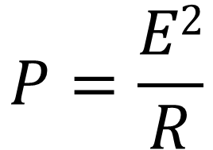
Power and Decibels (cont.)
Substituting the Ohm’s Law equivalents for voltage and current allows power to be calculated using resistance …
6

Slide 7
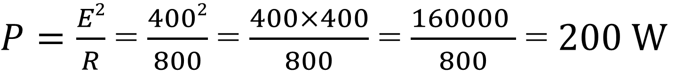
Power Calculation Examples
To find out how many watts of electrical power are used if 400 Vdc is supplied to an 800 Ω resistor …
7

Slide 8
Power Calculation Examples (cont.)
To find out how many watts of electrical power are used by a 12 V dc light bulb that draws 0.2 A …
$$P=E × I=12×0.2=2.4 W$$
8

Slide 9
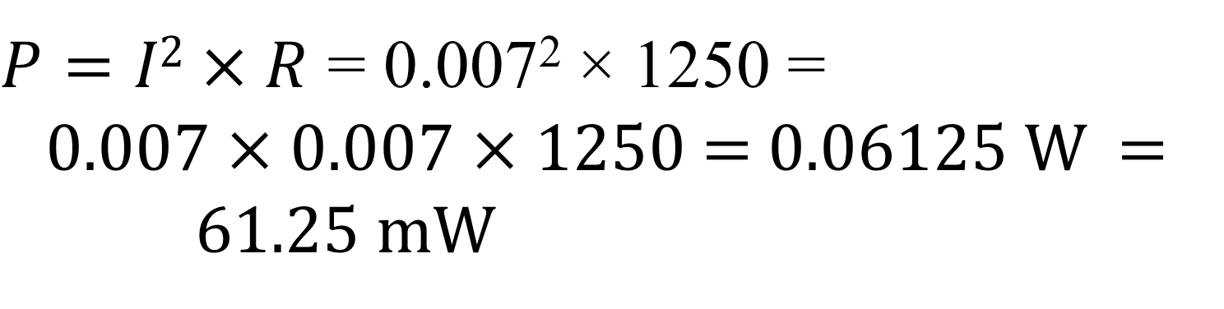
Power Calculation Examples (cont.)
To find out how many watts are being dissipated when a current of 7.0 mA flows through a 1.25 kΩ resistor …
Remember: (a) 7 mA = 0.007 A, (b) 1.25 kΩ = 1250 Ω
9

Slide 10
Calculating a Power or Voltage Ratio from dB
Inverse log notes …
(referred to as antilog)
Written as … log₁₀⁻¹
or … log⁻¹
On scientific calculators …
LOG⁻¹
ALOG
10^{X}
INV then LOG
dB
Power Ratio = log ⁻¹
10
dB
Voltage Ratio = log ⁻¹
20
10

Slide 11
Example Power & Voltage Ratio Calculations
--
--
Power ratio of 9 dB = log^{–1}(9/10) = log^{–1}(0.9) = 8
Voltage ratio of 32 dB = log^{–1}(32/20) = log^{–1}(1.6) = 40

Slide 12
Useful Power vs. dB Value to Remember
If you double the power (or cut it in half), there’s a 3 dB change …
2
dB = 10 log₁₀
= 10 log₁₀ (2) = 10 × (0.3) = 3 dB
1

Slide 13

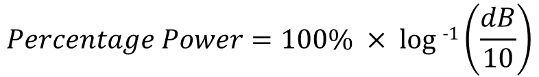
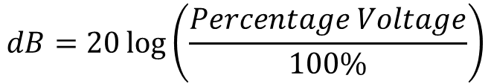
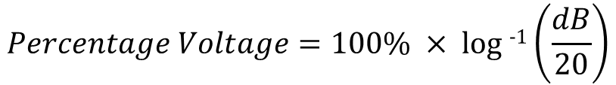
Converting dB to Percentage & Vice Versa
Application example: Suppose you are using an antenna feed line that has a loss of 1dB. You can calculate the amount of transmitter power that’s actually reaching your antenna and how much is lost in the feed line.
79.4% of your transmit power reaches the antenna … 20.6% is lost in the feed line.

Slide 14
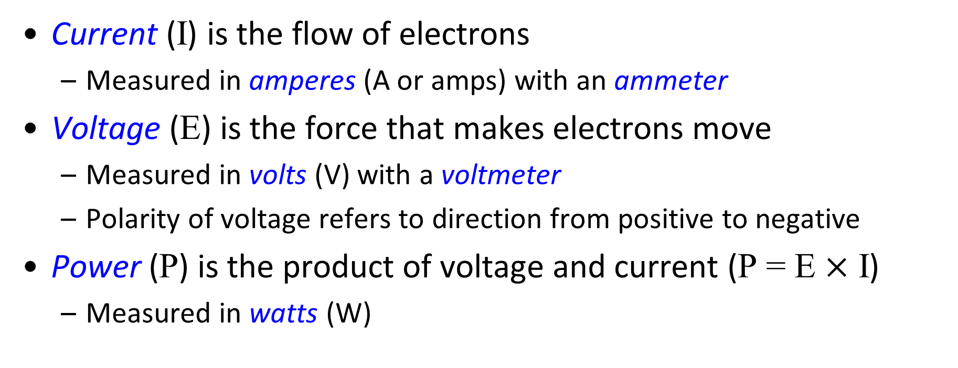
Current, Voltage, and Power Review

Slide 15
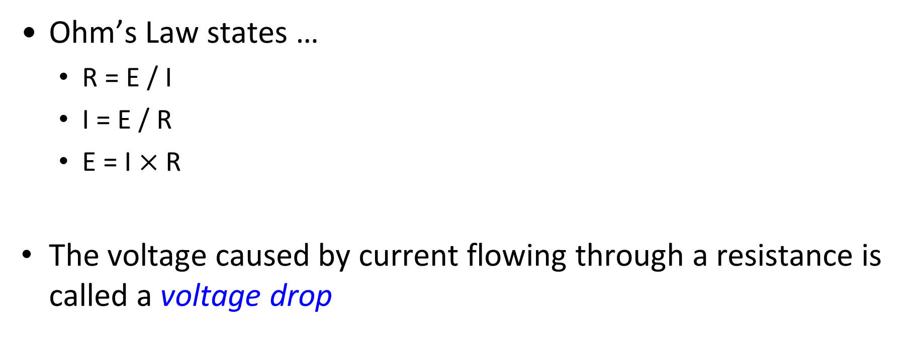
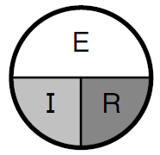
Resistance and Ohm’s Law Review

Slide 16
Frequency Review
A complete sequence of ac current (alternating current) flowing, stopping, reversing, and stopping again is a cycle
The number of cycles per second is the current’s frequency (f), measured in hertz (Hz)
A harmonic is a frequency at some integer multiple (2, 3, 4, etc.) of a lowest or fundamental frequency
  The harmonic at twice the frequency is the second harmonic, at three times is the third harmonic (there is no first harmonic)

Slide 17
Wavelength Review
Speed of light in space (c) is 300 million (3 × 10⁸) meters per second … somewhat slower in wires and cables
Wavelength (λ) of radio wave is the distance it travels during one complete cycle
  λ = c / f
  f = c / λ
A radio wave can be referred to by frequency OR wavelength because the speed of light is constant

Slide 18
Series and Parallel Circuits
Circuit: Any complete path through which current can flow
Series Circuit: Two or more components are connected so that the same current flows through all of the components
Parallel Circuit: Two or more components are connected so that the same voltage is applied to all of the components

Slide 19

Decibels (dB)
Formula: dB = 10 log₁₀ (power ratio) = 20 log₁₀ (voltage ratio)
Comparing a measured power or voltage to a reference value …
Positive dB values mean the ratio is > 1 and are called gain
Negative dB values (ratio < 1) are called loss or attenuation

Slide 20
PRACTICE QUESTIONS

Slide 21
What dB change represents a factor of two increase or decrease in power?
Approximately 2 dB
Approximately 3 dB
Approximately 6 dB
Approximately 9 dB
G5B01 (B) Page 4-2
21

Slide 22
How many watts of electrical power are used if 400 VDC is supplied to an 800-ohm load?
0.5 watts
200 watts
400 watts
3200 watts
G5B03 (B) Page 4-2
22

Slide 23
How many watts of electrical power are used by a 12 VDC light bulb that draws 0.2 amperes?
2.4 watts
24 watts
6 watts
60 watts
G5B04 (A) Page 4-2
23

Slide 24
How many watts are consumed when a current of 7.0 milliamperes flows through a 1,250-ohm resistance?
Approximately 61 milliwatts
Approximately 61 watts
Approximately 11 milliwatts
Approximately 11 watts
G5B05 (A) Page 4-2
24

Slide 25
What percentage of power loss is equivalent to a loss of 1 dB?
10.9 percent
12.2 percent
20.6 percent
25.9 percent
G5B10 (C) Page 4-3
25

Slide 26
Section 4.2
AC Power / RMS: Definition & Measurement
The power equation is very clear for dc power … P = E² / R
However, what is the value of E for ac power?
  Not peak, not average … it’s RMS (root mean square or V_{RMS})
If RMS voltage is used in the equations shown for calculating power (previous slides), the result for the ac signal is the same as for an unvarying dc voltage
The RMS for a sine wave is 0.707 times the sine wave’s peak voltage … see Figure 4.2 (next slide)

Slide 27
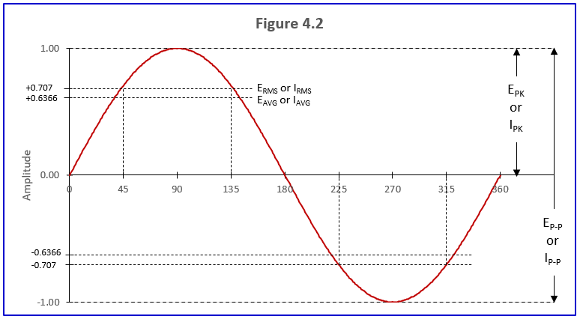
Figure 4.2
Relationships between RMS, average, peak, and peak-to-peak ac voltage and current

Slide 28
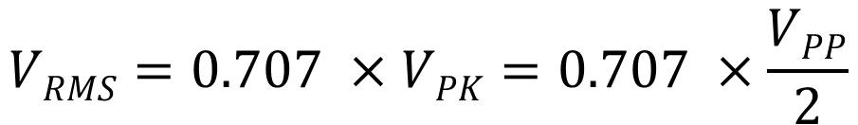
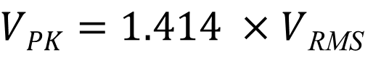
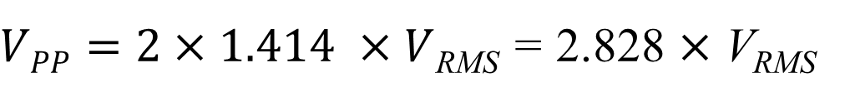
Waveform Formulas
(Note: Do not use these for non-sine waves!)
It is particularly important to know the relationship between RMS and peak voltages to choose components that have sufficient voltage ratings. Capacitors are often connected across the ac power line to perform RF filtering. The capacitor must be rated to withstand the ac peak voltage.
Refer to Figure 4.2

Slide 29
Waveform Calculation Examples
Example: A sine wave with a peak voltage of 17 V has what RMS value?
V_{RMS} = 0.707 × V_{PK} = 0.707 × 17 V = 12 V
Example: A sine wave with a peak-peak voltage of 100 V has what RMS value?
V_{P-P}
100
V_{RMS} = 0.707 ×
= 0.707 ×
= 35.4 V
2
2
Example: A sine wave with an RMS voltage of 120.0 V has what peak-to-peak voltage value?
V_{P-P} = 2 × 1.414 × 120 = 2.828 × 120 = 339.4 V

Slide 30
PEP: Definition and Measurement
PEP = Peak envelope power
PEP is the average power of one complete RF cycle at the peak of the signal’s envelope … a convenient way of measuring the max power of amplitude-modulated signals
However, this definition is confusing …
  See (following slide) definition from ARRL General Manual and www.mdarc.org

Slide 31
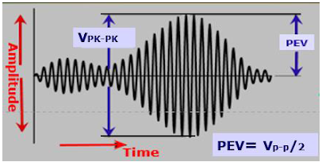
Clarification of Peak Envelope Power
PEP (or peak envelope power) is the average power of one complete RF cycle at the peak of the signal’s envelope. PEP is used because it is a convenient way to measure or specify the maximum power of amplitude-modulated signals.
To calculate average ac power, you need to know the load impedance and the RMS voltage. Measure the RF voltage at the very peak of the modulated signal’s envelope — this is the peak envelope voltage (PEV) as shown in this figure.

Slide 32
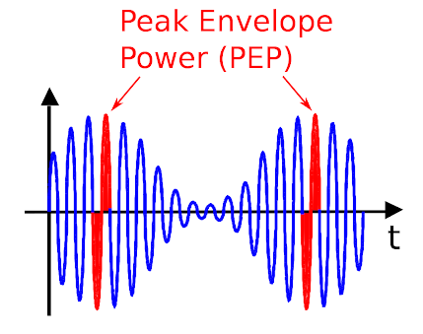
Clarification of Peak Envelope Power (cont.)
Once the RF cycle is identified, we calculate the average power over its complete duration. That's the red area in this figure.
Note that we calculate the power in both the positive voltage half-cycle and the negative voltage half-cycle. They don't cancel out because, as shown below, the PEV is squared, making both of them positive.
Start by measuring the amplitude of the peak, usually in volts. That is PEV in figure on previous slide.
Then apply the following formula … (next slide) …

Slide 33
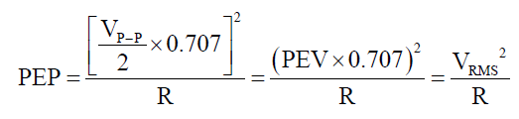

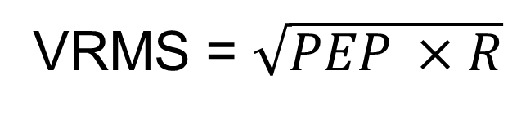
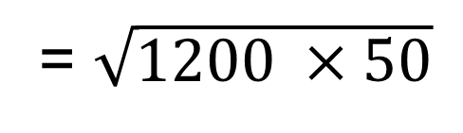
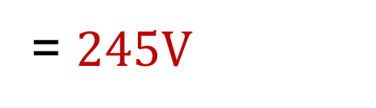
PEP Calculations
Example: If PEV is 50V across a 50Ω load, the PEP power is …
Example: If a 50Ω load is dissipating 1200W PEP, the RMS voltage is …

Slide 34
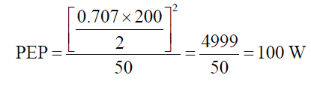
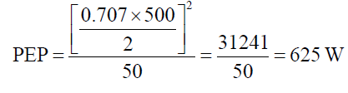
PEP Calculations (cont.)
If an oscilloscope measures 200 VP-P across a 50 Ω load, what would be the PEP power?
For the same device at 500 VP-P, the PEP power would be …

Slide 35
PEP Summary
PEP equals the average power IF an amplitude-modulated signal is NOT modulated
  An example of this is when modulation is removed from an AM signal (leaving only the steady carrier) or when a CW transmitter is keyed
An FM signal is a constant-power signal, so PEP is always equal to average power for FM signals. In other words, if an average-reading wattmeter connected to your transmitter reads 1060 W when you close the key on CW, your PEP output power will be …
1060 W

Slide 36
PRACTICE QUESTIONS

Slide 37
What is the PEP produced by 200 volts peak-to-peak across a 50-ohm dummy load?
1.4 watts
100 watts
353.5 watts
400 watts
G5B06 (B) Page 4-7
37

Slide 38
What value of an AC signal produces the same power dissipation in a resistor as a DC voltage of the same value?
The peak-to-peak value
The peak value
The RMS value
The reciprocal of the RMS value
G5B07 (C) Page 4-6
38

Slide 39
What is the peak-to-peak voltage of a sine wave with an RMS voltage of 120 volts?
84.8 volts
169.7 volts
240.0 volts
339.4 volts
G5B08 (D) Page 4-6
39

Slide 40
What is the RMS voltage of a sine wave with a value of 17 volts peak?
8.5 volts
12 volts
24 volts
34 volts
G5B09 (B) Page 4-6
40

Slide 41
What is the ratio of PEP to average power for an unmodulated carrier?
0.707
1.00
1.414
2.00
G5B11 (B) Page 4-8
41

Slide 42
What is the RMS voltage across a 50-ohm dummy load dissipating 1200 watts?
173 volts
245 volts
346 volts
692 volts
G5B12 (B) Page 4-7
42

Slide 43
What is the output PEP of an unmodulated carrier if the average power is 1060 watts?
530 watts
1060 watts
1500 watts
2120 watts
G5B13 (B) Page 4-8
43

Slide 44
What is the output PEP of 500 volts peak-to-peak across a 50-ohm load?
8.75 watts
625 watts
2500 watts
5000 watts
G5B14 (B) Page 4-7
44

Slide 45
Section 4.3
Basic Components
Refer to the following 5 slides … selected basic component samples from Figure 4.4 (page 4-9 in your text)
Three most basic components …
  Resistors: Designated with an R, resist flow of electricity, measured in ohms (Ω)
  Capacitors: Designated C, store electric energy, measured in farads (F)
  Inductors: Designated L, store magnetic energy, measured in henries (H)
Typical values associated with components include; nominal value, tolerance, temperature coefficient, and power rating

Slide 46
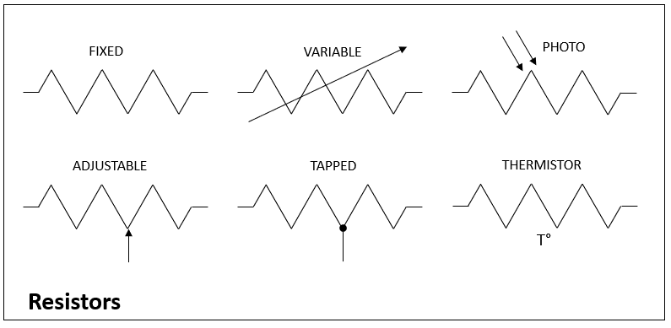
Common Schematic Symbols: Resistors
Fig. 4.4

Slide 47
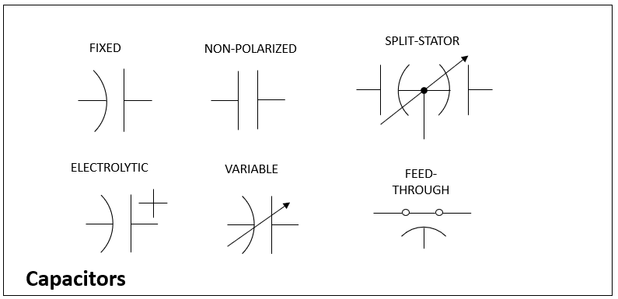
Common Schematic Symbols: Capacitors
Fig. 4.4

Slide 48
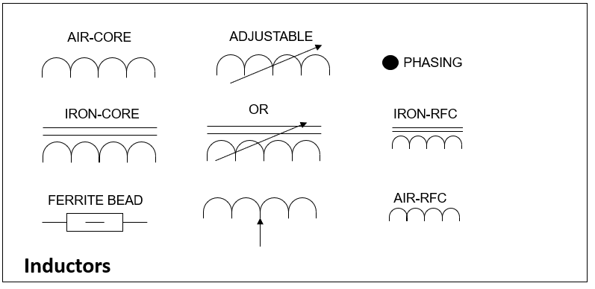
Common Schematic Symbols: Inductors
Fig. 4.4

Slide 49
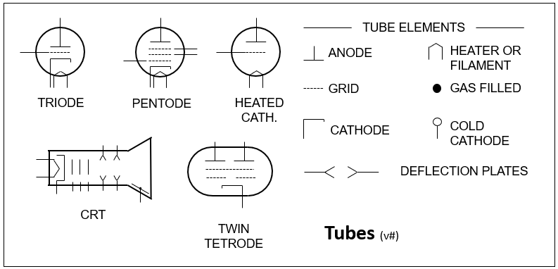
Common Schematic Symbols: Tubes
Fig. 4.4

Slide 50
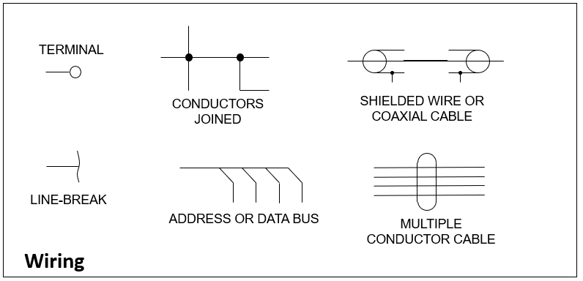
Common Schematic Symbols: Wiring
Fig. 4.4

Slide 51
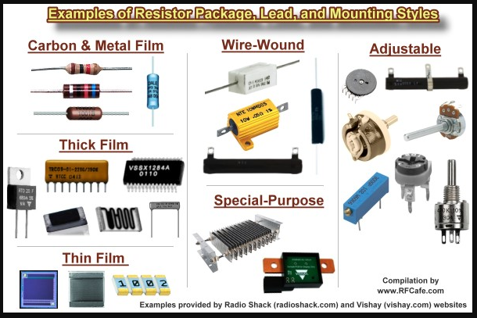
Resistors and Resistance
Several common types
Available with nominal values from 1Ω or less to more than 1MΩ
  Nominal value printed with text or colored bands
  Most common units are ohms (Ω), kiloohms (kΩ), and megohms (MΩ)
Precision tolerances range from 1% or less to 10%

Slide 52
Converting Between Units
CONVERT FROM | CONVERT TO (a) | CONVERT TO (b)
Ohms | Kiloohms: Divide by 1000 | Megohms: Divide by 1,000,000
Kiloohms | Ohms: Multiply by 1000 | Megohms: Divide by 1000
Megohms | Ohms: Multiply by 1,000,000 | Kiloohms: Multiply by 1000
EXAMPLE: 150 Ω = 150 / 1000 = 0.15 kΩ and 150 Ω = 150 / 1,000,000 = 0.00015 MΩ
EXAMPLE: 4.7 kΩ = 4.7 X 1000 = 4700 Ω and 4.7 kΩ = 4.7 / 1000 = .00047 MΩ
EXAMPLE: 2.2 MΩ = 2.2 X 1,000,000 = 2,200,000 Ω and 2.2 MΩ = 2.2 X 1000 = 2200 kΩ

Slide 53
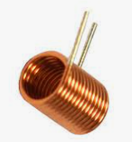
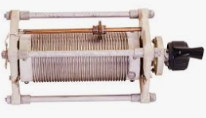
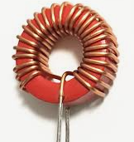
Inductors and Inductance
Like resistors, several common types
Double lines indicate a solid magnetic core
Variable inductors often have solid cores (use of double lines on schematics is optional)
Miniature inductors (not shown here) look similar to resistors
AIR-CORE
VARIABLE
MAGNETIC OR IRON CORE

Slide 54
Inductor Design
Inductance (ability to store magnetic energy) is directly proportional to the square of the number of turns and area enclosed by each turn
  Making an inductor LONGER without changing number of turns or diameter REDUCES inductance
Increasing the ability to store magnetic energy (called permeability) increases the inductance

Slide 55
Inductor Design (cont.)
The type of core and winding affects inductance and vary according to the use/purpose of the inductor
Variable inductors are often used in low-power receiving and transmitting applications
  Adjusted by moving a magnetic core in and out of the inductor (threaded cores move when turned)
  For high-power inductors, adjustment is made by moving a sliding contact along the inductor

Slide 56
Converting Between Units
CONVERT FROM | CONVERT TO | CONVERT TO
Nanohenries | Microhenries: Divide by 1000 | Millihenries: Divide by 1,000,000
Microhenries | Nanohenries: Multiply by 1000 | Millihenries: Divide by 1000
Millihenries | Nanohenries: Multiply by 1,000,000 | Microhenries: Multiply by 1000
EXAMPLE: 330 nH = 330 / 1000 = 0.33 µH and 330 nH = 330 / 1,000,000 = 0.00033 mH
EXAMPLE: 6.8 µH = 6.8 X 1000 = 6800 nH and 6.8 µH = 6.8 / 1000 = .0068 mH
EXAMPLE: 88 mH = 88 X 1,000,000 = 88,000,000 nH and 88 mH = 88 X 1000 = 8800 µH

Slide 57
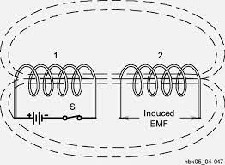
Inductor Coupling
Place 2 inductors close together with axes aligned
Magnetic field from one inductor can also pass through the second one, sharing some of its energy
This is called coupling
The ability of inductors to share or transfer magnetic energy is called mutual inductance

Slide 58
Inductor Design (cont.)
In toroidal winding the core contains nearly all the inductor’s magnetic field
Since little of the field extends outside the core, toroids can be placed next to each other (in almost any orientation) with minimal mutual inductance
  This property is useful in RF circuits
Composition of the core varies (ferrite, powdered iron, even exotic “rare earth” metals), makes it possible to obtain wide range of inductance values in a relatively small package
The combination of core materials (“mix”) is selected so the inductor performs best over a specific range of frequencies

Slide 59
PRACTICE QUESTIONS

Slide 60
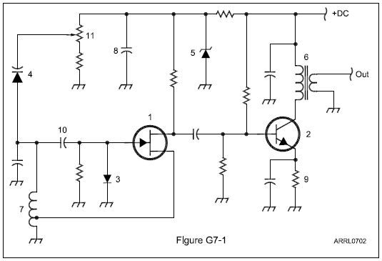
Which symbol in figure G7-1 represents a field effect transistor?
Symbol 2
Symbol 5
Symbol 1
Symbol 4
G7A09 (C) Page 4-9
60

Slide 61
Which symbol in figure G7-1 represents a Zener diode?
Symbol 4
Symbol 1
Symbol 11
Symbol 5
G7A10 (D) Page 4-9
61

Slide 62
Which symbol in figure G7-1 represents an NPN junction transistor?
Symbol 1
Symbol 2
Symbol 7
Symbol 11
G7A11 (B) Page 4-9
62

Slide 63
Which symbol in figure G7-1 represents a solid core transformer?
Symbol 4
Symbol 7
Symbol 6
Symbol 1
G7A12 (C) Page 4-9
63

Slide 64
Which symbol in figure G7-1 represents a tapped inductor?
Symbol 7
Symbol 11
Symbol 6
Symbol 1
G7A13 (A) Page 4-9
64

Slide 65
What determines the performance of a ferrite core at different frequencies?
Its conductivity
Its thickness
The composition, or “mix,” of materials used
The ratio of outer diameter to inner diameter
G6B01 (C) Page 4-12
65

Slide 66
What is an advantage of using a ferrite core toroidal inductor?
Large values of inductance may be obtained
The magnetic properties of the core may be optimized for a specific range of frequencies
Most of the magnetic field is contained in the core
All these choices are correct
G6B05 (D) Page 4-12
66

Slide 67
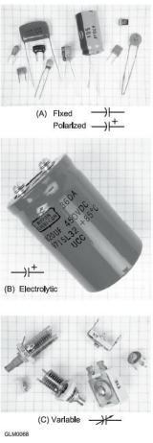
Capacitors and Capacitance
Capacitors have two conducting surfaces (electrodes) separated by a dielectric
Capacitance is the ability to store electric energy, measured in farads (F)
Blocks dc current flow
The simplest capacitor is a pair of metal plates separated by air
Increase capacitance by increasing surface areas, moving surfaces closer together, or changing dielectric material

Slide 68
Capacitors and Capacitance (cont.)
Tantalum and electrolytic capacitors are polarized, meaning the dc voltage may only be applied on one direction without damaging the electrolyte (check polarity markings for correct installation)
Capacitors have voltage ratings; exceeding this rating can result in arcing between conducting surfaces (usually destroys all but air-dielectric capacitors)

Slide 69
Capacitors and Capacitance (cont.)
Capacitor types:
  Ceramic – RF filtering and bypassing at high frequencies, low cost
  Plastic film – audio circuits & lower radio frequencies
  Silvered-mica – highly stable, low loss, used in RF circuits
  Electrolytic and tantalum – power supply filter circuits
  Air and vacuum dielectric – transmitting and RF circuits

Slide 70
Capacitors and Capacitance (cont.)
Capacitor uses:
  Blocking – pass ac signals while blocking dc signals
  Bypass – provide low impedance path for ac signals around higher-impedance circuit
  Filter – smooth out voltage pulses of rectified ac to an even dc voltage
  Suppressor – absorb energy of voltage transients or spikes
  Tuning – vary frequency of resonant circuits or adjust impedance matching circuits

Slide 71
Aluminum and Tantalum Electrolytic Capacitors
Designed to optimize their energy storage capabilities
Voltage must be applied with the correct polarity
Creates large capacitances in comparatively small volumes
Aluminum: Uses metal foil for conducting surfaces and dielectric is an insulating layer on the foil created by a wet paste or gel
Tantalum: Similar to aluminum in that a porous mass of tantalum is immersed in an electrolyte

Slide 72
PRACTICE QUESTIONS

Slide 73
Which of the following is characteristic of an electrolytic capacitor?
Tight tolerance
Much less leakage than any other type
High capacitance for a given volume
Inexpensive RF capacitor
G6A04 (C) Page 4-13
73

Slide 74
Which of the following is characteristic of low voltage ceramic capacitors?
Tight tolerance
High stability
High capacitance for given volume
Comparatively low cost
G6A08 (D) Page 4-14
74

Slide 75
Transformers
Transformers transfer ac power between 2 or more inductors (called windings) sharing a common core
The winding TO which power is applied is the primary
The winding FROM which power is supplied is the secondary
When voltage is applied to primary, mutual inductance causes voltage to appear across secondary
Transformers work in “both directions” (step-up and step-down)

Slide 76
Transformers (cont.)
Transformers change power from one combination of ac voltage and current to another by using windings with different numbers of turns
  The transformation occurs because all windings share the same magnetic field (wound on the same core)
A significant change between secondary & primary usually requires a change in wire size between windings
  In step-up transformers, the primary carries higher current and is wound with larger diameter wire than the secondary

Slide 77
Transformer “Math”
The ratio of number turns in the primary winding (N_{P}) to the number of turns in the secondary (N_{S}) determines how current and voltage are changed
Since most circuits are concerned with voltage, most transformer equations relate transformer input (primary) voltage (E_{P}) to output (secondary) voltage (E_{S})
E_{S}
N_{S}
N_{S}
=
OR
E_{S}
=
E_{P}
×
E_{P}
N_{P}
N_{P}

Slide 78
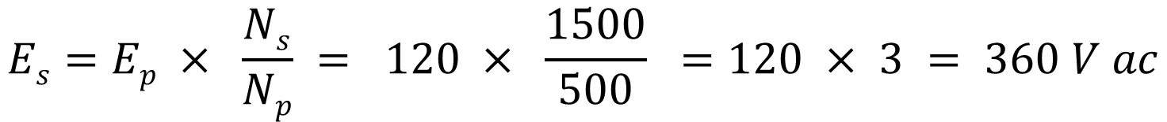
Transformer “Math” Examples
What is the voltage across a 1500-turn secondary winding if 120 V ac is
applied across the 500 turn primary winding?
$$Es=Ep × \frac{Ns}{Np} = 120 × \frac{1500}{500} =120 × 3 = 360 V ac$$

Slide 79
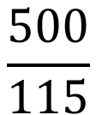

Transformer “Math” Examples (cont.)
What would be the secondary-to-primary turns ratio to change 115V ac to 500V ac?
E_{S}
N_{S}
N_{S}
E_{S}
=
… is the same as …
=
E_{P}
N_{P}
N_{P}
E_{P}
N_{S}
E_{S}
=
=
=
N_{P}
E_{P}

Slide 80
Transformer “Math” Examples (cont.)
What happens if a signal is applied to the secondary winding of a 4:1
transformer instead of the primary?
In the previous formula, reverse E_{P} and E_{S}.
A 4:1 transformer has 4 times the number of turns in the primary than secondary. Applying the signal to the secondary will increase the voltage proportionally … 4 times the input voltage.

Slide 81
PRACTICE QUESTIONS

Slide 82
What causes a voltage to appear across the secondary winding of a transformer when an AC voltage source is connected across its primary winding?
Capacitive coupling
Displacement current coupling
Mutual inductance
Mutual capacitance
G5C01 (C) Page 4-15
82

Slide 83
What is the output voltage if an input signal is applied to the secondary winding of a 4:1 voltage step-down transformer instead of the primary winding?
The input voltage is multiplied by 4
The input voltage is divided by 4
Additional resistance must be added in series with the primary to prevent overload
Additional resistance must be added in parallel with the secondary to prevent overload
G5C02 (A) Page 4-15
83

Slide 84
Why is the primary winding wire of a voltage step-up transformer usually a larger size than that of the secondary winding?
To improve the coupling between the primary and secondary
To accommodate the higher current of the primary
To prevent parasitic oscillations due to resistive losses in the primary
To ensure that the volume of the primary winding is equal to the volume of the secondary winding
G5C05 (B) Page 4-15
84

Slide 85
What is the voltage output of a transformer with a 500-turn primary and a 1500-turn secondary when 120 VAC is applied to the primary?
360 volts
120 volts
40 volts
25.5 volts
G5C06 (A) Page 4-15
85

Slide 86
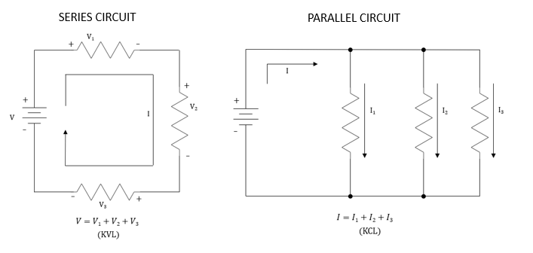
Components in Series and Parallel Circuits

Slide 87
Components in Series and Parallel Circuits
In series circuits, the current is the same in all components and voltages are summed (Kirchoff’s Voltage Law – KVL).
  Voltages add in a series circuit
In parallel circuits, voltage across all components is the same and the sum of currents into and out of circuit junctions must be equal (Kirchoff’s Current Law – KCL).
  Currents add in a parallel circuit
Components connected in series or parallel can be replaced with a single equivalent component

Slide 88
Calculating Series & Parallel Equivalent Values
COMPONENT | IN SERIES
RESISTOR | ADD VALUES, R1 + R2 + R3 + …
INDUCTOR | ADD VALUES, L1 + L2 + L3 + …
CAPACITOR | RECIPROCAL OF RECIPROCALS, 1/(1/C1 + 1/C2 + 1/C3 + …)
COMPONENT | IN PARALLEL
RESISTOR | RECIPROCAL OF RECIPROCALS, 1/(1/R1 + 1/R2 + 1/R3 + …)
INDUCTOR | RECIPROCAL OF RECIPROCALS, 1/(1/L1 + 1/L2 + 1/L3 + …)
CAPACITOR | ADD VALUES, C1 + C2 + C3 + …
Refer to Figure 4.10 & Tables 4.2, 4.3

Slide 89
Effect on Total Value of Adding Components in Series and Parallel
COMPONENT | ADDING IN SERIES | ADDING IN PARALLEL
RESISTOR | INCREASE | DECREASE
INDUCTOR | INCREASE | DECREASE
CAPACITOR | DECREASE | INCREASE
Refer to Figure 4.10 & Tables 4.2, 4.3

Slide 90
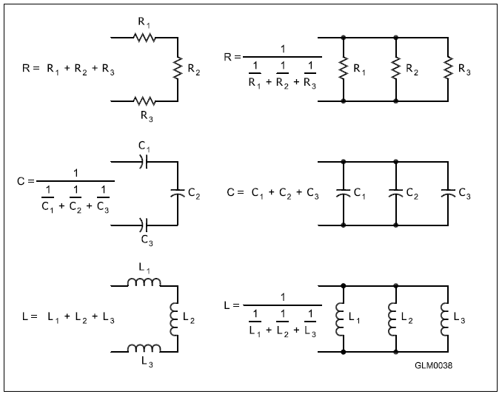
Figure 4.10: Illustrates how components in series and parallel can be combined into a single equivalent component value.
SERIES
PARALLEL

Slide 91
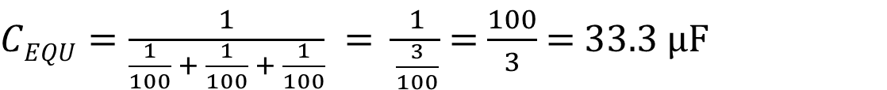



Examples: Calculating Series & Parallel Equivalent Values
Three 100 Ω resistors …
In Series …
$$REQU=100+100+100=300 Ω$$
In Parallel …
$REQU= \frac{1}{\frac{1}{100}+ \frac{1}{100}+ \frac{1}{100}}$$=$$\frac{1}{\frac{3}{100}}= \frac{100}{3}=33.3 Ω$
Three 100 µF capacitors …
In Series …
In Parallel …
$$CEQU=100+100+100=300µF$$

Slide 92









Calculating Series & Parallel Equivalent Values (cont.)
With only two components, the reciprocal of reciprocals calculation is greatly simplified …
R_{EQU} =
$$\frac{R1× R2}{R1+ R2}$$
What is the approximate total resistance of a 100- and a 200-ohm resistor in parallel?
$$REQU= \frac{R1×R2}{R1+R2}$$
$$= \frac{100×200}{100+200}$$
$$= \frac{20,000}{300}$$
$$=66.67 Ω$$
Inductance of a 20 mH and 50 mH inductor …
In series …
In parallel …

Slide 93


Calculating Series & Parallel Equivalent Values (cont.)
What is the total inductance of three 10 mH inductors in parallel?
$$LEQU= \frac{1}{\frac{1}{10}+ \frac{1}{10}+ \frac{1}{10}}= \frac{10}{3}=3.3 mH$$
What is the total inductance of three 10 mH inductors in series?
$$LEQU=10+10+10=30 mH$$

Slide 94





Calculating Series & Parallel Equivalent Values (cont.)
What is the total capacitance of two 5 nF and one 750 pF capacitors in series?
Note that the capacitors aren’t in the same units! First convert 5 nF to pF …
5 nF × 1,000 = 5,000 pF
$$CEQU= \frac{1}{\frac{1}{C1}+ \frac{1}{C2}+ \frac{1}{C3}}$$
$$= \frac{1}{\frac{1}{5000}+ \frac{1}{5000}+ \frac{1}{750}}$$
$$= \frac{1}{0.0002+0.0002+0.00133}$$
$$= \frac{1}{0.001733}$$
$$=577 pF$$
And, in parallel?
C_{EQU} = C₁ + C₂ + C₃ = 5000 + 5000 + 750 = 10750 pF = 10.75 nF

Slide 95
PRACTICE QUESTIONS

Slide 96
How does the total current relate to the individual currents in a circuit of parallel resistors?
It equals the average of the branch currents
It decreases as more parallel branches are added to the circuit
It equals the sum of the currents through each branch
It is the sum of the reciprocal of each individual voltage drop
G5B02 (C) Page 4-17
96

Slide 97
What is the total resistance of a 10-, a 20-, and a 50-ohm resistor connected in parallel?
5.9 ohms
0.17 ohms
17 ohms
80 ohms
G5C03 (A) Page 4-19
97

Slide 98
What is the approximate total resistance of a 100- and a 200-ohm resistor in parallel?
300 ohms
150 ohms
75 ohms
67 ohms
G5C04 (D) Page 4-17
98

Slide 99
What is the equivalent capacitance of two 5.0-nanofarad capacitors and one 750-picofarad capacitor connected in parallel?
576.9 nanofarads
1,733 picofarads
3,583 picofarads
10.750 nanofarads
G5C08 (D) Page 4-19
99

Slide 100
What is the capacitance of three 100-microfarad capacitors connected in series?
0.33 microfarads
3.0 microfarads
33.3 microfarads
300 microfarads
G5C09 (C) Page 4-18
100

Slide 101
What is the inductance of three 10-millihenry inductors connected in parallel?
0.30 henries
3.3 henries
3.3 millihenries
30 millihenries
G5C10 (C) Page 4-18
101

Slide 102
What is the inductance of a circuit with a 20-millihenry inductor connected in series with a 50-millihenry inductor?
7 millihenries
14.3 millihenries
70 millihenries
1,000 millihenries
G5C11 (C) Page 4-18
102

Slide 103
What is the capacitance of a 20-microfarad capacitor connected in series with a 50-microfarad capacitor?
0.07 microfarads
14.3 microfarads
70 microfarads
1,000 microfarads
G5C12 (B) Page 4-19
103

Slide 104
Which of the following components should be added to a capacitor to increase the capacitance?
An inductor in series
An inductor in parallel
A capacitor in parallel
A capacitor in series
G5C13 (C) Page 4-17
104

Slide 105
Which of the following components should be added to an inductor to increase the inductance?
A capacitor in series
A resistor in parallel
An inductor in parallel
An inductor in series
G5C14 (D) Page 4-17
105

Slide 106
END OF CHAPTER 4 PART 1 of 3

Slide 107
Slides created by …
Jerry D. Kilpatrick
KØILP (Amateur Radio)
PGØØØ72373 (Commercial Operator)
K0ILP.NC@gmail.com
Feel free to contact me if you find errors or have suggestions for improvement.

