Slide 1
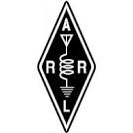

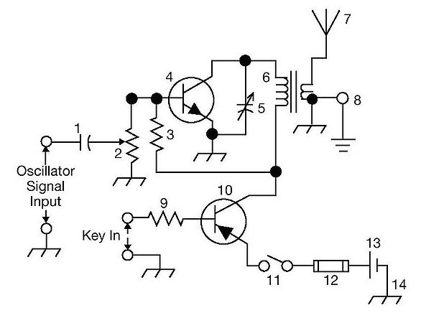
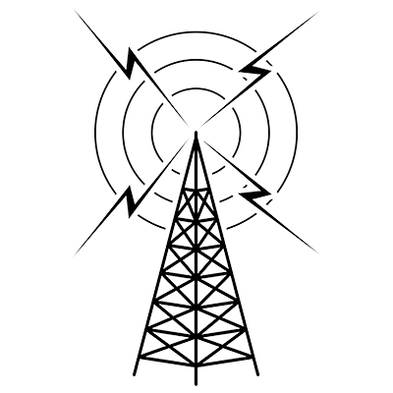
THE
ARRL
TENTH EDITION
GENERAL CLASS
LICENSE COURSE
FOR
HAM RADIO
All You Need to Pass Your General Class Exam!

Slide 2

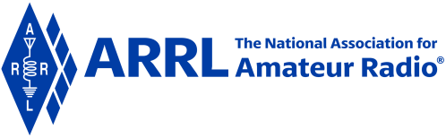
Resource & Reference
www.arrl.org/shop/Licensing-Education-and-Training

Slide 3
Chapter 5 Part 1 of 2
ARRL General Class
Radio Signals & Equipment
Sections 5.1, 5.2, 5.3
Basic Modes & Bandwidth, Radio’s Building Blocks, Transmitters

Slide 4
Section 5.1
Basic Modes & Bandwidth: Amplitude Modulated Modes
Varying the power or amplitude of a signal to add speech or data is called amplitude modulation (AM)
This info contained in the signal’s envelope – the max values of the instantaneous power for each cycle
The process of recovering speech or music from the AM envelope is called detection
AM signals are composed of a carrier and two sidebands (upper and lower … USB and LSB)

Slide 5
Amplitude Modulated Modes (cont.)
When an AM signal is modulated by a tone, the two sidebands are steady and unchanging (as long as the tone is transmitted)
Upper sideband is higher in frequency than the carrier; lower sideband is lower in frequency than carrier
AM signal with the carrier and one sideband removed is a single sideband signal (SSB)
SSB transmissions have more range than AM because all the SSB’s power is contained in a single sideband. The SSB’s smaller bandwidth makes it possible to fit more signals in a fixed frequency range.

Slide 6
Frequency & Phase Modulated Modes
Modes that vary the frequency of a signal to add speech or data info are called frequency modulation (FM)
Frequency is varied in proportion to the instantaneous amplitude of the modulating signal
Phase modulation (PM) is created by varying the signal’s phase angle
These signals have a constant power, whether modulated or not

Slide 7
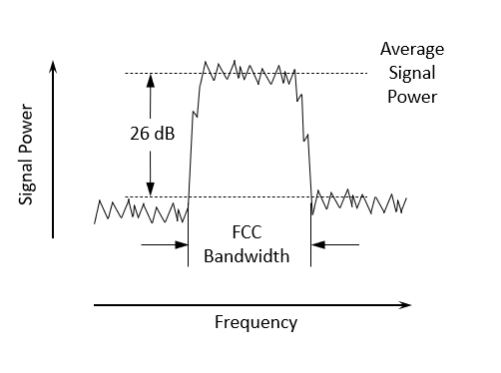
Bandwidth Definition
Figure 5.1: The FCC defines bandwidth as the width of a frequency band outside of which the mean [average] power of the transmitted signal is attenuated at least 26 dB below the mean power.

Slide 8
Bandwidth Definition (cont.)
The difference in frequency between the lowest and highest component of a composite signal is the signal’s bandwidth
  See Fig 5.1 for the FCC definition (previous slide)
The FCC limits signal bandwidth so that many stations and types of signals can share the limited amount of spectrum space (see Table 5.1, next slide)

Slide 9
Table 5.1: Amateur Signal Bandwidths
Most Common Amateur Signals
Type of Signal | Typical Bandwidth
AM voice | 6 kHz
Amateur television | 6 MHz
SSB voice | 2 to 3 kHz
Digital using SSB | 50 to 3000 Hz (0.05 – 3 kHz)
CW | 100 to 300 Hz (0.1 – 0.3 kHz)
FM voice | 5 to 16 kHz

Slide 10
Link Budgets
Telecommunications term that accounts for all the power gains and losses a signal experiences within a system
In amateur radio, this is generally the transmit power and antenna gains from the sending station minus any system losses the receiving station experiences
Losses result from ionospheric refraction, attenuation, or a variety of other causes
Link margin (LKM) is the difference between the minimum power level needed to receive a signal and the actual power level of the received signal (measured in dB)

Slide 11
PRACTICE QUESTIONS

Slide 12
What is the name of the process that changes the phase angle of an RF signal to convey information?
Phase convolution
Phase modulation
Phase transformation
Phase inversion
G8A02 (B) Page 5-2
12

Slide 13
What is the name of the process that changes the instantaneous frequency of an RF wave to convey information?
Frequency convolution
Frequency transformation
Frequency conversion
Frequency modulation
G8A03 (D) Page 5-2
13

Slide 14
What type of modulation varies the instantaneous power level of the RF signal?
Power modulation
Phase modulation
Frequency modulation
Amplitude modulation
G8A05 (D) Page 5-2
14

Slide 15
Which of the following phone emissions uses the narrowest bandwidth?
Single sideband
Vestigial sideband
Phase modulation
Frequency modulation
G8A07 (A) Page 5-2
15

Slide 16
What is a link budget?
The financial costs associated with operating a radio link
The sum of antenna gains minus system losses
The sum of transmit power and antenna gains minus system losses as seen at the receiver
The difference between transmit power and receiver sensitivity
G8A13 (C) Page 5-3
16

Slide 17
What is link margin?
The opposite of fade margin
The difference between received power level and minimum required signal level at the input to the receiver
Transmit power minus receiver sensitivity
Receiver sensitivity plus 3 dB
G8A14 (B) Page 5-3
17

Slide 18
Section 5.2
Radio’s Building Blocks
Nearly all radios are made up of a few fundamental types of circuits
There’s a variety of ways circuits are built, but basic functions are the same
Radio circuits that perform signal generating & processing functions can also be performed on digital data by software in a radio that uses digital signal processing (DSP) … referred to as software-defined radio (SDR)

Slide 19
Filters
Used to attenuate (reduce in strength) or pass signals
Classified by their response (how they act on signals)
Range of signals passes is the passband
Range of signals attenuated is the stopband (attenuation is also referred to as rejection)

Slide 20
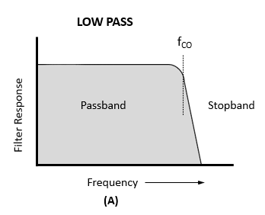
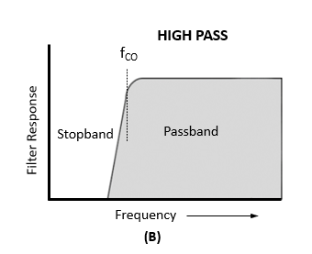
Figure 5.2 – Generic filter response curves showing how filters of different types affect signals. A larger filter response means less attenuation of the signal cutoff frequencies are shown as f_{CO}.
The cutoff frequency is the frequency at which the output signal power is reduced to one-half that of the input signal. Above a low-pass filter’s cutoff frequency, the attenuation generally increases with frequency.

Slide 21
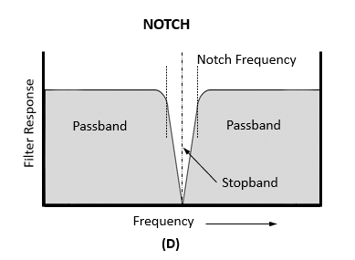
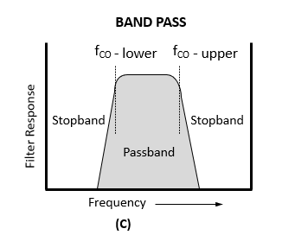
Figure 5.2 – Generic filter response curves showing how filters of different types affect signals. A larger filter response means less attenuation of the signal cutoff frequencies are shown as f_{CO}.
The frequency range between the upper and lower cutoff frequencies is the filter’s bandwidth.

Slide 22
Filters (cont.)
Low-pass filters (Fig 5.2A) pass all frequencies below the cutoff frequency with little or no attenuation. The cutoff frequency (f_{CO}) is the frequency at which the output signal power is reduced to one-half that of the input signal.
High-pass filter (Fig 5.2B) is the opposite; signals are passed above the cutoff frequency and attenuated below.

Slide 23
Filters (cont.)
Band-pass filters have upper and lower cutoff frequencies. Signals between these are passed … outside are attenuated.
  Frequency range between upper and lower cutoff is the filter’s bandwidth
  Opposite of band-pass is band-stop (attenuates signals between cutoff frequencies) … narrow stopbands are called notch filters
Even though filters pass a range of frequencies, they may attenuate signals in the passband. This is called insertion loss.
Outside passband, attenuation may vary, but maximum attenuation is the filter’s ultimate rejection.

Slide 24
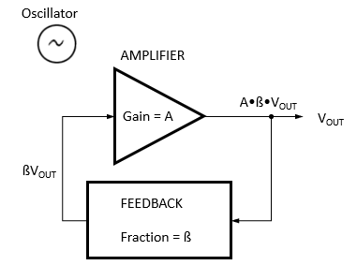
Oscillators
Fig 5.3: An oscillator consists of an amplifier with feedback from the output to input. The product of gain and feedback ratio must be greater than 1 at the frequency of oscillation.

Slide 25
Oscillators (cont.)
An oscillator consists of an amplifier that increases signal amplitude (gain) and a feedback circuit to route some of the amplifier’s output signal back to its input
Oscillator circuits must include a filter so that feedback is present at only the intended frequency
The oscillator output frequency can be fixed or variable

Slide 26
Oscillators (cont.)
LC oscillator’s feedback circuits consist of an inductor (L) and capacitor (C) connected (in parallel or series) to form a resonant circuit
  Often called a tank circuit because of their ability to store energy
  The resonant frequency of the LC circuit (determined by the L and C values) is the frequency of the oscillator
The output frequency of a variable-frequency oscillator (VFO) can be adjusted by changing the L or C. VFOs are used to tune a radio to different frequencies.

Slide 27
Oscillators (cont.)
Two other widely used VFO circuits are …
  Phase-locked loop (PLL)
  Direct digital synthesizer (DDS)
    Controllable by software
    Comparable stability to crystal oscillators
    Used as the high-stability VFO in most current transceivers

Slide 28
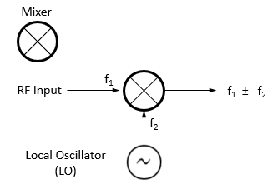
Mixers
Mixers change signals to another frequency
A mixer circuit combines signals with two frequencies, f₁ and f₂, and produces signals with the sum and difference frequencies at its output (heterodyning)
Example …
  f₁ = 14.050 MHz
  f₂ = 3.35 MHz
  There will be output signals at 17.4 (f₁ + f₂) and 10.7 (f₁ – f₂) MHz
Fig 5.4: The mixer combines signals of different frequencies, producing signals at the sum and difference frequencies.

Slide 29
Multipliers (see Fig 5.5 in text)
Similar to a mixer
Creates a harmonic of an input frequency
Multipliers are often used when a stable VHF or UHF signal is required that cannot be generated directly at VHF/UHF
A low-frequency oscillator supplies the multiplier input, and the output is tuned to the desired harmonic of the input signal
Also used in FM transmitters (covered later)

Slide 30
Modulators
Add info to a carrier signal by varying the carrier’s amplitude, frequency, or phase
Can be used for AM, FM, or SSB

Slide 31
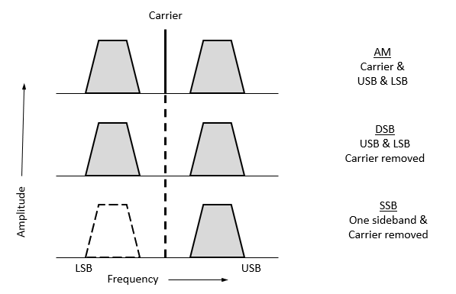
Amplitude Modulation
Figure 5.6: The spectrum of 3 types of AM signals. Full AM has both sidebands and the carrier. The carrier is represented by the vertical line in the middle, and the sidebands contain speech or data signals that have been used to modulate the carrier. DSB removes the carrier, but has the same bandwidth as full AM. SSB removes one sideband and has the lowest bandwidth of the 3.

Slide 32
Amplitude Modulation (cont.)
DSB can be produced by a balanced modulator – special mixer where f₁ is the carrier and f₂ is the modulator
SSB is generated by removing the unwanted sideband and carrier with a filter (filter method) or by combining signals with certain phase relationships (phasing method)
Using only one sideband uses transmitted output power more effectively

Slide 33
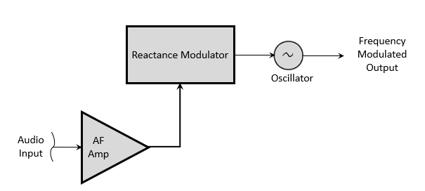
Frequency & Phase Modulation: Figure 5.7
(A) FREQUENCY MODULATION

Slide 34
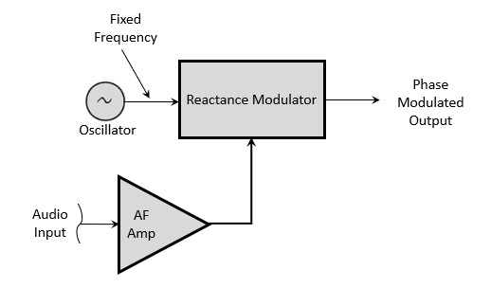
Frequency & Phase Modulation: Figure 5.7
(B) PHASE MODULATION

Slide 35
Frequency & Phase Modulation (cont.)
Frequency modulation (FM) – the signal frequency varies in proportion to modulating signal’s amplitude – called deviation
Phase modulation (PM) – deviation varies with both amplitude and frequency of the modulating signal … produced by a reactance modulator connected to a tuned RF amplifier following the oscillator
When modulation is applied, the phase of the carrier will be changed, but the average frequency will NOT change
Sound identical on the air

Slide 36
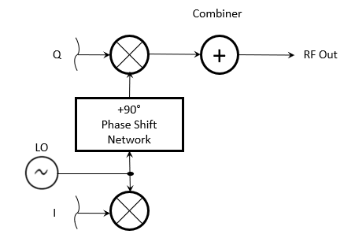
Quadrature Modulation
Also called I/Q modulation because of the I & Q signals that create the modulated output signal
Used to transmit digital data, but different combinations of I & Q signals can create signals with any form of modulation
The RF output of the combiner consists of a pair of modulated signals that have carrier signals 90° different in phase
Widely used in software-defined radios (SDR) … where traditional analog components have been replaced by programming (e.g., filtering, modulation, detection, etc.)
Fig 5.8: Block diagram of an I/Q modulator. I & Q are designators for input signals that can be analog signals or streams of digital data.
Quadrature simply means phase-shifted by 90 degrees.

Slide 37
PRACTICE QUESTIONS

Slide 38
Which of the following are basic components of a sine wave oscillator?
An amplifier and a divider
A frequency multiplier and a mixer
A circulator and a filter operating in a feed-forward loop
A filter and an amplifier operating in a feedback loop
G7B07 (D) Page 5-5
38

Slide 39
What determines the frequency of an LC oscillator?
The number of stages in the counter
The number of stages in the divider
The inductance and capacitance in the tank circuit
The time delay of the lag circuit
G7B09 (C) Page 5-5
39

Slide 40
Which of the following is characteristic of a direct digital synthesizer (DDS)?
Extremely narrow tuning range
Relatively high-power output
Pure sine wave output
Variable output frequency with the stability of a crystal oscillator
G7C05 (D) Page 5-5
40

Slide 41
What term specifies a filter’s attenuation inside its passband?
Insertion loss
Return loss
Q
Ultimate rejection
G7C07 (A) Page 5-5
41

Slide 42
What is the phase difference between the I and Q RF signals that software-defined radio (SDR) equipment uses for modulation and demodulation?
Zero
90 degrees
180 degrees
45 degrees
G7C09 (B) Page 5-7
42

Slide 43
What is an advantage of using I-Q modulation with software-defined radios (SDRs)?
The need for high resolution analog-to-digital converters is eliminated
All types of modulation can be created with appropriate processing
Minimum detectible signal level is reduced
Automatic conversion of the signal from digital to analog
G7C10 (B) Page 5-7
43

Slide 44
Which of these functions is performed by software in a software-defined radio (SDR)?
Filtering
Detection
Modulation
All these choices are correct
G7C11 (D) Page 5-4
44

Slide 45
What is the frequency above which a low-pass filter’s output power is less than half the input power?
Notch frequency
Neper frequency
Cutoff frequency
Rolloff frequency
G7C12 (C) Page 5-4
45

Slide 46
What term specifies a filter’s maximum ability to reject signals outside its passband?
Notch depth
Rolloff
Insertion loss
Ultimate rejection
G7C13 (D) Page 5-5
46

Slide 47
The bandwidth of a band-pass filter is measured between what two frequencies?
Upper and lower half-power
Cutoff and rolloff
Pole and zero
Image and harmonic
G7C14 (A) Page 5-4
47

Slide 48
What emission is produced by a reactance modulator connected to a transmitter RF amplifier stage?
Multiplex modulation
Phase modulation
Amplitude modulation
Pulse modulation
G8A04 (B) Page 5-7
48

Slide 49
What is another term for the mixing of two RF signals?
Heterodyning
Synthesizing
Frequency inversion
Phase inversion
G8B03 (A) Page 5-5
49

Slide 50
What is the stage in a VHF FM transmitter that generates a harmonic of a lower frequency signal to reach the desired operating frequency?
Mixer
Reactance modulator
Balanced converter
Multiplier
G8B04 (D) Page 5-6
50

Slide 51
What combination of a mixer’s Local Oscillator (LO) and RF input frequencies is found in the output?
The ratio
The average
The sum and difference
The arithmetic product
G8B11 (C) Page 5-5
51

Slide 52
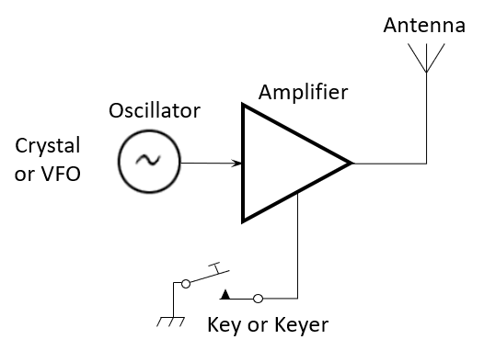
Section 5.3
Transmitters: CW Transmitters
Fig 5.9: The simplest transmitter consists of the oscillator and amplifier and a means of turning the output signal on and off – the key (or keyer). A single crystal oscillator can be replaced with a variable-frequency oscillator to allow the transmitter to be tuned to different frequencies.

Slide 53
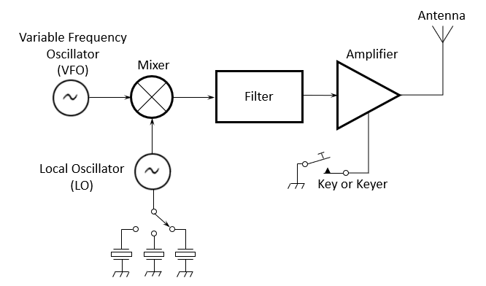
CW Transmitters (cont.)
Fig 5.10: By changing the frequency of the local oscillator (LO), the VFO’s output can be shifted from band to band, creating a multiband transmitter.

Slide 54
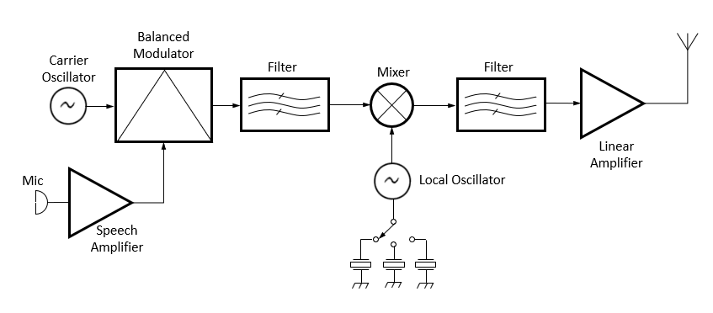
SSB Phone Transmitters
Fig 5.11: Substituting the circuits to create an SSB signal for the VFO creates a multiband SSB transmitter.
How to change the CW transmitter to SSB phone …

Slide 55
SSB Phone Transmitters (cont.)
Refer to Figure 5.11 …..
Voice signals from a mic are processed by a speech amplifier and input to the balanced modulator
The variable frequency oscillator is the other input to the balanced modulator
The output is a DSB signal, so a filter is used to removed the undesired sideband, producing an SSB signal
Distortion anywhere in the transmit chain will generate unwanted spurious signals (harmonics, mixing products, splatter, etc.)

Slide 56
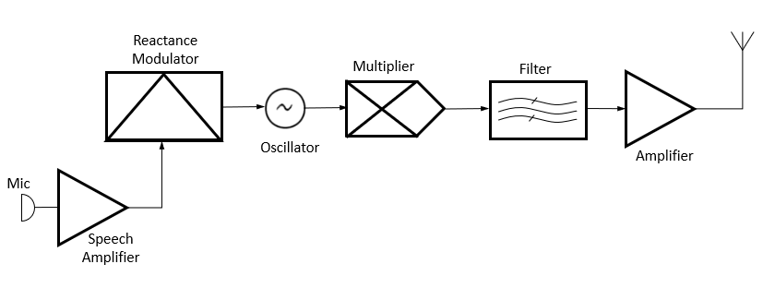
FM Transmitters
Fig 5.12: Carrier and modulation are generated at relatively low frequencies in FM transmitters.
The modulated signal is then multiplied to the desired output frequency. The amount of signal deviation is also multiplied.

Slide 57
FM Transmitters (cont.)
Modulation and frequency changing are performed differently in FM transmitters (see Figure 5.12, previous slide)
It is much more practical to generate the signal at low frequency and multiply it to reach the desired band
EXAMPLE: In a 2 meter FM transmitter, the modulated oscillator frequency is approximately 12 MHz, and multipliers select the 12th harmonic for transmission. For an output on 146.52 MHz, the oscillator must produce a 146.52 / 12 = 12.21 MHz signal.

Slide 58
FM Transmitters (cont.)
The frequency deviation is also multiplied. For example, if the 146.52 MHz signal is to have the standard deviation of 5 MHz, the maximum oscillator deviation would be 5 / 12 MHz = 0.416.7 MHz or 416.7 Hz.
Carson’s Rule provides a good approximation of an FM signal’s bandwidth.
BW = 2 × (peak deviation + highest modulating frequency)
In Our Example: If an FM phone signal’s peak deviation is limited to 5 kHz and the highest modulating frequency is 3 kHz, then …
BW = 2 × (5 + 3) = 16 kHz

Slide 59
Signal Quality
Overmodulation – AM Modes
  An AM or SSB signal that varies excessively in response to the modulating signal
  Distorts transmitted audio
  Causes: Speaking too loudly, mic gain too high, audio gain too high

Slide 60
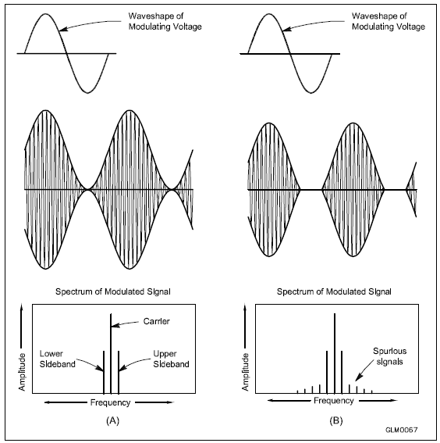
Fig. 5.13 – Modulation
Modulation envelope of an AM signal, waveform created by connecting the peaks of the modulated signal – modulation envelope of an SSB signal is similar
A – Properly modulated signal
B – Example of cutoff (transmitter output is turned off instead of following the modulating signal)

Slide 61
Overmodulation – AM (cont.)
Refer to Fig 5.13B
  Example of cutoff … transmitter output is turned off instead of following the modulated signal
    Flattopping occurs when transmitter output reaches a maximum limit and cannot increase further, even though the modulating signal is increasing
    If output signal is completely cut off between peaks, the result is carrier cutoff
    Both types of overmodulation cause interference by generating spurious signals (aka distortion products) beyond normal signal bandwidth (called splatter or buckshot)

Slide 62
Overmodulation – AM (cont.)
ALC (automatic level control) circuits in the transmitter help prevent this … reduces output power during voice peaks
  Controlled by properly setting transmit audio or microphone gain
  Should be adjusted to activate only on voice peaks
Two-tone test is used to monitor transmitter linearity … keeps signal clean
  Only needs to be performed occasionally to note appropriate gain settings and level adjustments
  Two-tone comes from use of 2 non-harmonically related signals for the test

Slide 63
Controlling Sideband Frequency
Most radios display carrier frequency of the SSB signal
  Actual signal lies entirely above (USB) or below (LSB) this frequency
Each SSB occupies 3 kHz, so you will need to stay far enough from edge of frequency privilege to avoid illegal transmission
  For Generals, using LSB on 40 m, operate with carrier frequency at least 3 kHz above the edge of the band segment – 7.178 MHz (occupying 7.175 to 7.178 MHz … see Fig 5.14)

Slide 64
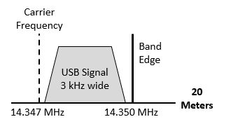
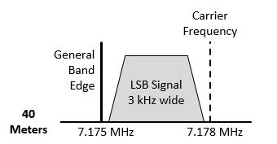
Fig 5.14
When sidebands extend from the carrier toward a band edge or a band segment edge, operate with a displayed carrier frequency no closer than 3 kHz to the edge frequency and be sure your signal is “clean.”

Slide 65
Speech Processing
Average power of an AM or SSB signal is much lower than CW
  When transmitted over HF as an AM signal in the presence of noise, interference, etc., the received signal can be difficult to understand
Speech processing increases the average power of the signal without distorting it … result is improved intelligibility of the received signal in poor conditions
Caution: Speech processors can also amplify low-level background noise, reducing intelligibility

Slide 66
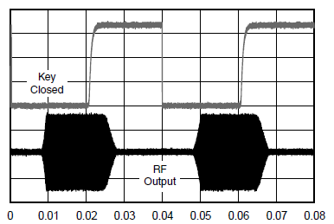
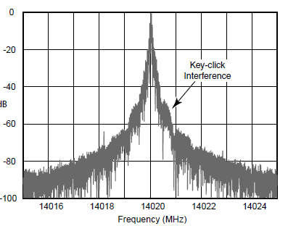
CW Key Clicks
Sharp transient clicking sounds heard on adjacent frequencies as a transmitter turns on and off too rapidly during CW transmissions or if transmitter turns on/off erratically.
Fig. 5.15: CW waveforms can be inspected using a monitoring oscilloscope.

Slide 67
PRACTICE QUESTIONS

Slide 68
What control is typically adjusted for proper ALC setting on a single sideband transceiver?
The RF clipping level
Transmit audio or microphone gain
Antenna inductance or capacitance
Attenuator level
G2A12 (B) Page 5-12
68

Slide 69
What signals are used to conduct a two-tone test?
Two audio signals of the same frequency shifted 90 degrees
Two non-harmonically related audio signals
Two swept frequency tones
Two audio frequency range square wave signals of equal amplitude
G4B07 (B) Page 5-12
69

Slide 70
What type of transmitter performance does a two-tone test analyze?
Linearity
Percentage of suppression of carrier and undesired sideband for SSB
Percentage of frequency modulation
Percentage of carrier phase shift
G4B08 (A) Page 5-12
70

Slide 71
What is the purpose of a speech processor in a transceiver?
Increase the apparent loudness of transmitted voice signals
Increase transmitter bass response for more natural-sounding SSB signals
Prevent distortion of voice signals
Decrease high-frequency voice output to prevent out-of-band operation
G4D01 (A) Page 5-12
71

Slide 72
How does a speech processor affect a single sideband phone signal?
It increases peak power
It increases average power
It reduces harmonic distortion
It reduces intermodulation distortion
G4D02 (B) Page 5-12
72

Slide 73
What is the effect of an incorrectly adjusted speech processor?
Distorted speech
Excess intermodulation products
Excessive background noise
All these choices are correct
G4D03 (D) Page 5-12
73

Slide 74
What frequency range is occupied by a 3 kHz LSB signal when the displayed carrier frequency is set to 7.178 MHz?
7.178 to 7.181 MHz
7.178 to 7.184 MHz
7.175 to 7.178 MHz
7.1765 to 7.1795 MHz
How to derive (since the signal is LSB, we SUBTRACT the 3 kHz from the carrier frequency) …
7.178 MHz = 7178 kHz
7178 kHz – 3 kHz = 7175 kHz
Answer = 7175 to 7178 kHz = 7.175 to 7.178 MHz
G4D08 (C) Page 5-12
74

Slide 75
What frequency range is occupied by a 3 kHz USB signal with the displayed carrier frequency set to 14.347 MHz?
14.347 to 14.647 MHz
14.347 to 14.350 MHz
14.344 to 14.347 MHz
14.3455 to 14.3485 MHz
G4D09 (B) Page 5-12
75

Slide 76
How close to the lower edge of a band’s phone segment should your displayed carrier frequency be when using 3 kHz wide LSB?
At least 3 kHz above the edge of the segment
At least 3 kHz below the edge of the segment
At least 1 kHz below the edge of the segment
At least 1 kHz above the edge of the segment
G4D10 (A) Page 5-12
76

Slide 77
How close to the upper edge of a band’s phone segment should your displayed carrier frequency be when using 3 kHz wide USB?
At least 3 kHz above the edge of the band
At least 3 kHz below the edge of the band
At least 1 kHz above the edge of the segment
At least 1 kHz below the edge of the segment
G4D11 (B) Page 5-12
77

Slide 78
Which of the following describes a linear amplifier?
Any RF power amplifier used in conjunction with an amateur transceiver
An amplifier in which the output preserves the input waveform
A Class C high efficiency amplifier
An amplifier used as a frequency multiplier
G7B10 (B) Page 5-10
78

Slide 79
What circuit is used to select one of the sidebands from a balanced modulator
Carrier oscillator
Filter
IF amplifier
RF amplifier
G7C01 (B) Page 5-10
79

Slide 80
What output is produced by a balanced modulator?
Frequency modulated RF
Audio with equalized frequency response
Audio extracted from the modulation signal
Double-sideband modulated RF
G7C02 (D) Page 5-10
80

Slide 81
Which of the following is an effect of overmodulation?
Insufficient audio
Insufficient bandwidth
Frequency drift
Excessive bandwidth
G8A08 (D) Page 5-11
81

Slide 82
What is meant by the term “flat-topping,” when referring to an amplitude-modulated phone signal?
Signal distortion caused by insufficient collector current
The transmitter’s automatic level control (ALC) is properly adjusted
Signal distortion caused by excessive drive or speech levels
The transmitter’s carrier is properly suppressed
G8A10 (C) Page 5-11
82

Slide 83
What is the modulation envelope of an AM signal?
The waveform created by connecting the peak values of the modulated signal
The carrier frequency that contains the signal
Spurious signals that envelop nearby frequencies
The bandwidth of the modulated signal
G8A11 (A) Page 5-11
83

Slide 84
What is the total bandwidth of an FM phone transmission having 5 kHz deviation and 3 kHz modulating frequency?
3 kHz
5 kHz
8 kHz
16 kHz
G8B06 (D) Page 5-11
84

Slide 85
What is the frequency deviation for a 12.21 MHz reactance modulated oscillator in a 5 kHz deviation, 146.52 MHz FM phone transmitter?
101.75 Hz
416.7 Hz
5 kHz
60 kHz
G8B07 (B) Page 5-10
85

Slide 86
Amplifiers
Radio operators (HF) sometimes use amplifiers to boost signals when conditions are poor, to accommodate difficult propagation paths, etc.
On HF, high-power amplifiers often use vacuum tube circuits that require operator adjustment
The efficiency of an amplifier is defined as the RF output power divided by the dc input power
Also called linears

Slide 87
Four Common Amplifier Classes
Class A – The most linear, lowest signal distortion, least efficient; because class A’s pass the entire sinusoidal input cycle, the conduct 100% of the time
Class B – Known as push-pull, pair of amplifying devices each active during complementary halves of the signal’s cycle, good linearity, good efficiency
Class AB – Midway between A and B, linearity not as good as A, but efficiency is improved
Class C – Highest efficiency, only suitable for CW and FM (due to poor linearity)

Slide 88
Amplifiers (cont.)
Some linear amplifiers can be operated in either Class AB for SSB operation or in Class C for CW
Transceivers often include a delay in the keying circuit timing so that the changeover relay is completely switched before transceiver is allowed to supply any RF output
  Prevents hot-switching in which amplifier is already supplying RF
  Can destroy the relay or other external devices

Slide 89
Tuning & Driving Vacuum Tube Amplifiers
Set BAND switch to desired frequency
Apply drive power to amplifier while adjusting TUNE control to obtain minimum plate current (called the dip)
Adjust LOAD to obtain peak output power
Continue adjusting until max output power is obtained
Avoid exceeding max plate current
Input power to amplifier may also be adjusted during this process

Slide 90
Amplifiers (cont.)
Tubes can be destroyed by applying too much drive
Modern amplifiers have protective circuits
Similar cautions apply to solid-state amplifiers with power transistors that can be destroyed with excessive drive power
Some amplifiers generate automatic leveling control (ALC) signals that can be connected to the transmitter to limit excess drive
  Check both the amplifier and transceiver manuals to be sure signals are compatible and so you know how to use the ALC meter readings

Slide 91
Neutralization
HF amplifiers can self-oscillate because of positive feedback in an amplifier tube
Self-oscillation creates spurious output signals and may damage the tube or amplifier components
The technique of preventing self-oscillation is called neutralization
  Done by creating negative feedback (small variable capacitor between amplifier’s output and input circuits)

Slide 92
PRACTICE QUESTIONS

Slide 93
What is the effect on plate current of the correct setting of a vacuum-tube RF power amplifier’s TUNE control?
A pronounced peak
A pronounced dip
No change will be observed
A slow, rhythmic oscillation
G4A04 (B) Page 5-15
93

Slide 94
What is a reason to use Automatic Level Control (ALC) with an RF power amplifier?
To balance the transmitter audio frequency response
To reduce harmonic radiation
To prevent excessive drive
To increase overall efficiency
G4A05 (C) Page 5-15
94

Slide 95
What is the correct adjustment for the LOAD or COUPLING control of a vacuum tube RF power amplifier?
Minimum SWR on the antenna
Minimum plate current without exceeding maximum allowable grid current
Highest plate voltage while minimizing grid current
Desired power output without exceeding maximum allowable plate current
G4A08 (D) Page 5-15
95

Slide 96
What is the purpose of delaying RF output after activating a transmitter’s keying line to an external amplifier?
To prevent key clicks on CW
To prevent transient overmodulation
To allow time for the amplifier to switch the antenna between the transceiver and the amplifier output
To allow time for the amplifier power supply to reach operating level
G4A09 (C) Page 5-15
96

Slide 97
What is the purpose of neutralizing an amplifier?
To limit the modulation index
To eliminate self-oscillations
To cut off the final amplifier during standby periods
To keep the carrier on frequency
G7B01 (B) Page 5-16
97

Slide 98
Which of these classes of amplifiers has the highest efficiency?
Class A
Class B
Class AB
Class C
G7B02 (D) Page 5-15
98

Slide 99
In a Class A amplifier, what percentage of the time does the amplifying device conduct?
100%
More than 50% but less than 100%
50%
Less than 50%
G7B04 (A) Page 5-15
99

Slide 100
How is the efficiency of an RF power amplifier determined?
Divide the DC input power by the DC output power
Divide the RF output power by the DC input power
Multiply the RF input power by the reciprocal of the RF output power
Add the RF input power to the DC output power
G7B08 (B) Page 5-15
100

Slide 101
For which of the following modes is a Class C power stage appropriate for amplifying a modulated signal?
SSB
FM
AM
All these choices are correct
G7B11 (B) Page 5-15
101

Slide 102
END OF CHAPTER 5 PART 1 OF 2

Slide 103
Slides created by …
Jerry D. Kilpatrick
KØILP (Amateur Radio)
PGØØØ72373 (Commercial Operator)
K0ILP.NC@gmail.com
Feel free to contact me if you find errors or have suggestions for improvement.

