Slide 1
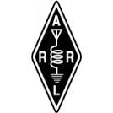

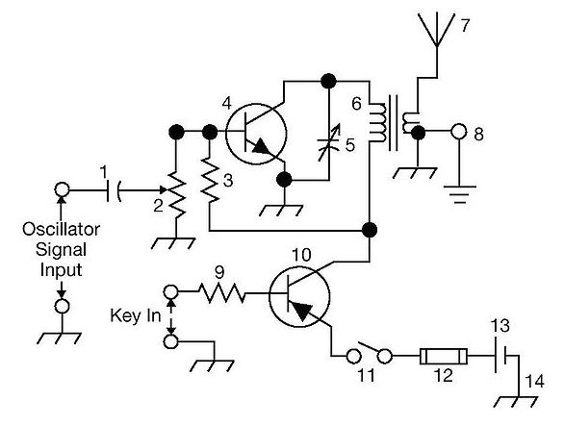
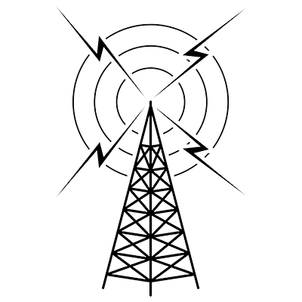
THE
ARRL
TENTH EDITION
GENERAL CLASS
LICENSE COURSE
FOR
HAM RADIO
All You Need to Pass Your General Class Exam!

Slide 2


Resource & Reference
www.arrl.org/shop/Licensing-Education-and-Training

Slide 3
Chapter 5 Part 2 of 2
ARRL General Class
Radio Signals & Equipment
Sections 5.4, 5.5
Receivers, HF Station Installation

Slide 4
Section 5.4
Superheterodyne Receivers
Most receivers used by today’s amateurs are superheterodyne
Received signals are incredibly weak – on the order of nano or picowatts
  Received signals are first strengthened by the RF amplifier, then applied to the RF input of a mixer
  The local oscillator (LO) is adjusted so that the desired signal creates a mixing product at the intermediate frequency (IF)
  A detector or demodulator stage follows the IF to recover the modulating information
  Input amplifier gain, demodulator stage bandwidth, and input amplifier noise can all affect receiver sensitivity

Slide 5
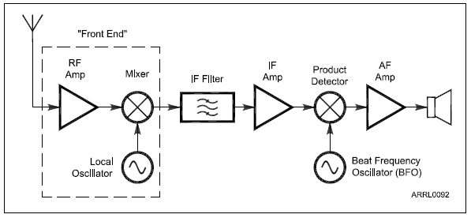
Fig. 5.16
A superheterodyne receiver converts signals to audio in two steps. The front end converts the frequency of a signal to the intermediate frequency (IF) where most of the gain of the receiver is provided. A second mixer – the product detector – converts the signal to audio frequencies.

Slide 6
Superheterodyne Receivers (cont.)
Once amplified to a more usable level, SSB and CW signals are demodulated by a product detector, a special type of mixer
If an AM signal is being received, a product detector or envelope detector recovers the modulating signal
Output of the detector is an audio signal amplified by an audio frequency (AF) amplifier and input to a speaker, headphones, or sound card

Slide 7
Superheterodyne Receivers (cont.)
The RF amplifier and mixer are the receiver’s front end
  Processes weak signals at their original frequencies
  A preselector is often used to reject out-of-band signals
  A preamplifier (preamp) is used if additional sensitivity is needed (weak signals)

Slide 8
Superheterodyne Receivers (cont.)
The simplest possible superhet consists of a mixer connected to the antenna, an oscillator to act as the LO, and a detector that operates directly on the resulting IF signal … See Figure 5.16
The single-frequency IF stages make it much easier to create high quality filters and high gain amplifiers without having to be tuned. Only the LO needs to be tuned in a superhet receiver.
Recall the formula for intermodulation (mixing of signals) … f₁ + f₂
  For example, to convert an RF signal on 14.250 MHz to an IF of 455 kHz, the LO must be tuned to either 14.250 – 455 kHz = 13.795 MHz or to 14.250 + 455 kHz = 14.705 MHz

Slide 9
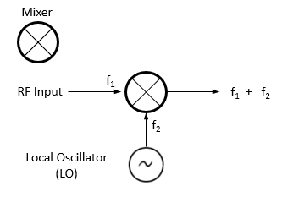
Superhets (cont.)
Superhets have some weaknesses, like all radio designs
  Because there are mixing products at both the sum and difference frequencies, undesired signals can create their own mixing products at the IF … see next slide for examples (refer to Fig 5.4, explained in Chapter 5 Part 1)
Fig 5.4

Slide 10
Superhet (cont.)
Another flaw is caused by the LO and other oscillator circuits. Leakage of signals into the signal path can cause steady signals to appear (called birdies).
Fig. 5.16 shows a single-conversion, with only one mixer converting the signal from RF to IF
  The IF stages provide most of the gain and selectivity
  Filtering is applied at each IF (allows filter bandwidth selection for desired signal) … this gives the best received signal quality with the lowest unwanted noise and interference, maximizing the signal-to-noise ratio (SNR)

Slide 11
Superhet Mixer Weakness Example (see Fig 5.4)
In a mixer, with an RF Input or Input Frequency (f₁) and Local Oscillator (f₂), remember there are mixing products at …
f₁ ± f₂ meaning f₁ + f₂ AND f₁ – f₂
With a LO = 13.800 MHz, a mixing product of 455 kHz (0.455 can be generated by a signal of either 14.255 MHz or 13.345 MHz).
14.255 MHz (signal) – 13.800 MHz (LO) = 0.455 MHz
13.800 MHz (LO) – 13.345 MHz (signal) = 0.455 MHz
Assuming that the INTENDED signal at 14.255 MHz is an image response.

Slide 12
FM Receivers (see Fig. 5.17)
Similar to AM/SSB/CW superhets
  The linear IF amplifier is replaced by a limiter
  Limiter amplifies the received signal until all amplitude modulated info (noise) is removed and only a square wave of the varying frequency remains
  Audio information is recovered by a discriminator or quadrature detector that replaces the product detector

Slide 13
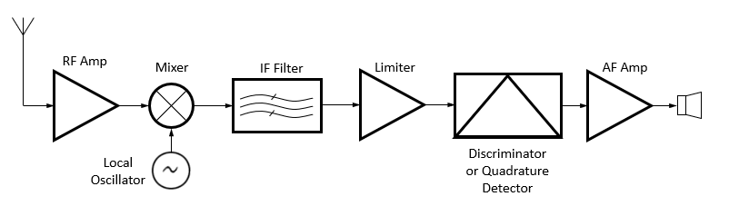
Fig 5.17: Once the FM signal is converted to the IF, hi-gain amplifiers called limiters change the signal to a square wave that only varies in frequency (not amplitude). A discriminator converts the frequency variations to audio.

Slide 14
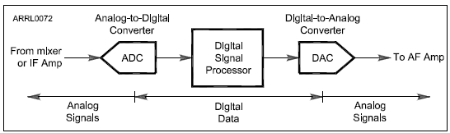
Digital Signal Processing (DSP)
The general term for converting signals from analog to digital is digital signal processing
Fig 5.18 (below): DSP systems use an analog-to-digital converter (ADC) to change the signal to digital data. A special type of microprocessor then performs the mathematical operations on the data to accomplish filtering, noise reduction, or other functions. A digital-to-analog converter (DAC) changes the processed data back to analog form for output as audio.

Slide 15
Digital Signal Processing (cont.)
Two advantages over analog circuitry
  Performance & flexibility
DSP offers selectable preprogrammed filters and allow the operator to adjust the filter bandwidth and shape and even to define new filters
Expensive functions in analog circuits can be implemented in DSP as a program without additional hardware

Slide 16
Managing Receiver Gain (RF Gain)
When looking for weak signals, set RF gain to maximum (for highest receiver sensitivity)
Lower RF gain volume to reduce background noise
Automatic gain control (AGC) circuits vary gain of the RF and IF amplifiers so output volume stays constant for both weak and strong signals
  AGC circuit changes the voltage that controls the IF amp gain. This voltage is read by the S-meter (measures signal strength).

Slide 17
RF Gain and AGC (cont.)
S-meters are calibrated in S-units
  One S-unit equals up to 6 dB (fourfold = 4X) change in signal strength
S-9 (a strong signal) is located at the midpoint of the display
  Larger values to the right (20, 40, 60)
  These correspond to “dB above S-9”
Reading of “S-9 + 20 dB” is a signal 20 dB (100 times) stronger than an S-9 signal

Slide 18
Receiver Linearity
If the received signal is distorted, spurious signals will appear just as if a transmitting station were emitting them
The most common form of receiver nonlinearity is overload (also called front-end overload) or gain compression
Solution to overload is to filter out the offending signal or reduce receiver gain (attenuator circuit). Proper use of attenuator and RF gain controls can dramatically reduce received noise distortion caused by strong signals.

Slide 19
Rejecting Interference and Noise
IF filters narrow the receiver’s passband (removes unwanted signals)
Notch filters remove signals in a very narrow band of frequencies (such as a signal tone from an interfering carrier)
Passband or IF shift adjust receiver’s passband above or below the displayed carrier frequency (avoids interference on adjacent frequencies)
Reverse sideband controls allow switching between receiving CW signals above carrier frequency (USB) and below it (LSB). Avoids interference by placing the signals on the “other side” of the carrier where filtering rejects them.

Slide 20
Rejecting Interference and Noise (cont.)
Noise blankers sense short, sharp pulses in the IF signals and reduce the gain of the IF and audio amplifiers during the pulse … called blanking
  Adjustable noise blankers can be set to blank the receiver at different noise levels
Noise reduction is performed by the DSP
  Removes hiss and noise from the audio that is not part of the desired speech, data, or CW
  Increasing the noise reduction level may cause some of the desired signal to be removed (causes distortion) … use the least noise reduction require to minimize this

Slide 21
PRACTICE QUESTIONS

Slide 22
What is the purpose of the notch filter found on many HF transceivers?
To restrict the transmitter voice bandwidth
To reduce interference from carriers in the receiver passband
To eliminate receiver interference from impulse noise sources
To remove interfering splatter generated by signals on adjacent frequencies
G4A01 (B) Page 5-21
22

Slide 23
What is one advantage of selecting the opposite, or “reverse,” sideband when receiving CW?
Interference from impulse noise will be eliminated
More stations can be accommodated within a given signal passband
It may be possible to reduce or eliminate interference from other signals
Accidental out-of-band operation can be prevented
G4A02 (C) Page 5-21
23

Slide 24
How does a noise blanker work?
By temporarily increasing received bandwidth
By redirecting noise pulses into a filter capacitor
By reducing receiver gain during a noise pulse
By clipping noise peaks
G4A03 (C) Page 5-21
24

Slide 25
What happens as a receiver’s noise reduction control level is increased?
Received signals may become distorted
Received frequency may become unstable
CW signals may become severely attenuated
Received frequency may shift several kHz
G4A07 (A) Page 5-21
25

Slide 26
What is the purpose of using a receive attenuator?
To prevent receiver overload from strong incoming signals
To reduce the transmitter power when driving a linear amplifier
To reduce power consumption when operating from batteries
To reduce excessive audio level on strong signals
G4A13 (A) Page 5-20
26

Slide 27
What does an S meter measure?
Carrier suppression
Impedance
Received signal strength
Transmitter power output
G4D04 (C) Page 5-20
27

Slide 28
How does a signal that reads 20 dB over S9 compare to one that reads S9 on a receiver, assuming a properly calibrated S meter?
It is 10 times less powerful
It is 20 times less powerful
It is 20 times more powerful
It is 100 times more powerful
G4D05 (D) Page 5-20
28

Slide 29
How much change in signal strength is typically represented by one S unit?
6 dB
12 dB
15 dB
18 dB
G4D06 (A) Page 5-20
29

Slide 30
How much must the power output of a transmitter be raised to change the S meter reading on a distant receiver from S8 to S9?
Approximately 1.5 times
Approximately 2 times
Approximately 4 times
Approximately 8 times
G4D07 (C) Page 5-20
30

Slide 31
How is a product detector used?
Used in test gear to detect spurious mixing products
Used in transmitter to perform frequency multiplication
Used in an FM receiver to filter out unwanted sidebands
Used in a single sideband receiver to extract the modulated signal
G7C04 (D) Page 5-18
31

Slide 32
Which of the following is an advantage of a digital signal processing (DSP) filter compared to an analog filter?
A wide range of filter bandwidths and shapes can be created
Fewer digital components are required
Mixing products are greatly reduced
The DSP filter is much more effective at VHF frequencies
G7C06 (A) Page 5-19
32

Slide 33
Which parameter affects receiver sensitivity?
Input amplifier gain
Demodulator stage bandwidth
Input amplifier noise figure
All these choices are correct
G7C08 (D) Page 5-18
33

Slide 34
Which mixer input is varied or tuned to convert signals of different frequencies to an intermediate frequency (IF)?
Image frequency
Local oscillator
RF input
Beat frequency oscillator
G8B01 (B) Page 5-17
34

Slide 35
What is the term for interference from a signal at twice the IF frequency from the desired signal?
Quadrature response
Image response
Mixer interference
Intermediate interference
G8B02 (B) Page 5-18
35

Slide 36
Why is it good to match receiver bandwidth to the bandwidth of the operating mode?
It is required by FCC rules
It minimizes power consumption in the receiver
It improves impedance matching of the antenna
It results in the best signal-to-noise ratio
G8B09 (D) Page 5-19
36

Slide 37
Section 5.5
HF Station Installation
HF operating, with longer wavelengths and higher field strengths, makes grounding and interference control much more important
The General Exam focuses on three related areas …
  Mobile installations
  RF grounding
  RF interference

Slide 38



Mobile Installations – Power Connections
Mobile radios that can output 100 W require solid power connections capable of supplying 20 A or more
  Solid state radios perform unpredictably with input voltage drops below the specified minimum power supply voltage
Best power connection is direct to battery, heavy gauge wire, with both leads fused
  Do NOT use cigarette lighter or aux socket … usually rated for only a few amperes … insufficient to supply a 100 W HF radio*
* If you have an older vehicle … something from the 1980’s, for example … it may have an old-fashioned cigarette lighter socket rated with enough amps to power your radio. But, confirm with BOTH owner’s manuals before you try it.
Every machine, operated WRONGLY enough, becomes a SMOKE machine!

Slide 39
Mobile Installations – Antenna Connections
A limitation of mobile installations is that electrically short (smaller in terms of wavelength) antennas are less efficient that full-sized ones
  Particularly true on lower frequency bands
Tips to improve antenna performance
  Use most efficient antenna you can
  Make sure your ground connections to vehicle are solid
  Mount antenna where it is clear of metal surfaces

Slide 40
Mobile Interference
Different interference sources than home stations
  Ignition noise (spark plugs firing) … n/a in diesel engines
  Alternator whine
  Vehicle’s accessories
  On-board control computers
  Electric motors in fuel pumps, windows, and battery charging systems
  Winch motors in 4X4 vehicles & trucks

Slide 41
Grounding & Bonding
AC grounding prevents hazardous voltages from appearing on equipment chassis, creating a shock hazard
To manage RF, bond equipment enclosures together (see Fig 5.19) … Bonding means to connect two points together to minimize voltage differences between them
During digital operation, unwanted RF currents can cause distortion, erratic operation of computer interfaces, activate transmitter improperly, and garble digital protocols

Slide 42
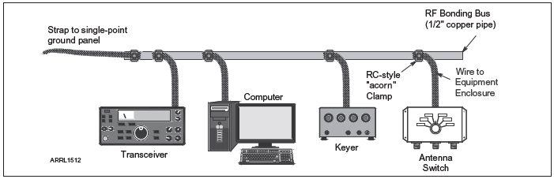
Figure 5.19 — This example of a typical RF bonding bus at the operating position helps keep all of the equipment at the same RF voltage.

Slide 43
Grounding & Bonding (cont.)
Bonding basics …
  Connect all metal equipment enclosures directly together or to a common RF bonding bus
  Keep connections, straps, and wires SHORT
  Use short, heavy conductors (#12 or #14 AWG) or strap
  If strong RF is present, use a piece of wide flashing or screen under the equipment, connected to the bonding bus
If ground connection is resonant at an odd number of ¼ wavelengths, it will generate high impedance (enables RF voltages on enclosures and cables)

Slide 44
Grounding & Bonding (cont.)
Ground loops are created by a continuous current path around a series of equipment connections
Loop acts as a single-turn inductor … picks up voltages from magnetic fields (from transformers, ac wiring, etc.)
Result is a “hum” in transmitted signals or that interferes with control or data signals
Ground loops can be avoided by connecting all ground conductors to the RF bonding bus

Slide 45
RF Interference (RFI): Causes & Solutions
RFI | CAUSE | SOLUTION
Fundamental Overload | Radio/TV receivers unable to reject strong signals … causes distortion or inability to receive desired signal | Prevent signal by using filters in signal path
Common-mode & Direct pickup | From electronic equipment with internal electronics … picked up on outside of cable shields and conductors of unshielded connections | Block current with RF chokes
Harmonics | Spurious emissions from an amateur station may be received by radio or TV equipment (there is no 1st harmonic … it’s called the fundamental frequency) | Use a low-pass filter at the transmitter
Intermodulation | Poor contacts between conductors picking up RF signals can create a nonlinear connection that acts as a mixer and mixing products from the signals | Find/repair the poor contact or block the RF signals (look for odd-order harmonics … closest to the original frequencies)
Arcing | A spark or sustained arc creates radio crackling or buzz over wide frequency range, (from power-line hardware) | May require power company to make repairs; filter specific equip.

Slide 46
Common RFI Symptoms
RFI is quite varied
Some more common types are …
  CW, FM, or data: Interference consists of ON/OFF buzzes, humming, clicks or thumps when the interfering signal is transmitted
  AM phone: Equipment experiencing overload or direct detection will often emit a replica of the speaker’s voice
  SSB voice: Similar to AM phone, but voice will be distorted or garbled

Slide 47
Suppressing RFI
Filters are effective and easy to install
Block RF by placing an impedance in its path
  Form conductor carrying RF current into an RF choke by winding it around or through a ferrite core
Ferrite beads placed on cables to prevent RF common-mode from flowing on outside of cables/shields
Interference to audio equipment and sensor connections can be eliminated by using a small (100 pF to 1 nF) bypass capacitor across balanced connections

Slide 48
PRACTICE QUESTIONS

Slide 49
Which of the following might be useful in reducing RF interference to audio frequency devices?
Bypass inductor
Bypass capacitor
Forward-biased diode
Reverse-biased diode
G4C01 (B) Page 5-25
49

Slide 50
Which of the following could be a cause of interference covering a wide range of frequencies?
Not using a balun or line isolator to feed balanced antennas
Lack of rectification of the transmitter’s signal in power conductors
Arcing at a poor electrical connection
Using a balun to feed an unbalanced antenna
G4C02 (C) Page 5-25
50

Slide 51
What sound is heard from an audio device experiencing RF interference from a single sideband phone transmitter?
A steady hum whenever the transmitter is on the air
On-and-off humming or clicking
Distorted speech
Clearly audible speech
G4C03 (C) Page 5-25
51

Slide 52
What sound is heard from an audio device experiencing RF interference from a CW transmitter?
On-and-off humming or clicking
A CW signal at a nearly pure audio frequency
A chirpy CW signal
Severely distorted audio
G4C04 (A) Page 5-25
52

Slide 53
What is a possible cause of high voltages that produce RF burns?
Flat braid rather than round wire has been used for the ground wire
Insulated wire has been used for the ground wire
The ground rod is resonant
The ground wire has high impedance on that frequency
G4C05 (D) Page 5-24
53

Slide 54
What is a possible effect of a resonant ground connection?
Overheating of ground straps
Corrosion of the ground rod
High RF voltages on the enclosures of station equipment
A ground loop
G4C06 (C) Page 5-24
54

Slide 55
Which of the following would reduce RF interference caused by common-mode current on an audio cable?
Place a ferrite choke on the cable
Connect the center conductor to the shield of all cables to short circuit the RFI signal
Ground the center conductor of the audio cable causing the interference
Add an additional insulating jacket to the cable
G4C08 (A) Page 5-25
55

Slide 56
How can the effects of ground loops be minimized?
Connect all ground conductors in series
Connect the AC neutral conductor to the ground wire
Avoid using lock washers and star washers when making ground connections
Bond equipment enclosures together
G4C09 (D) Page 5-24
56

Slide 57
What could be a symptom caused by a ground loop in your station’s audio connections?
You receive reports of “hum” on your station’s transmitted signal
The SWR reading for one or more antennas is suddenly very high
An item of station equipment starts to draw excessive amounts of current
You receive reports of harmonic interference from your station
G4C10 (A) Page 5-24
57

Slide 58
What technique helps to minimize RF “hot spots” in an amateur station?
Building all equipment in a metal enclosure
Using surge suppressor power outlets
Bonding all equipment enclosures together
Placing low-pass filters on all feed lines
G4C11 (C) Page 5-24
58

Slide 59
Why must all metal enclosures of station equipment be grounded?
It prevents a blown fuse in the event of an internal short circuit
It prevents signal overload
It ensures that the neutral wire is grounded
It ensures that hazardous voltages cannot appear on the chassis
G4C12 (D) Page 5-23
59

Slide 60
Which of the following direct, fused power connections would be the best for a 100 watt HF mobile installation?
To the battery using heavy-gauge wire
To the alternator or generator using heavy-gauge wire
To the battery using insulated heavy duty balanced transmission line
To the alternator or generator using insulated heavy duty balanced transmission line
G4E03 (A) Page 5-23
60

Slide 61
Why should DC power for a 100-watt HF transceiver not be supplied by a vehicle’s auxiliary power socket?
The socket is not wired with an RF-shielded power cable
The socket’s wiring may be inadequate for the current drawn by the transceiver
The DC polarity of the socket is reversed from the polarity of modern HF transceivers
Drawing more than 50 watts from this socket could cause the engine to overheat
G4E04 (B) Page 5-23
61

Slide 62
Which of the following most limits an HF mobile installation?
“Picket fencing”
The wire gauge of the DC power line to the transceiver
Efficiency of the electrically short antenna
FCC rules limiting mobile output power on the 75-meter band
G4E05 (C) Page 5-23
62

Slide 63
Which of the following may cause receive interference in a radio installed in a vehicle?
The battery charging system
The fuel delivery system
The control computers
All these choices are correct
G4E07 (D) Page 5-23
63

Slide 64
How does a ferrite bead or core reduce common-mode RF current on the shield of a coaxial cable?
By creating an impedance in the current’s path
It converts common-mode current to differential mode
By creating an out-of-phase current to cancel the common-mode current
Ferrites expel magnetic fields
G6B10 (A) Page 5-25
64

Slide 65
Which intermodulation products are closest to the original signal frequencies?
Second harmonics
Even-order
Odd-order
Intercept point
G8B05 (C) Page 5-25
65

Slide 66
What process combines two signals in a non-linear circuit or connection to produce unwanted spurious outputs?
Intermodulation
Heterodyning
Detection
Rolloff
G8B12 (A) Page 5-25
66

Slide 67
Which of the following is an odd-order intermodulation product of frequencies F1 and F2?
HOW TO CALCULATE: To obtain the answer, remember that intermodulation refers to mixing products (f₁ + f₂). The odd-order intermodulation refers to a harmonic (i.e., a spurious harmonic emission). Since odd-order harmonics are closest to the original (fundamental) frequency, we have to assume they’re referring to the second harmonic of F1 (instead of the 3rd, 4th, etc.). The frequency of this 2nd harmonic is represented by the formula (2 × f₁ or 2F1). So, the two intermodulation products of F1 and F2, where F1 is really the 2nd harmonic of F1 would be 2F1 + F2 and 2F1 – F2. The second intermodulation product (2F1 – F2) matches answer C.
5F1-3F2
3F1-F2
2F1-F2
All these choices are correct
G8B13 (C) Page 5-25
67

Slide 68
END OF CHAPTER 5 PART 2 OF 2

Slide 69
Slides created by …
Jerry D. Kilpatrick
KØILP (Amateur Radio)
PGØØØ72373 (Commercial Operator)
K0ILP.NC@gmail.com
Feel free to contact me if you find errors or have suggestions for improvement.

