Slide 1
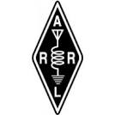
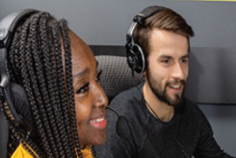
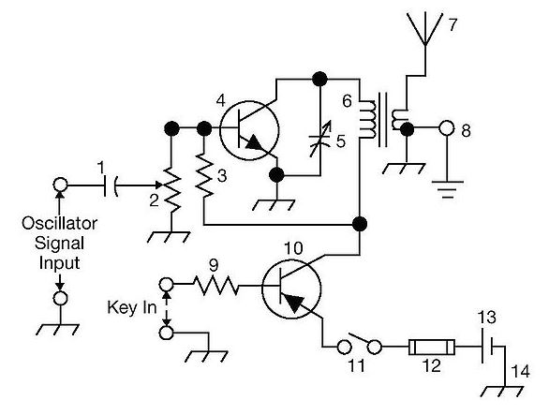
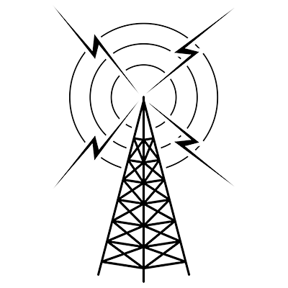
THE
ARRL
TENTH EDITION
GENERAL CLASS
LICENSE COURSE
FOR
HAM RADIO
All You Need to Pass Your General Class Exam!

Slide 2
Resource & Reference
www.arrl.org/shop/Licensing-Education-and-Training

Slide 3
Chapter 6 Part 1 of 1 ARRL General Class Digital Modes Sections 6.1, 6.2, 6.3, 6.4, 6.5 Basics of Digital Modes, Character-Based Modes, Packet-Based Modes & Systems, Receiving & Transmitting Digital Modes, Digital Operating Procedures

Slide 4
Section 6.1 Basics of Digital Modes: Where to Find Digital Activity
Communications are digital modes if info is exchanged as individual characters encoded as digital bits … Morse Code (CW), radioteletype, PSK31, FT8, D-STAR, DMR, slow-scan TV, etc.
Digital modes are restricted to CW/data segments of each HF band *
Found near top of CW segment
Example: On 20 meters, most PSK signals are near 14.070 MHz. RTTY and other digital modes are found above that between 14.070 and 14.112 MHz. See Table 6.1.
* CW isn't formally restricted anywhere in the ham bands

Slide 5
Digital Modes Overview
Data rates and bandwidths specified by FCC rules
Digital codes not specified by the FCC must be public
Radioteletype (RTTY) – originally used mechanical teleprinters but migrated to computer sound cards
PSK31 – good weak signal mode using low transmitter power and very narrow bandwidth (computer sound card)
PACTOR – stands for PACket Teletype Over Radio
WINMOR – stands for WINdows Messaging Over Radio
Packet Radio – common on the VHF and UHF bands (1200 & 9600 baud)

Slide 6
Table 6.1: Digital Signal Band Plan (HF Bands)
Band (meters) | Frequency Range (MHz) | Notes
160 | 1.800 – 1.810 | FT8 is on 1.840 MHz
80 | 3.570 – 3.600
60 | 5332, 5348, 5358.5, 5373, 5405 kHz | Channel center frequencies
40 | 7.070 – 7.125 | RTTY DX calling frequency 7.040
30 | 10.130 – 10.150
20 | 14.070 – 14.0995 and 14.1005 – 14.112 | PSK31 calling frequency 14.070
17 | 18.100 – 18.110
15 | 21.070 – 21.110
12 | 24.920 – 24.930
10 | 28.070 – 28.189

Slide 7
Definitions
Air link: the part of the comm system that involves radio transmission and reception of signals
Bit: the fundamental unit of data; a 0 or 1 representing all or part of a binary number
Bit rate: number of digital bits/second sent from one system to another
Baud(s): number of symbols/second sent from one system to another
Duty cycle: ratio of time that transmitter is on to total time plus off time
Protocol: rules that control the method used to exchange data between systems
Mode: combination of a protocol with a modulation method
CLARIFICATION: Digital voice modes are regulated as voice emissions by the FCC. Examples include; Icom’s D-STAR, Yaesu’s System Fusion, AOR’s digital voice system, DMR.

Slide 8
Frequency Shift Keying (FSK)
VFO = variable frequency oscillator
Individual bits of data encoded as tones
As data are transmitted, different tone frequencies are used
The frequencies in a two-tone FSK signal are called mark and space
Space represents 0, mark represents 1
In “direct” FSK, the frequency of the transmitter’s VFO is controlled by a digital data signal from the computer
Audio FSK (AFSK) – audio tones modulate an SSB or FM transmitter through the mic input
Multiple FSK – more than 2 tones are used to create more codes

Slide 9
Phase Shift Keying (PSK)
Most common type of phase shift is to invert one of the tone waveforms (shifting phase 180°)
Rapid changes in phase can be heard from human ear as a raspy noise of buzz – the signature of PSK signals on the air received by a CW or SSB receivers (sort of like the sound on an old computer modem)

Slide 10
PRACTICE QUESTIONS

Slide 11
In what segment of the 20-meter band are most digital mode operations commonly found?
At the bottom of the slow-scan TV segment, near 14.230 MHz
At the top of the SSB phone segment, near 14.325 MHz
In the middle of the CW segment, near 14.100 MHz
Between 14.070 MHz and 14.100 MHz
G2E08 (D) Page 6-2
11

Slide 12
How is direct binary FSK modulation generated?
By keying an FM transmitter with a sub-audible tone
By changing an oscillator’s frequency directly with a digital control signal
By using a transceiver’s computer data interface protocol to change frequencies
By reconfiguring the CW keying input to act as a tone generator
G8A01 (B) Page 6-4
12

Slide 13
How are the two separate frequencies of a Frequency Shift Keyed (FSK) signal identified?
Dot and dash
On and off
High and low
Mark and space
G8C11 (D) Page 6-4
13

Slide 14
Which of the following provide digital voice modes?
WSPR, MFSK16, and EasyPAL
FT8, FT4, and FST4
Winlink, PACTOR II, and PACTOR III
DMR, D-STAR, and SystemFusion
G8C16 (D) Page 6-3
14

Slide 15
Section 6.2 Character-Based Modes
Simplest use of digital communications is a mode in which individual characters are entered by an operator, then transmitted to another station where they are read by another operator (e.g., CW)
Speeds are low, but convenient to use and require little additional equipment other than sound card or modem
Sometimes referred to as keyboard-to-keyboard or chat
Transmit a stream of characters without additional data (referred to as unstructured)

Slide 16
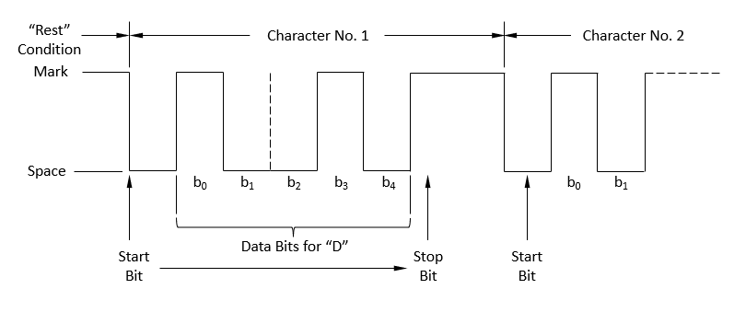
RTTY: Oldest form of ham radio digital communications
Fig 6.1: The Baudot timing sequence for the bit pattern that encodes the letter D. The start bit is sent first. Start / stop bits are required to allow the receiving and transmitting systems to sync. Mark / space are represented as audio tones in the signal. Baudot is origin of term baud.
Referred to in FCC rules as narrowband, direct-printing telegraphy

Slide 17
Radioteletype (RTTY)
RTTY uses Baudot code (represents each character as a 5-bit sequence)
5 bits allow for 32 different characters … not enough for entire English alphabet, numerals, and punctuation
2 special codes (LTRS & FIGS) are used to switch between 2 character sets (doubles number of available characters)
The difference between the mark and space tones (see Fig 6.1) is called the signal’s shift
You should always answer an RTTY station at same speed and shift it’s using
Most common HF phase shift is 170 Hz

Slide 18
PSK31 (Phase Key Shifting)
Most popular PSK mode (also called 31 Baud)
Uses a sound card to generate RTTY signals
31 is the symbol rate (actually 31.25 baud)
Designed for keyboard-to-keyboard communication (typing rates up to 50 wpm)
Also referred to as BPSK31
QPSK31 (Quadrature PSK31) sends TWO audio tones, so there are now four possible phase shift combinations

Slide 19
PSK31 (cont.)
Since PSK has two tones, you have to select the right sideband (USB or LSB) to decode the data … sideband sensitive
PSK uses a variable length character code called Varicode that assigns shorter codes to common characters and longer codes for uncommon characters (like Morse code)
Capital letters & punctuation take longer to send
If you’re used to RTTY (no lower case), turn off CAPS LOCK!
QPSK31 / PSK31 have about the same bandwidth (2.5 kHz)
QPSK31 is sideband sensitive and its encoding provides error detection

Slide 20
PRACTICE QUESTIONS

Slide 21
What is the most common frequency shift for RTTY emissions in the amateur HF bands?
85 Hz
170 Hz
425 Hz
850 Hz
G2E06 (B) Page 6-5
21

Slide 22
Which of the following is characteristic of QPSK31?
It is sideband sensitive
Its encoding provides error correction
Its bandwidth is approximately the same as BPSK31
All these choices are correct
G8A06 (D) Page 6-5
22

Slide 23
Which of the following describes Baudot code?
A 7-bit code with start, stop, and parity bits
A code using error detection and correction
A 5-bit code with additional start and stop bits
A code using SELCAL and LISTEN
G8C04 (C) Page 6-5
23

Slide 24
Which of the following statements is true about PSK31?
Upper case letters are sent with more power
Upper case letters use longer Varicode bit sequences and thus slow down transmission
Error correction is used to ensure accurate message reception
Higher power is needed as compared to RTTY for similar error rates
G8C08 (B) Page 6-5
24

Slide 25
Which type of code is used for sending characters in a PSK31 signal?
Varicode
Viterbi
Volumetric
Binary
G8C12 (A) Page 6-5
25

Slide 26
Section 6.3 Packet-Based Modes & Systems
Packet-based or structured modes are derived from early teletype-over-radio modes (TOR) and computer-to-computer network protocols
Hams have adapted these protocols, creating packet radio, PACTOR, WINMOR, and other communication systems
Some packet modes (JT65 & FT8) require precisely-defined transmission periods … utility software is available to keep your computer synchronized to within 1 second of standard time

Slide 27
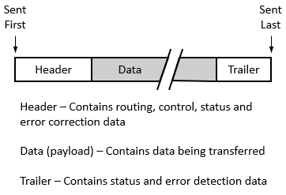
Packet Basics
Packet refers to the transmission of data in structured groups (frames)
Figure 6.2: Packet communication systems package data with control and routing information and add error detection information. Each package of header, data, and trailer is called a frame. Different packet protocols use different sets of information and methods of creating the frame.

Slide 28
Packet Basics (cont.) … see Fig 6.2
Header – Contains bit patterns that allow receiver to synch with the packet’s structure, control, and routing information, and for some protocols, error detection/correction information.
Data – Data to be exchanged between the systems. Usually ASCII characters. Usually compressed for efficiency.
Trailer – Additional info used for error detection.
Forward error correction (FEC) goes beyond simply detecting errors. By including redundant encoded info with the data, it’s possible for receiver to CORRECT certain types of data errors.
Most common error detection mechanism is a cyclic redundancy check or CRC

Slide 29
Automatic Repeat reQuest (ARQ) Systems
If mismatch is detected, receiving system responds with NAK (not acknowledged) and protocol requests retransmission
Transmitting system will continue to send packet until received without errors or retransmission limit is exceeded
ARQ used in modes: PACTOR, packet radio, WINMOR, etc.
ARQ protocols were designed for wired network connections, and the transmission can only be received from one receiving station during the connection. This means you can’t break in to an ongoing contact between two stations using an ARQ mode.

Slide 30
ARQ (cont.)
So that a station can advertise its presence, ARQ protocols provide a broadcast mode to transmit without another station having established a contact
A MON mode is also provided so that other stations can listen to the conversation without error correction
Using the MON (monitoring) mode allows you to determine if a frequency is occupied by 2 stations having an ARQ mode contact
Designed to transfer data between only two stations … meaning you can’t break in to an ongoing contact

Slide 31
Packet Radio
TOR systems developed to compensate for transmission errors in RTTY (e.g., MTOR, G-TOR, etc.)
Used almost exclusively on UHF bands
Sends short bursts of characters with error detection and correction data
Based on computer network protocol X.25
One of the oldest packet-switching communication protocols
Popular during the late 1970s and 1980s (computer industry)
Packets exchanged using VHF FM voice at 1200 or 9600 baud
Does not work well with HF because data are easily disrupted by noise and fading (even at 300 baud allowed on HF)

Slide 32
PACTOR and WINMOR
Original TOR protocols (AMTOR, G-TOR) are reliable, but slow
PACTOR (Packet-based TOR) and WINMOR (Windows TOR) addresses reliability AND speed … extends TOR capability
PACTOR 1 uses FSK (frequency shift key) modulation; PACTOR 1 thru 4 use advanced PSK modulation (PACTOR 4 not yet legal for US amateurs)
PACTOR and VARA modes overcome some of the issues with HF (e.g., garbled text over fading signal paths)

Slide 33
WINLINK (www.winlink.org)
Enables transferring of email messages & digital files on HF bands
Winlink isn’t a mode … it’s a gateway communication system
Uses internet to connect its email servers with gateway and mailbox stations around the world on HF, VHF and UHF
Winlink stations do not connect directly with the internet, but provide a means for stations out of local internet connection range
Even without internet connectivity, Winlink Express can act as standalone mailbox stations or communicate directly with each other
On HF, WINLINK uses PACTOR and VARA modes (VARA is the more popular)
VARA is a TOR software developed by EA5HVK Software

Slide 34
FT8 & WSPR (WS = Weak Signal)
Supported by the WSJT software suite (and JT65, MSK144, etc.)
https://wsjt.sourceforge.io/wsjtx.html
Uses 8-tone frequency shift keying modulation and error decoding/correction to enable successful decoding at very low signal-to-noise ratios (SNR)
FT8 sends 75-bit messages … limits messages to call signs, grid locators, signal reports, etc.
FT8 signal reports are on the signal-to-noise ratio, so a report of +3 means the signal is 3dB above the noise floor
Most common FT8 transmission range is 14.074 and 14.077 MHz
Be sure to locate a clear frequency and select the time slot that doesn't interfere with the calling station. Specifically, when responding, select a clear frequency in the alternate time slot to that used by the calling station.
WSPR (“whisper”) experiments with HF propagation paths at very low signal-to-noise ratios … does not support 2-way QSOs
Low power WSPR transmitters generate coded packets; stations that receive these report success on www.wsprnet.org

Slide 35
Amateur Wireless Networks
Certain wireless networking frequencies overlap with amateur bands (see Table 6.2)
Amateurs are able to use them for many of the same purposes that unlicensed users are able to (text messages, Voice Over IP, email, etc.)
If you operate a wireless network on FCC Part 97 frequencies, you must comply with the prohibitions on encryption
Hams use two basic network topologies; mesh and star configurations
An advantage of the mesh networking topology is that if one node fails, a packet may be able to find its destination by routing through another available node

Slide 36
Table 6.2: Wireless Networking Frequencies

Slide 37
AREDN (AMATEUR RADIO EMERGENCY DATA NETWORK)
A mesh network
Uses commercially available routers in the 900 MHz, 2.4, 3.4, and 5.8 GHz amateur bands
Supported device list at:
https://www.arednmesh.org/content/supported-platform-matrix
Generally used during emergencies or to support community events like road races, parades, and other large gatherings

Slide 38
PRACTICE QUESTIONS

Slide 39
What is VARA?
A low signal-to-noise digital mode used for EME (moonbounce)
A digital protocol used with Winlink
A radio direction finding system used on VHF and UHF
DX spotting system using a network of software defined radios
G2E02 (B) Page 6-9
39

Slide 40
Which of the following is good practice when choosing a transmitting frequency to answer a station calling CQ using FT8?
Always call on the station’s frequency
Call on any frequency in the waterfall except the station’s frequency
Find a clear frequency during the same time slot as the calling station
Find a clear frequency during the alternate time slot to the calling station
G2E04 (D) Page 6-9
40

Slide 41
Which of the following is required when using FT8?
A special hardware modem
Computer time accurate to within approximately 1 second
Receiver attenuator set to -12 dB
A vertically polarized antenna
G2E07 (B) Page 6-7
41

Slide 42
How do you join a contact between two stations using the PACTOR protocol?
Send broadcast packets containing your call sign while in MONITOR mode
Transmit a steady carrier until the PACTOR protocol times out and disconnects
Joining an existing contact is not possible, PACTOR connections are limited to two stations
Send a NAK code
G2E09 (C) Page 6-8
42

Slide 43
What is the primary purpose of an Amateur Radio Emergency Data Network (AREDN) mesh network?
To provide FM repeater coverage in remote areas
To provide real time propagation data by monitoring amateur radio transmissions worldwide
To provide high-speed data services during an emergency or community event
To provide DX spotting reports to aid contesters and DXers
G2E11 (C) Page 6-10
43

Slide 44
Which of the following describes Winlink?
An amateur radio wireless network to send and receive email on the internet
A form of Packet Radio
A wireless network capable of both VHF and HF band operation
All of the above
G2E12 (D) Page 6-8
44

Slide 45
What is another name for a Winlink Remote Message Server?
Terminal Node Controller
Gateway
RJ-45
Printer/Server
G2E13 (B) Page 6-8
45

Slide 46
Which of the following is a common location for FT8?
Anywhere in the voice portion of the band
Anywhere in the CW portion of the band
Approximately 14.074 MHz to 14.077 MHz
Approximately 14.110 MHz to 14.113 MHz
G2E15 (C) Page 6-9
46

Slide 47
What type of modulation is used by FT8?
8-tone frequency shift keying
Vestigial sideband
Amplitude compressed AM
8-bit direct sequence spread spectrum
G8A09 (A) Page 6-9
47

Slide 48
What is QPSK modulation?
Modulation using quasi-parallel to serial conversion to reduce bandwidth
Modulation using quadra-pole sideband keying to generate spread spectrum signals
Modulation using Fast Fourier Transforms to generate frequencies at the first, second, third, and fourth harmonics of the carrier frequency to improve noise immunity
Modulation in which digital data is transmitted using 0-, 90-, 180- and 270-degrees phase shift to represent pairs of bits
G8A12 (D) Page 6-8
48

Slide 49
Which digital mode is used as a low-power beacon for assessing HF propagation?
WSPR
MFSK16
PSK31
SSB-SC
G8C02 (A) Page 6-9
49

Slide 50
What part of a packet radio frame contains the routing and handling information?
Directory
Preamble
Header
Trailer
G8C03 (C) Page 6-7
50

Slide 51
In an ARQ mode, what is meant by a NAK response to a transmitted packet?
Request retransmission of the packet
Packet was received without error
Receiving station connected and ready for transmissions
Entire file received correctly
G8C05 (A) Page 6-8
51

Slide 52
Which of the following narrow-band digital modes can receive signals with very low signal-to-noise ratios?
MSK144
FT8
AMTOR
MFSK32
G8C07 (B) Page 6-9
52

Slide 53
Which is true of mesh network microwave nodes?
Having more nodes increases signal strengths
If one node fails, a packet may still reach its target station via an alternate node
Links between two nodes in a network may have different frequencies and bandwidths
More nodes reduce overall microwave out of band interference
G8C09 (B) Page 6-10
53

Slide 54
How does forward error correction (FEC) allow the receiver to correct data errors?
By controlling transmitter output power for optimum signal strength
By using the Varicode character set
By transmitting redundant information with the data
By using a parity bit with each character
G8C10 (C) Page 6-8
54

Slide 55
What does an FT8 signal report of +3 mean?
The signal is 3 times the noise level of an equivalent SSB signal
The signal is S3 (weak signals)
The signal-to-noise ratio is equivalent to +3dB in a 2.5 kHz bandwidth
The signal is 3 dB over S9
G8C15 (C) Page 6-9
55

Slide 56
Section 6.4 Receiving & Transmitting Digital Modes
Most digital modes on HF are transmitted as USB signals
Exception … RTTY uses LSB
Modem or software must be configured to correct baud rate and receiving tone frequency to receive data, even if the signal is strong and seems to be tuned correctly
Since PSK31 uses a single tone, either USB or LSB will work (most use USB)

Slide 57
Bandwidth of Digital Modes
Like other amateur signals, digital mode bandwidth is defined by the FCC … §97.3(a)(8)
Bandwidth of signal changes with the symbol rate
As symbol rate increases, so does the bandwidth needed for the signal needed to transmit them … see Table 6.2 for details
Most common method of generating / transmitting these modes is to connect to audio output from computer sound card to microphone of an SSB transceiver

Slide 58
Table 6.2
Be careful when operating near the edge of a data signal band. Using LSB for an FSK mode, the sidebands will be below the displayed carrier frequency of you radio.
Bandwidth Comparison of Digital Modes
MODE | BANDWIDTH (Hz)
PSK31 | 50
FT8 | 50
RTTY | 200
MFSK16 | 300
JT65 | 350
DominoEX | 524
Olivia | 1000
WINMOR | 1600
MT63 | 2000
PACTOR-III | 2300
PACTOR-4 | 2300
Bandwidths are approximate for the highest commonly used symbol rate and are not specifications
FSK = Frequency shift keying

Slide 59
Transmitter Duty Cycle
Most amateur transmitters are not designed to operate at full power for an extended period of time
CW only operates at full power 40-50% of the time
SSB only operates at full power 20-25% of the time
FM modes operate at full power the entire transmission time!
Extended transmissions may be enough to exceed a transmitter’s average power rating
Reduce transmit power to prevent overheating (usually to 50% of max.)

Slide 60
Digital Mode Signal Quality
Digital modes can generate interference (like phone and CW)
For digital modes that use an SSB transmitter to transmit audio frequency shift keying (AFSK), the most common problem is supplying too much or too little audio from the computer to the radio’s microphone input
On waterfall displays, the vertical lines represent spurious emissions … caused by overmodulation of the transmitter
MFSK16 (another variation of FSK, m = multi) is a method of signal modulation that extends the radio teletype (RTTY) two-tone technique to multiple tones, producing fewer errors

Slide 61
ALC and Digital Modes (automatic level control)
Used for preventing excessive drive to amplifier inputs
ALC circuits reduce gain when power levels get too high
However, it comes at a price. The signal compression can result in distortion.
Resist temptation to turn up gain
For digital signals, distortion caused by ALC makes the signal harder to decode and creates spurious emissions, similar to overmodulation
When in digital mode, your ALC system should be either disabled or the input level and gain turned down to the point where the ALC does not activate.

Slide 62
PRACTICE QUESTIONS

Slide 63
Which mode is normally used when sending RTTY signals via AFSK with an SSB transmitter?
USB
DSB
CW
LSB
G2E01 (D) Page 6-12
63

Slide 64
What is the standard sideband for JT65, JT9, FT4, or FT8 digital signal when using AFSK?
LSB
USB
DSB
SSB
G2E05 (B) Page 6-12
64

Slide 65
What could be wrong if you cannot decode an RTTY or other FSK signal even though it is apparently tuned in properly?
The mark and space frequencies may be reversed
You may have selected the wrong baud rate
You may be listening on the wrong sideband
All these choices are correct
G2E14 (D) Page 6-12
65

Slide 66
Why should the ALC system be inactive when transmitting AFSK data signals?
ALC will invert the modulation of the AFSK mode
The ALC action distorts the signal
When using digital modes, too much ALC activity can cause the transmitter to overheat
All these choices are correct
G4A11 (B) Page 6-13
66

Slide 67
Why is it important to know the duty cycle of the mode you are using when transmitting?
To aid in tuning your transmitter
Some modes have high duty cycles that could exceed the transmitter’s average power rating
To allow time for the other station to break in during a transmission
To prevent overmodulation
G8B08 (B) Page 6-13
67

Slide 68
What is the relationship between transmitted symbol rate and bandwidth?
Symbol rate and bandwidth are not related
Higher symbol rates require wider bandwidth
Lower symbol rates require wider bandwidth
Bandwidth is half the symbol rate
G8B10 (B) Page 6-12
68

Slide 69
What is indicated on a waterfall display by one or more vertical lines on either side of a data mode or RTTY signal?
Long path propagation
Backscatter propagation
Insufficient modulation
Overmodulation
G8C13 (D) Page 6-13
69

Slide 70
Section 6.5 Digital Operating Procedures Initiating & Terminating Digital Contacts
Sample CQ from a digital mode (RTTY, PSK31, etc.) … from KØILP
CQ CQ CQ DE KØILP KØILP KØILP K
Sample/typical response … by KX4IU
KØILP KØILP KØILP DE KX4IU KX4IU KX4IU K
Modes such as PACTOR and VARA … the software or modem will have a specific disconnect message … BYE or D
The K here is not a typo … used at end of transmission to indicate the other station is to transmit as shown.

Slide 71
Connecting to Gateway and Mailbox Stations
The exact connection method depends upon equipment and mode, but begin by sending a CONNECT message
If signal is received without errors, a training sequence of packets may be exchanged to determine protocol to use
Because these stations respond without a human control operator present, FCC classifies them as automatically-controlled digital stations … restricted to certain band segments (Table 6.4)
Data also permitted on 6-meter and shorter wavelength bands
Stations under FCC rules must operate under local or remote control (with control operator in charge of all transmissions)

Slide 72
Table 6.4
BAND (Meters) | FREQUENCY RANGE (MHz)
160 | Not permitted
80 | 3.585 – 3.600
60 | Not permitted
40 | 7.100 – 7.105
30 | 10.140 – 10.150
20 | 14.095 – 14.0995 & 14.1005 – 14.112
17 | 18.105 – 18.110
15 | 21.090 – 21.100
12 | 24.925 – 24.930
10 | 28.120 – 28.189
6 | 50.1 – 54.0
2 | 144.1 – 148
Automatic Control Band Segments for RTTY & Data

Slide 73
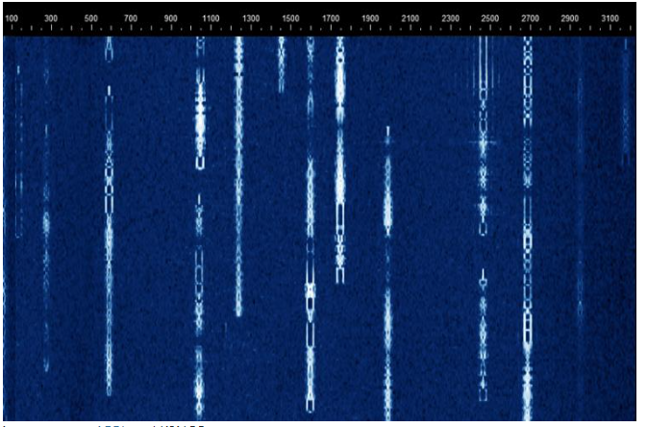
During the Contact (Operating Displays) – See Fig 6.5 in text
A waterfall display displays the presence of signals as a series of lines representing a scan across the frequency range
Signal strength is represented as brightness, intensity, or color
As new lines are captured, older lines are moved down or to one side, giving the impression of a waterfall

Slide 74
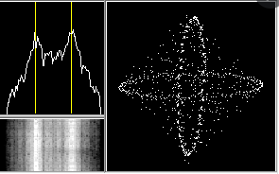
Tuning Aids for RTTY Signal Display
The left side is a spectrum of the filtered received audio. The vertical lines are at the mark and space frequencies, and help tune in the signal so the peaks are on the lines (indicating the right tone frequencies)
The crossed-ellipses on the right are used for fine tuning … ellipses at right angles and the same size indicate correct tuning

Slide 75
Third-Party Traffic in Digital Modes
All FCC rules about 3rd party messages apply to digital transmissions
Includes info in email, digital images, or web pages transmitted via amateur radio
Commercial messages may not be transmitted via amateur radio

Slide 76
Interfering Signals in Digital Modes
“Hidden transmitter” problems occur in all modes
If you’re in a skip zone for one of the stations involved in a contact or that is trying to connect to the same digital station, you won’t hear the hidden transmitter, but the receiving station might hear both of you (hidden to YOU)
The resulting interference is unintentional but prevents both you and the hidden transmitter from completing a contact
Packet modes (PACTOR, WINMOR) don’t recover from reception difficulties as well as keyboard-to-keyboard modes (RTTY, PSK31), resulting in … failure to connect, frequent retries, transmission delays, timeouts, and dropped connections

Slide 77
PRACTICE QUESTIONS

Slide 78
What is required to conduct communications with a digital station operating under automatic control outside the automatic control band segments?
The station initiating the contact must be under local or remote control
The interrogating transmission must be made by another automatically controlled station
No third-party traffic may be transmitted
The control operator of the interrogating station must hold an Amateur Extra class license
G1E03 (A) [97.221] Page 6-15
78

Slide 79
Under what circumstances are messages that are sent via digital modes exempt from Part 97 third-party rules that apply to other modes of communication?
Under no circumstances
When messages are encrypted
When messages are not encrypted
When under automatic control
G1E09 (A) [97.115] Page 6-16
79

Slide 80
On what bands may automatically controlled stations transmitting RTTY or data emissions communicate with other automatically controlled digital stations?
On any band segment where digital operation is permitted
Anywhere in the non-phone segments of the 10-meter or shorter wavelength bands
Only in the non-phone Extra Class segments of the bands
Anywhere in the 6-meter or shorter wavelength bands, and in limited segments of some of the HF bands
G1E11 (D) [97.221, 97.305] Page 6-15
80

Slide 81
What symptoms may result from other signals interfering with a PACTOR or VARA transmission?
Frequent retries or timeouts
Long pauses in message transmission
Failure to establish a connection between stations
All these choices are correct
G2E03 (D) Page 6-16
81

Slide 82
Which of the following is a way to establish contact with a digital messaging system gateway station?
Send an email to the system control operator
Send QRL in Morse code
Respond when the station broadcasts its SSID
Transmit a connect message on the station’s published frequency
G2E10 (D) Page 6-15
82

Slide 83
What action results from a failure to exchange information due to excessive transmission attempts when using an ARQ mode?
The checksum overflows
The connection is dropped
Packets will be routed incorrectly
Encoding reverts to the default character set
G8C06 (B) Page 6-16
83

Slide 84
Which of the following describes a waterfall display?
Frequency is horizontal, signal strength is vertical, time is intensity
Frequency is vertical, signal strength is intensity, time is horizontal
Frequency is horizontal, signal strength is intensity, time is vertical
Frequency is vertical, signal strength is horizontal, time is intensity
G8C14 (C) Page 6-16
84

Slide 85
END OF CHAPTER 6 PART 1 OF 1

Slide 86
Slides created by …
Jerry D. Kilpatrick
KØILP (Amateur Radio)
PGØØØ72373 (Commercial Operator)
K0ILP.NC@gmail.com
Feel free to contact me if you find errors or have suggestions for improvement.

