Slide 1
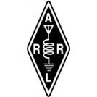

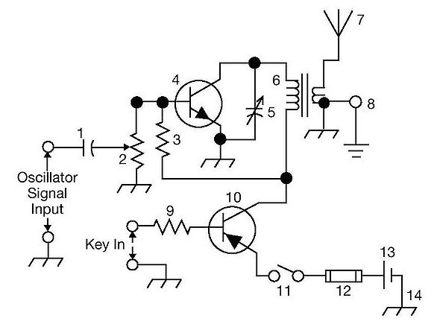
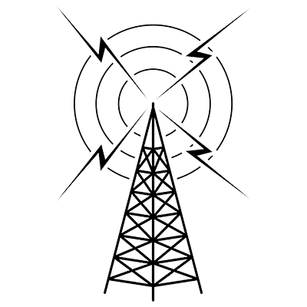
THE
ARRL
TENTH EDITION
GENERAL CLASS
LICENSE COURSE
FOR
HAM RADIO
All You Need to Pass Your General Class Exam!

Slide 2


Resource & Reference
www.arrl.org/shop/Licensing-Education-and-Training

Slide 3
Chapter 7 Part 1 of 2
ARRL General Class
Antennas
Sections 7.1, 7.2
Dipoles, Ground-planes, Yagi Antennas

Slide 4
Section 7.1 – Dipoles & Ground-planes
Dipoles
The most fundamental antenna
Straight conductor that is 1⁄2 wavelength (λ/2) long with feed point in the middle (referred to as a doublet)
Strongest radiation direction is broadside to its axis in a plane containing the antenna’s conductor
Weakest radiation is off the ends (see Fig 7.1)
Shape of azimuth pattern for a dipole in free space is a figure 8

Slide 5
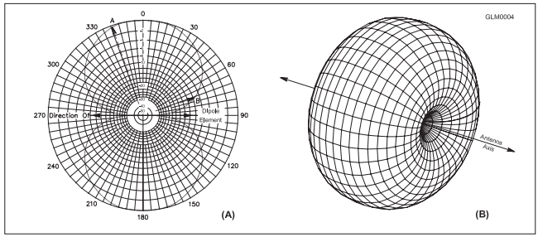
Fig 7.1
Part A shows the radiation pattern in the plane of a dipole located in free space. The dipole element is located on the line from 270 to 90 degrees in this figure. Part B shows the three-dimensional radiation pattern in all directions around the dipole.

Slide 6
Dipoles (cont.)
Dipole is often used as reference antenna for gain measurements
  Gain measured in dBd
  Isotropic antenna as the reference, gain is given in dBi
    Isotropic (theoretical) antenna: radiates equally in all directions
  Convert dBd to dBi by adding 2.15 dB
  Convert dBi to dBd by subtracting 2.15 dB
Current in half-wave dipole is highest in middle, Ø at ends; voltage along dipole is highest at ends and lowest in middle (Fig 7.2)

Slide 7
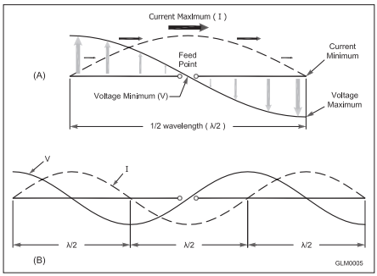
Fig 7.2
The half-wave dipole at A has its maximum current in the middle and maximum voltage at each end. Feed point impedance is lowest in the middle. At odd harmonics of the fundamental frequency, the dipole’s feed point impedance is low at the midpoint once again as shown at B.

Slide 8
Dipoles (cont.)
Impedance increases as feed point is moved away from the center; several thousand ohms at the ends
Example: End-fed half-wave (EFHW) antenna … popular for portable operating (lightweight and easy to install)
  EFHW is just a half-wave dipole fed at one end
Calculating free-space length …
  In free space, 1⁄2 wavelength in feet equals 492 divided by frequency in MHz
  CAUTION: You will generally find that the length will be SHORTER than the free-space wavelength calculation. However, exam questions won’t require you to answer the exceptions. Just be aware that wire thickness and height above ground influence the resonant length.
Length (ft) = 492 / frequency (MHz)

Slide 9
Example: What is the approximate length in feet of a 1/2-wave dipole resonant at 3.550 MHz?
$Free Space Length= \frac{492}{frequency (MHz)}$ = $\frac{492}{3.55}$ = 139 ft
Remember, the actual antenna will be a little shorter than this. But, build it to the calculation, and use your tuner to tell you if it needs trimmed. Ideally, you want SWR as close to 1:1 as you can get without tuning.

Slide 10
Example: What is the approximate length in feet of a 1⁄2-wave dipole for 14.250 MHz?
$Free Space Length= \frac{492}{frequency (MHz)}$ = $\frac{492}{14.25}$ = 34.5 ft

Slide 11
Dipoles (cont.)
Center-fed dipoles are easiest to use on the band for which they are resonant
The feed point impedance is a good match for 50 or 75-Ω coax and for coax on odd multiples of the fundamental frequency
A dipole doesn’t need to be straight to be effective
  Dipole can be supported in the center where the feed line can be conveniently attached
  This configuration is called an inverted V
  As long as the legs of the dipole form an angle of 90 degrees or more, the inverted V is nearly as effective as a horizontally installed dipole

Slide 12
Ground Plane Verticals
The ground-plane antenna is one-half of a dipole with the missing portion made up by an electrical mirror, called the ground plane
  Made from sheet metal or a screen of radial wires
  Basic ground-plane is 1⁄4-wavelength (λ/4) long with feed point at the junction of antenna and ground plane
For HF ground-plane antennas at ground level, radial wires are laid on surface of ground or buried within a few inches of surface

Slide 13
Ground Plane Verticals (cont.)
Ground-planes are called verticals because that’s the usual way of constructing and installing them
Ground-plane radiates best broadside to its axis
If installed vertically, the ground-plane antenna’s pattern is omnidirectional, uniform in all azimuth angles or directions
  Useful for VHF and UHF mobile/portable communications where signals may come from any direction

Slide 14
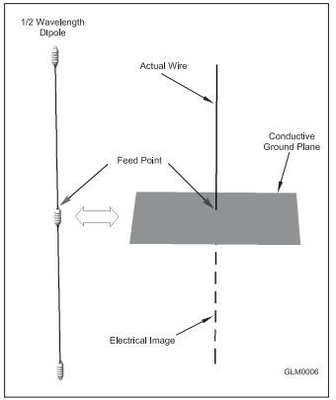
Fig 7.3: Ground Plane
The ground plane, whether made of solid metal or radial wires, creates an electrical mirror image of the 1⁄4-wavelength antenna. This creates the electrical equivalent of a dipole antenna.
The feed point impedance at the base of the ideal ground-plane is 35 Ω, half of a complete dipole’s impedance, because only half of the antenna is physically there and able to radiate energy.

Slide 15
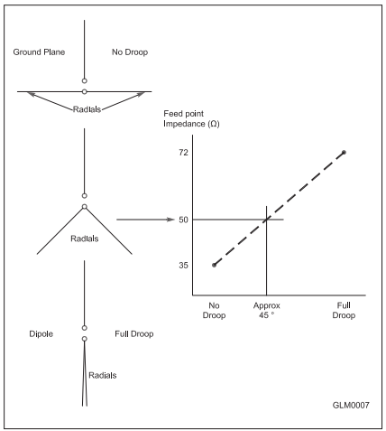
Fig 7.4: Ground Plane
The feed point impedance of a ground-plane antenna with radials perpendicular to the antenna is approximately 35 Ω, resulting in a 1.4:1 SWR with 50-Ω coaxial cable. Drooping or sloping the radials gradually raises the feed point impedance until, with the radials drooped so far as to become the other half of a dipole, feed point impedance becomes 72 Ω. A 50-Ω feed point is reached with radials drooping approximately 45 degrees.

Slide 16
Ground Planes (cont.)
A droop angle between 30 and 45 degrees as shown in Fig 7.4 results in the feed point impedance increasing to approx. 50 Ω (matches coaxial cable)
As with the dipole, it is not useful to provide a one-size-fits-all formula for length of a ground-plane antenna
Since the ground-plane is one-half the size of a dipole, start with one-half the free-space length (246 / f in MHz) and be prepared to trim the antenna’s length

Slide 17

Example: What is the approximate length in feet of a 1⁄4-wave monopole antenna cut for 28.5 MHz?
$$Free Space Length= \frac{246}{f}= \frac{246}{28.5}=8.6 ft$$

Slide 18
Mobile HF Antennas
Mobile HF antennas are often some form of ground-plane
  Most popular is the vertically-oriented whip
A full-sized λ/4 mobile whip is not feasible on bands below 28 and 24 MHz (too long)
Loading techniques are used to increase their electrical length
  Loading coils: A coil added at base or somewhere along the length
  Capacitance hats: Spokes or a wheel-shaped structure is added near the top of the antenna
  Linear loading: Part of the antenna is folded back on itself

Slide 19
Mobile HF Antennas (cont.)
Another common feature on mobile whips is corona ball at the tip
  Does add a small amount of loading capacitance, but primary function is to eliminate high-voltage discharges from the sharp tip of the antenna while transmitting
A loaded antenna is not as efficient as a full-sized straight whip and will have a small operating bandwidth without retuning
The screwdriver antenna design — a whip with an adjustable loading coil at the base (changes the inductance) — has gained popularity for HF mobile operation as a good compromise between performance and convenience

Slide 20
Effects of Ground
A dipole’s feed point impedance and radiation pattern are both affected by its physical height above ground
Feed point impedance is affected because the electrical image is electrically reversed from the actual dipole
As the image and antenna get closer together, the actual antenna begins to be “shorted out” by the image
Below 1⁄4 wavelength in height, dipole’s feed point impedance steadily decreases until it is close to Ø at ground level

Slide 21
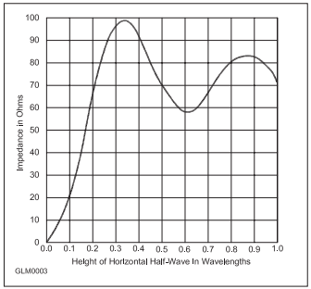
Fig 7.5
The feed point impedance of a horizontal
dipole over perfect ground varies dramatically with height. At ground level, the antenna is effectively “shorted out” by its electrical image. As the antenna is raised, the impedance gradually approaches the 72-Ω feed point impedance of a dipole in free space.
Above 1⁄4 λ, the impedance varies as suggested by Figure 7.5, eventually reaching a stable value at a height of several wavelengths.

Slide 22
Effects of Ground (cont.)
Height above ground also affects radiation patterns because of reflection of the antenna’s radiated energy by the ground
The direct and reflected signals take different amounts of time to travel to the receiving antenna so they can add together, cancel each other, or any combination in between
Fig 7.6 shows what happens when a dipole is raised in steps from a very low height to more than one wavelength above ground

Slide 23
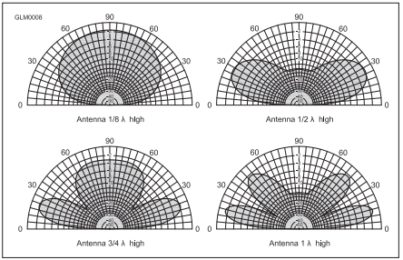
Fig 7.6
As a low dipole starting at 1⁄8 wavelength above ground is
raised, the effects of its electrical ground image cause the elevation pattern to flatten out. At multiples of 1/2 wavelength in height, the pattern has a null in the vertical direction because the direct and reflected signals cancel.
At heights below 1⁄2 wavelength, the dipole’s pattern is almost omnidirectional and is maximum straight up.

Slide 24
NVIS Propagation
Near-vertical incidence sky-wave propagation are signals that go straight up
Signals radiated at high vertical angles on low frequencies are usually reflected back to the ground over a wide area, ensuring good communication
Horizontal dipoles from 1⁄10 to 1⁄4 wavelength high produce an omnidirectional, high-angle pattern ideal for NVIS use
Used by many public service teams

Slide 25
Effects of Ground (cont.)
Polarization also affects the amount of signal that is lost from the resistance of the ground
Radio waves reflecting from the ground have lower losses when the polarization of the wave is parallel to the ground (i.e., horizontally polarized)
Because the radiation pattern is made up of reflected waves combining with direct waves that are not reflected, lower reflection loss results in stronger maximum signal strength

Slide 26
Antenna Terms
Feed point impedance: Ratio of RF voltage to current at an antenna’s feed point
Resonant: When antenna feed point impedance is completely resistive with no reactance
Radiation pattern: Graph of antenna’s signal strength in every direction or at every vertical angle
Azimuthal pattern: Shows signal strength in horizontal directions
Elevation pattern: Shows signal strength in vertical directions
Lobes: Regions in the radiation pattern where antenna is radiating a signal
Nulls: Points at which radiation is at a minimum between lobes
Isotropic antenna: Radiates equally in every possible direction (theoretical only)
Omnidirectional antenna: Radiates a signal equally in every horizontal direction
Directional antenna: Radiates preferentially in one or more directions
Gain: Concentrating transmitted or received signals in a specific direction
Front-to-back ratio: Ratio of gain in the preferred or forward direction to the opposite direction
Front-to-side ratio: Ratio of gain in the preferred or forward direction to directions at right angles

Slide 27
PRACTICE QUESTIONS

Slide 28
What is the purpose of a capacitance hat on a mobile antenna?
To increase the power handling capacity of a whip antenna
To reduce radiation resistance
To electrically lengthen a physically short antenna
To lower the radiation angle
G4E01 (C) Page 7-6
28

Slide 29
What is the purpose of a corona ball on an HF mobile antenna?
To narrow the operating bandwidth of the antenna
To increase the “Q” of the antenna
To reduce the chance of damage if the antenna should strike an object
To reduce RF voltage discharge from the tip of the antenna while transmitting
G4E02 (D) Page 7-6
29

Slide 30
What is one disadvantage of using a shortened mobile antenna as opposed to a full-size antenna?
Short antennas are more likely to cause distortion of transmitted signals
Q of the antenna will be very low
Operating bandwidth may be very limited
Harmonic radiation may increase
G4E06 (C) Page 7-6
30

Slide 31
Which of the following is a common way to adjust the feed point impedance of an elevated quarter-wave ground-plane vertical antenna to be approximately 50 ohms?
Slope the radials upward
Slope the radials downward
Lengthen the radials beyond one wavelength
Coil the radials
G9B02 (B) Page 7-5
31

Slide 32
Which of the following best describes the radiation pattern of a quarter-wave ground-plane vertical antenna?
Bi-directional in azimuth
Isotropic
Hemispherical
Omnidirectional in azimuth
G9B03 (D) Page 7-5
32

Slide 33
What is the radiation pattern of a dipole antenna in free space in a plane containing the conductor?
It is a figure-eight at right angles to the antenna
It is a figure-eight off both ends of the antenna
It is a circle (equal radiation in all directions)
It has a pair of lobes on one side of the antenna and a single lobe on the other side
G9B04 (A) Page 7-3
33

Slide 34
How does antenna height affect the azimuthal radiation pattern of a horizontal dipole HF antenna at elevation angles higher than about 45 degrees?
If the antenna is too high, the pattern becomes unpredictable
Antenna height has no effect on the pattern
If the antenna is less than 1/2 wavelength high, the azimuthal pattern is almost omnidirectional
If the antenna is less than 1/2 wavelength high, radiation off the ends of the wire is eliminated
G9B05 (C) Page 7-7
34

Slide 35
Where should the radial wires of a ground-mounted vertical antenna system be placed?
As high as possible above the ground
Parallel to the antenna element
On the surface or buried a few inches below the ground
At the center of the antenna
G9B06 (C) Page 7-5
35

Slide 36
How does the feed point impedance of a horizontal 1/2 wave dipole antenna change as the antenna height is reduced to 1/10 wavelength above ground?
It steadily increases
It steadily decreases
It peaks at about 1/8 wavelength above ground
It is unaffected by the height above ground
G9B07 (B) Page 7-6
36

Slide 37
How does the feed point impedance of a 1/2 wave dipole change as the feed point is moved from the center toward the ends?
It steadily increases
It steadily decreases
It peaks at about 1/8 wavelength from the end
It is unaffected by the location of the feed point
G9B08 (A) Page 7-3
37

Slide 38
Which of the following is an advantage of a horizontally polarized as compared to a vertically polarized HF antenna?
Lower ground losses
Lower feed point impedance
Shorter radials
Lower radiation resistance
G9B09 (A) Page 7-7
38

Slide 39
What is the approximate length for a 1/2 wave dipole antenna cut for 14.250 MHz?
8 feet
16 feet
24 feet
33 feet
Reminder: Length of ½ wave dipole is 492 / f in MHz
Length = 492 / 14.25 = 34.5 feet
No exact match, so closest choice is D.
G9B10 (D) Page 7-4
39

Slide 40
What is the approximate length for a 1/2 wave dipole antenna cut for 3.550 MHz?
42 feet
84 feet
132 feet
263 feet
Reminder: Length of ½ wave dipole is 492 / f in MHz
Length = 492 / 3.55 = 139 feet
No exact match, so closest choice is C.
G9B11 (C) Page 7-4
40

Slide 41
What is the approximate length for a 1/4 wave vertical antenna cut for 28.5 MHz?
8 feet
11 feet
16 feet
21 feet
Reminder: Length of ½ wave dipole is 492 / f in MHz
So, ¼ wave dipole is half that … 246 / f
Length = 246 / f = 246 / 28.5 = 8.6 feet
No exact match, so closest choice is A.
G9B12 (A) Page 7-5
41

Slide 42
How does antenna gain stated in dBi compare to gain stated in dBd for the same antenna?
Gain in dBi is 2.15 dB lower
Gain in dBi is 2.15 dB higher
Gain in dBd is 1.25 dBd lower
Gain in dBd is 1.25 dBd higher
G9C04 (B) Page 7-3
42

Slide 43
Which of the following antenna types will be most effective as a near vertical incidence skywave (NVIS) antenna for short-skip communications on 40 meters during the day?
A horizontal dipole placed between 1/10 and 1/4 wavelength above the ground
A vertical antenna placed between 1/4 and 1/2 wavelength above the ground
A horizontal dipole placed at approximately 1/2 wavelength above the ground
A vertical dipole placed at approximately 1/2 wavelength above the ground
G9D01 (A) Page 7-7
43

Slide 44
What is the feed point impedance of an end-fed half-wave antenna?
Very low
Approximately 50 ohms
Approximately 300 ohms
Very high
G9D02 (D) Page 7-4
44

Slide 45
How does a “screwdriver” mobile antenna adjust its feed point impedance?
By varying its body capacitance
By varying the base loading inductance
By extending and retracting the whip
By deploying a capacitance hat
G9D08 (B) Page 7-6
45

Slide 46
What is the common name of a dipole with a single central support?
Inverted V
Inverted L
Sloper
Lazy H
G9D12 (A) Page 7-4
46

Slide 47
Section 7.2
Yagi/Directional Antenna Basics
Directional antennas create gain as well as reject interference and noise from other than the desired direction
By aiming your antenna in the direction shown on the azimuthal projection map, you will be beaming your signal directly at the other station
Dipole, ground-plane, and random wire antennas use a single radiating element
An array antenna uses two or more elements to create maximum field strength in a specific direction, called the main lobe or major lobe of the radiation pattern

Slide 48
Directional Antennas (cont.)
Two types of arrays: driven and parasitic
  Driven array: all of the antenna elements are connected to the transmitter and are called driven elements
  Parasitic array: one or more of the elements are not connected to the feed line but influence the antenna’s pattern by interacting with the radiated energy from the driven element(s)
Whether an array is driven or parasitic, its radiation pattern is determined by constructive and destructive interference
  If in phase, they will reinforce each other
  If out of phase, they will cancel

Slide 49
Yagi Structure
Most popular of all directional antennas because of simple construction & good performance
Yagi is a parasitic array with a single driven element and at least one parasitic element
The driven element (DE) is a resonant dipole, approximately 1⁄2 wavelength long
Parasitic elements placed in the direction of maximum gain are called directors and are slightly shorter than the driven element
Parasitic elements in the direction of minimum gain are called reflectors and are slightly longer than the driven element
The front-to-back ratio is the ratio of signal strength at the peak of the radiation pattern’s major lobe to that in exactly the opposite direction

Slide 50
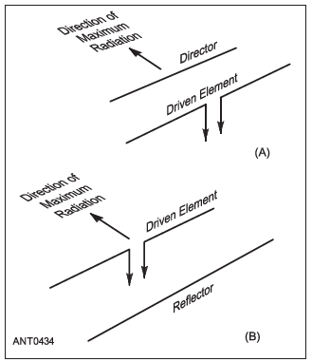
Figure 7.8 – Two Element Yagi
Two-element Yagi antenna with a single parasitic element. At A the parasitic element acts as a director, and at B as a reflector. The arrows show the direction of maximum radiation.

Slide 51
Yagi Design Tradeoffs – Typical Decisions
Primary variables for Yagi antennas are the length and diameter of each element and their placement along the boom of the antenna
These affect gain, SWR, and front-to-back ratio in different ways:
  More directors increase gain
  A longer boom with a fixed number of directors increases gain up to a maximum length beyond which gain is reduced
  Larger diameter elements reduce SWR variation with frequency (increases SWR bandwidth
  Placement and tuning of elements affects gain and feed point impedance (and SWR)
There are other general rules of cause-and-effect, but these are typical of the decisions that antenna designers (and purchasers) should consider

Slide 52
Yagi Impedance Matching
Most Yagi designs that have desirable radiation patterns also have a feed point impedance somewhat below 50 Ω (regular coax), with feed point impedance from 20 to 25 Ω … results in undesirable SWR (> 2:1)
Most common technique for matching impedance is gamma match (see Fig 7.9A in text)
  A short section of parallel-conductor transmission line that uses the driven element as one of its conductors. The transmission line transforms the low impedance of the feed point to a higher value. An adjustable capacitor — either an actual variable capacitor or a short piece of insulated wire inside a hollow gamma rod — is used to adjust the gamma match for an SWR of 1:1.
A mechanical advantage of the gamma match over other techniques is that the driven element need not be insulated from the boom, simplifying construction

Slide 53
Yagi Impedance Matching (cont.)
Beta match (or “hairpin”) … see Fig 7.9C in text: a short length or “stub” of parallel conductor transmission line connected directly across the driven element feed point
  The stub acts as an inductive reactance that can compensate for any capacitive reactance at the feed point
  The balun is used to maintain electrical balance between both halves of the driven element
Other techniques, such as the omega match, impedance transformers, and transmission line stubs are described in references such as The ARRL Antenna Book

Slide 54
PRACTICE QUESTIONS

Slide 55
Which of the following describes an azimuthal projection map?
A map that shows accurate land masses
A map that shows true bearings and distances from a specific location
A map that shows the angle at which an amateur satellite crosses the equator
A map that shows the number of degrees longitude that an amateur satellite appears to move westward at the equator with each orbit
G2D04 (B) Page 7-9
55

Slide 56
Which of the following would increase the bandwidth of a Yagi antenna?
Larger-diameter elements
Closer element spacing
Loading coils in series with the element
Tapered-diameter elements
G9C01 (A) Page 7-12
56

Slide 57
What is the approximate length of the driven element of a Yagi antenna?
1/4 wavelength
1/2 wavelength
3/4 wavelength
1 wavelength
G9C02 (B) Page 7-11
57

Slide 58
How do the lengths of a three-element Yagi reflector and director compare to that of the driven element?
The reflector is longer, and the director is shorter
The reflector is shorter, and the director is longer
They are all the same length
Relative length depends on the frequency of operation
G9C03 (A) Page 7-11
58

Slide 59
What is the primary effect of increasing boom length and adding directors to a Yagi antenna?
Gain increases
Beamwidth increases
Front-to-back ratio decreases
Resonant frequency is lower
G9C05 (A) Page 7-12
59

Slide 60
What does “front-to-back ratio” mean in reference to a Yagi antenna?
The number of directors versus the number of reflectors
The relative position of the driven element with respect to the reflectors and directors
The power radiated in the major lobe compared to that in the opposite direction
The ratio of forward gain to dipole gain
G9C07 (C) Page 7-11
60

Slide 61
What is meant by the “main lobe” of a directive antenna?
The magnitude of the maximum vertical angle of radiation
The point of maximum current in a radiating antenna element
The maximum voltage standing wave point on a radiating element
The direction of maximum radiated field strength from the antenna
G9C08 (D) Page 7-9
61

Slide 62
Which of the following can be adjusted to optimize forward gain, front-to-back ratio, or SWR bandwidth of a Yagi antenna?
The physical length of the boom
The number of elements on the boom
The spacing of each element along the boom
All these choices are correct
G9C10 (D) Page 7-12
62

Slide 63
What is a beta or hairpin match?
A shorted transmission line stub placed at the feed point of a Yagi antenna to provide impedance matching
A 1/4 wavelength section of 75-ohm coax in series with the feed point of a Yagi to provide impedance matching
A series capacitor selected to cancel the inductive reactance of a folded dipole antenna
A section of 300-ohm twin-lead transmission line used to match a folded dipole antenna
G9C11 (A) Page 7-12
63

Slide 64
Which of the following is a characteristic of using a gamma match with a Yagi antenna?
It does not require that the driven element be insulated from the boom
It does not require any inductors or capacitors
It is useful for matching multiband antennas
All these choices are correct
G9C12 (A) Page 7-12
64

Slide 65
END OF CHAPTER 7 PART 1 OF 2

Slide 66
Slides created by …
Jerry D. Kilpatrick
KØILP (Amateur Radio)
PGØØØ72373 (Commercial Operator)
K0ILP.NC@gmail.com
Feel free to contact me if you find errors or have suggestions for improvement.

