Slide 1
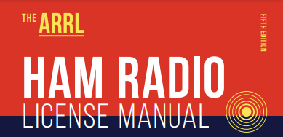
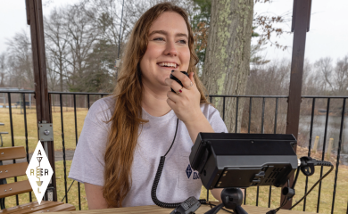

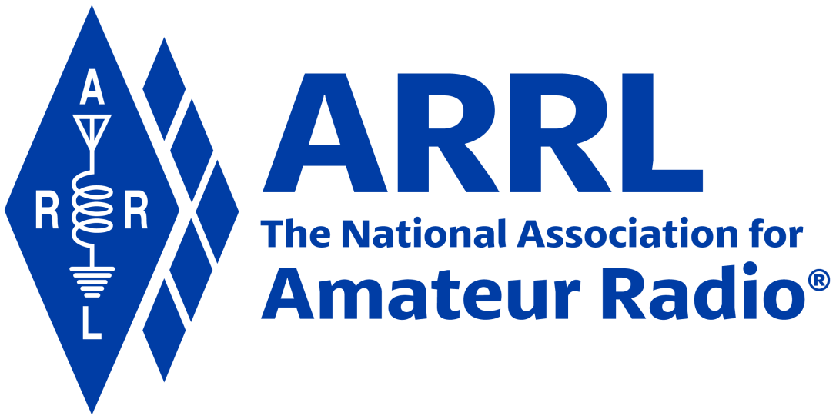
Amateur Radio Technician Exam Preparation Course

Slide 2
Amateur Radio Technician Exam Prep Course
Module 1

Slide 3
Course Overview
Welcome to Amateur Radio
Radio and Signals Fundamentals
Electricity, Components, and Circuits
Propagation, Antennas, and Feed Lines
Amateur Radio Equipment
Communicating With Other Hams
Licensing Regulations
Operating Regulations
Safety
Examination time (what you may not know)!
Notes:
Bullet 10 obviously isn’t a chapter in the manual. But, the reality is you’re taking this course to prepare you to PASS the Technician Class exam.
What you may not have considered is WHAT’S NEXT?
WHEN (not IF) you pass the tech exam, you are allowed to take the General Class examination at the same test session for free. You’ll find that the content between Technician and General to be somewhat similar … it’s just that General is a little more advanced. But, you may want to begin familiarizing yourself with General material by the time you get about halfway through this course. One ham radio club in North Carolina observed that about 50% of their students in this course were able to also pass the General exam on the same day. And, if you pass the General exam, you may take the Extra exam for free. But, beware! The Extra is challenging!

Slide 4
Let’s Get Started
Our goal during this class is for each of you to achieve the Technician class Amateur Radio license!
The license will authorize you to operate an Amateur Radio (ham radio) transmitter.

Slide 5
What is Amateur Radio?
Amateur (or Ham) Radio is a personal radio service authorized by the Federal Communications Commission (FCC)
  To encourage the advancement of the art and science of radio
  To promote the development of an emergency communication capability to assist communities when needed
  To develop a pool of trained radio operators
  To promote international goodwill by connecting private citizens in countries around the globe
Through ham radio, you will become an ambassador for your community and your country

Slide 6
More About Amateur Radio …
The Amateur Radio Service is governed by Part 97 of the FCC Rules and Regulations *
Anyone can be a ham radio operator, there is no age limit
Amateur Radio operators cannot accept payment of any type for operating their radio, whether money or other goods or services **
* The exact reference is “Title 47 Code of Federal Regulations (CFR) Part 97” or 47 CFR Part 97
** What if I want to get paid! You can … get a Commercial Radio Operator License …
https://www.fcc.gov/commercial-radio-operator-license-program

Slide 7
What Do Hams Do?
Communicate
Experiment
Build
Compete
Serve their communities
Engage in lifelong learning
Notes:
Many hams will focus on specific skills or services. For example, you might decide to become a CW (Morse Code) expert, and even compete during Field Day events. Or, you may be an educator and help ARRL or your local club develop training materials, just like this course. Some clubs, for example, volunteer entire teams of operators to provide communications for community events (such as Christmas parades, veterans marches, etc.).

Slide 8
What Makes Ham Radio Different?
There are many unlicensed radio services available (FRS, GMRS, etc.)
Amateur Radio is very flexible…
  Fewer restrictions
  More frequencies (channels or bands)
  More power (to improve range and quality)
  More ways to communicate
  It’s FREE to operate your radio!

Slide 9
With More Privileges Comes More Responsibility
Ham Radios are much more capable and have the potential of interfering with other radio services
Ham radios have unlimited reach, they easily reach around the globe and into space
FCC authorization is required to ensure the operator is qualified to operate safely, legally and appropriately – this is why you are here

Slide 10
Steps To Obtaining Your License
Study the material in the Ham Radio License manual (make sure you have the current edition)
Review the question pool (back of the book)
Take practice exams
  www.arrl.org/examreview
  www.qrz.com
Practice a proctored 35 question multiple choice test
  Questions pulled directly from the question pool
  Need to answer 26 questions correctly (miss 9)

Slide 11

END OF MODULE 1

