Slide 1
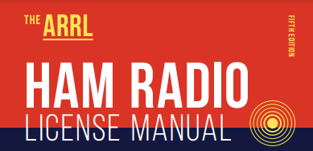
Amateur Radio Technician Exam Preparation Course

Slide 2
Amateur Radio Technician Exam Prep Course
Module 5
Amateur Radio Equipment
5.1 Modulation
5.2 Transmitters and Receivers
5.3 Digital Communications
5.4 Power Supplies and Batteries

Slide 3
Modulation & Bandwidth
Antenna
The Basic Radio Station
Feed line
Transceiver
TRANSMITTER
TR SWITCH
RECEIVER
POWER SUPPLY
Review from previous module

Slide 4
What Happens During Radio Communication?
Transmitting (sending a signal) …
Information (voice, data, video, commands, etc.) is converted to electronic form
The information in electronic form is added to a radio wave
The radio wave carrying the information is sent from the station antenna into space

Slide 5
What Happens During Radio Communication? (cont.)
Receiving …
The radio wave carrying the information is intercepted by the receiving station’s antenna
The receiver extracts the information from the received wave
The information is then presented to the user in a format that can be understood (sound, picture, words on a computer screen, response to a command, etc.)

Slide 6
What Happens During Radio Communication? (cont.)
Adding and extracting the information can be simple or complex
This makes ham radio fun … learning all about how radios work
Don’t be intimidated. You will be required to only know the basics, but you can learn as much about the “art and science” of radio as you want.

Slide 7
Adding Information – Modulation
When we add some information to the radio wave, (the carrier) we modulate the wave
Turn the wave on and off (Morse code)
Speech or music
Data
Different modulation techniques vary different properties of the wave to add the information:
Amplitude, frequency, or phase
A signal that doesn’t carry any information is called unmodulated
Recovering the information from a modulated signal is called demodulation

Slide 8
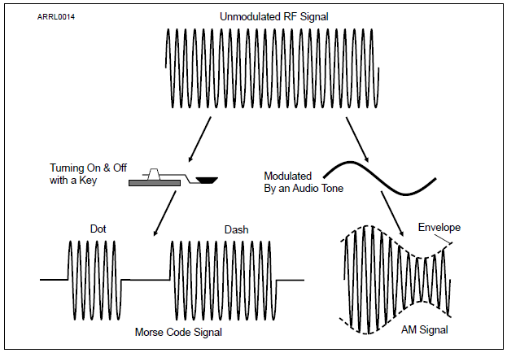
Continuous Wave (CW)
The simplest type of modulation is a continuous wave turned ON and OFF in a coded pattern
Morse code radio signals are called CW for that reason
Figure 5.1 — Information can be added to an RF signal by modulating the signal’s amplitude.

Slide 9
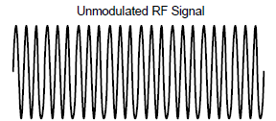
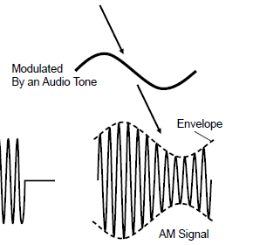
Amplitude Modulation (AM)
In AM, the amplitude of the carrier wave is modified in step with the waveform of the information (the tone shown here)
The information is contained in the outline or envelope of the resulting signal
Recovering speech or music from the envelope of an AM signal is called detection

Slide 10
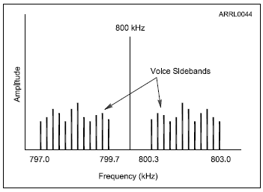
Composite Signals – Sidebands
An actual AM signal is made up of three separate signals working together — a carrier and two sidebands
The carrier is a steady, unmodulated signal
The upper sideband or USB signal is higher in frequency than the carrier
The lower sideband or LSB signal is lower in frequency than the carrier

Slide 11
SINGLE-SIDEBAND (SSB)
In an AM signal the carrier doesn’t carry any information
Each sideband contains a copy of the modulating signal
Only one sideband is needed to transmit the information
All of the SSB signal’s power is concentrated in the one sideband
SSB signals are effective for long-distance and weak signal voice contacts because of the additional power
The upper sideband (USB) is used on VHF and UHF
Both USB and LSB are used on the MF and HF bands

Slide 12
Frequency and Phase Modulation
Modes that vary the frequency of a signal to add speech or data information are called frequency modulation or FM
The frequency of an FM signal varies with the amplitude of the modulating signal
Phase modulation varies a signal’s phase instead of changing its frequency … in other words, very similar to FM
FM is the mode used by most VHF and UHF repeaters
Because of the way FM receivers work, only one signal can be received at a time. This is called the capture effect and if multiple signals are present, only the strongest will be heard in the receiver.

Slide 13
Bandwidth of Modulated Signals
A signal can have both a frequency and a strength or amplitude
Signals are spread out over a range of frequencies (called bandwidth)
You can communicate with SSB over much longer ranges and in poorer conditions than with FM or AM, particularly on the VHF and UHF bands
For even better range, extremely narrow CW signals are the easiest for a human operator to send and receive, particularly in noisy or fading conditions
CW and SSB are considered weak signal modes because they are more effective than FM at low signal strengths

Slide 14
Bandwidth of Modulated Signals (cont.)
If an SSB signal can use either an upper or lower sideband — which one should you use?
Ham radio has standardized on the following conventions …
Below 10 MHz, LSB
Above 10 MHz, USB — including all of the VHF and UHF bands
One exception: amateurs are required to use USB on the five channels of the 60 meter band (5 MHz)

Slide 15
PRACTICE QUESTIONS

Slide 16
What is CW?
A type of electromagnetic propagation
A digital mode used primarily on 2 meter FM
A technique for coil winding
Another name for a Morse code transmission
T8D09 D 5-2

Slide 17
Which of the following is a form of amplitude modulation?
Spread spectrum
Packet radio
Single sideband
Phase shift keying (PSK)
T8A01 C 5-3

Slide 18
What type of modulation is commonly used for VHF packet radio transmissions?
FM or PM
SSB
AM
PSK
T8A02 A 5-4

Slide 19
Which type of modulation is commonly used for VHF and UHF voice repeaters?
AM
SSB
PSK
FM or PM
T8A04 D 5-4

Slide 20
Which of the following is a disadvantage of FM compared with single sideband?
Voice quality is poorer
Only one signal can be received at a time
FM signals are harder to tune
All these choices are correct
T8A12 B 5-4

Slide 21
Which type of voice mode is often used for long-distance (weak signal) contacts on the VHF and UHF bands?
FM
DRM
SSB
PM
T8A03 C 5-4

Slide 22
Which of the following types of signal has the narrowest bandwidth?
FM voice
SSB voice
CW
Slow-scan TV
T8A05 C 5-4

Slide 23
Which sideband is normally used for 10 meter HF, VHF, and UHF single-sideband communications?
Upper sideband
Lower sideband
Suppressed sideband
Inverted sideband
T8A06 A 5-4

Slide 24
What is a characteristic of single sideband (SSB) compared to FM?
SSB signals are easier to tune in correctly
SSB signals are less susceptible to interference
SSB signals have narrower bandwidth
All these choices are correct
T8A07 C 5-4

Slide 25
What is the approximate bandwidth of a typical single sideband (SSB) voice signal?
1 kHz
3 kHz
6 kHz
15 kHz
T8A08 B 5-4

Slide 26
What is the approximate bandwidth of a VHF repeater FM voice signal?
Less than 500 Hz
About 150 kHz
Between 10 and 15 kHz
Between 50 and 125 kHz
T8A09 C 5-4

Slide 27
What is the approximate bandwidth of AM fast-scan TV transmissions?
More than 10 MHz
About 6 MHz
About 3 MHz
About 1 MHz
T8A10 B 5-4

Slide 28
What is the approximate bandwidth required to transmit a CW signal?
2.4 kHz
150 Hz
1000 Hz
15 kHz
T8A11 B 5-4

Slide 29
Transmitters and Receivers
Usually combined into one unit called a transceiver
Give you control of frequency and mode
Generalized categories
Mobile
Single band
Dual band
All band
Multi-mode
Handheld or HT

Slide 30
Single-Band Mobile
Single-band, 2 meter … good starter radio
Operates from 13.8 volts DC, requires external power supply or car battery
Requires an external antenna
Can be operated mobile or as a base station
Limited to frequency modulation (FM) and usually either 2 meters or 70 cm bands
Up to approximately 50 watts output
Typical frequencies: VHF/UHF FM

Slide 31
Dual-Band Mobile
Same as the single-band transceiver but includes additional band(s)
Most common are 2 meter and 70 cm bands
Often includes 6 meters, 222 MHz (1.25 meters) or 1.2 GHz bands
Might have separate antenna connections for each band or a single connection for a dual-band antenna
Up to approximately 50 watts output
Typical frequencies: VHF/UHF FM

Slide 32
Multimode Transceiver
Nearly all HF rigs are multimode
VHF multimode operates on FM plus AM/SSB/CW modes
Required for weak-signal operation on VHF/UHF
More features add complexity and cost
More flexibility will allow you to explore new modes as you gain experience (and increased license privileges)

Slide 33
Multiband Transceiver
Covers many bands – usually refers to coverage of HF + VHF/UHF
Also covers all modes
Frequently 100 watts on HF, some power limitations on high bands (25-50 watts)
Larger units have internal power supplies, smaller units need external power supply
Some have built-in “tuners”

Slide 34
Handheld (HT) Transceiver
Small handheld FM units
Can be single band or dual band
Limited power (usually 5 watts or less)
Includes power (battery) and antenna in one package
Often purchased as a starter rig but low power limits range
Single, dual and multiband versions (with increasing cost and complexity)
Some can receive outside the ham bands, such as aircraft, commercial FM broadcast, etc.

Slide 35
Handheld (HT) Transceiver (cont.)
Very portable and self-contained
Internal microphone and speaker
Rubber duck antenna
Battery powered
Extra battery packs
AA cell pack useful in emergencies
Drop-in, fast charger
Extended antenna
External microphone and speaker
Headset

Slide 36
Side-By-Side Comparison
 | SINGLE BAND | DUAL BAND | MULTIMODE | MULTIBAND | HANDHELD
FREQUENCY AGILITY | LIMITED | MEDIUM | MEDIUM | FULL | LIMITED
FUNCTION-ALITY | LIMITED | LIMITED | FULL | FULL | LIMITED
EASE OF USE | EASY | MEDIUM | MEDIUM | DIFFICULT | EASY
PROGRAM-MING | EASY | EASY | MEDIUM | CHALLENGING | EASY/MEDIUM
POWER | LOW | LOW | MEDIUM | HIGH | LOW
COST | LOW | MODEST | HIGH | HIGH | LOW

Slide 37
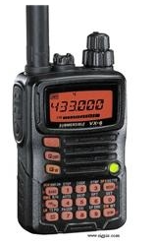
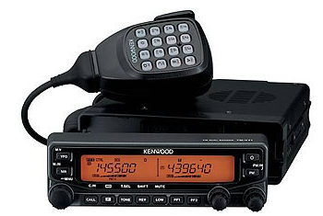
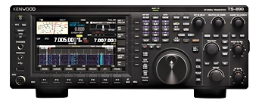
Sample Radios
HANDHELD (HT)
MULTIBAND
DUAL BAND

Slide 38
Selecting Band, Frequency and Mode
Two functions common to all radios …
Control of frequency and mode
Amateurs can use many different modes … most other radio services are restricted to a single mode
For multiband radios, begin by selecting the band
Then, select a frequency within the band (called tuning)
Uses the variable frequency oscillator (VFO) and/or keypad (directly enter frequencies)
Memories or memory channels are used to store frequencies and modes for later recall (quickly tune to frequently used frequencies)
For multimode radios, select the mode
SSB, AM, FM, CW, Data

Slide 39
Transmitter Functions
Transmitter output power
In HF rigs and radios using AM/SSB and CW, controlled by an RF power control knob
FM handheld and mobile radios have selectable fixed power levels
Microphone gain controls the level of speech audio of SSB transmitters
FM transmitters usually have a fixed microphone gain
Switching between receive and transmit on voice …
Manual: Use push-to-talk (PTT) button
Automatic: Voice-operated transmitter control circuit (VOX)
On CW (Morse Code), use a key (an electronic keyer is faster than manual)
Use a dummy load to avoid interfering with other stations while you’re adjusting transmitter (heavy duty resistor that can absorb and dissipate output power)

Slide 40
Spurious Signals
Excessive modulation results in distortion of transmitted speech (spurious outputs on adjacent frequencies) … called splatter
Overmodulated FM signal has excessive deviation (overdeviating)
Usually caused by speaking too loudly into the microphone
Overmodulation of an AM or SSB signal is caused by speaking too loudly or by setting the microphone gain or speech compression too high

Slide 41
Receiver Functions
AF Gain: Volume control (sets speaker or headphone listening level)
RF Gain: Adjusts the sensitivity of the receiver to incoming signals
Automatic Gain Control (AGC): Adjusts sensitivity to keep the output volume constant for both weak and strong signals
Squelch: Mutes the receiver’s audio output when no signal is present (eliminates continuous noise)
Many transceivers have a monitor switch that temporarily opens the squelch to hear weak signals

Slide 42
Selectivity and Sensitivity
Receivers are compared on the basis of two primary characteristics: sensitivity and selectivity
Sensitivity determines receiver’s ability to detect signals
Specified as a minimum detectable signal level (in µV)
A preamplifier (preamp) is used to boost sensitivity
Selectivity is the ability of a receiver to discriminate between signals
High selectivity means that a receiver can operate properly even in the presence of strong signals on nearby frequencies

Slide 43
Filtering and Tuning
A receiver rejects unwanted signals through the use of filters
Signals then pass through filters narrow enough (i.e., smaller bandwidth) to reject all but the desired signal
Wide filters (around 2.4 kHz) are used for SSB reception
Narrow filters (around 500 Hz) are used for CW and data mode
Multiple filters allows you to reduce noise or interference by selecting a filter with just enough bandwidth to pass the desired signal
Receiver incremental tuning (RIT … also called clarifier) is a fine-tuning control used for SSB or CW
Allows you to tune in a station that is slightly off frequency or to adjust the pitch of an operator’s voice that seems too high or low

Slide 44
VHF/UHF RF Power Amplifiers
RF power amplifiers can be used to increase the output power by a factor of five or more
Many VHF/UHF power amplifiers can be used on all modes (including SSB and CW … switch between modes)
Caution 1: Be sure your antenna is capable of handling the higher power!
Caution 2: Be sure you learn about RF exposure!

Slide 45
Transverters
By using mixers, it is possible to convert an entire transceiver to operate on a different band
Mixers are part of equipment called a transverter
A receiving converter mixer shifts input signals to the desired band where they are received as regular signals by the transceiver
Transverters allow one main transceiver to be used on one or more new bands

Slide 46
PRACTICE QUESTIONS

Slide 47
Which of the following can be used to enter a transceiver’s operating frequency?
The keypad or VFO knob
The CTCSS or DTMF encoder
The Automatic Frequency Control
All these choices are correct
T4B02 A 5-5

Slide 48
What is a way to enable quick access to a favorite frequency or channel on your transceiver?
Enable the frequency offset
Store it in a memory channel
Enable the VOX
Use the scan mode to select the desired frequency
T4B04 B 5-5

Slide 49
What is an electronic keyer?
A device for switching antennas from transmit to receive
A device for voice activated switching from receive to transmit
A device that assists in manual sending of Morse code
An interlock to prevent unauthorized use of a radio
T4A12 C 5-7

Slide 50
What is the function of a transceiver’s PTT input?
Input for a key used to send CW
Switches transceiver from receive to transmit when grounded
Provides a transmit tuning tone when grounded
Input for a preamplifier tuning tone
T7A07 B 5-7

Slide 51
What is the primary purpose of a dummy load?
To prevent transmitting signals over the air when making tests
To prevent over-modulation of a transmitter
To improve the efficiency of an antenna
To improve the signal-to-noise ratio of a receiver
T7C01 A 5-7

Slide 52
What does a dummy load consist of?
A high-gain amplifier and a TR switch
A non-inductive resistor mounted on a heat sink
A low-voltage power supply and a DC relay
A 50-ohm reactance used to terminate a transmission line
T7C03 B 5-7

Slide 53
What would cause your FM transmission audio to be distorted on voice peaks?
Your repeater offset is inverted
You need to talk louder
You are talking too loudly
Your transmit power is too high
T2B05 C 5-8

Slide 54
What is the effect of excessive microphone gain on SSB transmissions?
Frequency instability
Distorted transmitted audio
Increased SWR
All these choices are correct
T4B01 B 5-8

Slide 55
What can you do if you are told your FM handheld or mobile transceiver is over-deviating?
Talk louder into the microphone
Let the transceiver cool off
Change to a higher power level
Talk farther away from the microphone
T7B01 D 5-8

Slide 56
What is the purpose of a squelch function?
Reduce a CW transmitter’s key clicks
Mute the receiver audio when a signal is not present
Eliminate parasitic oscillations in an RF amplifier
Reduce interference from impulse noise
T2B13 B 5-8

Slide 57
How is squelch adjusted so that a weak FM signal can be heard?
Set the squelch threshold so that receiver output audio is on all the time
Turn up the audio level until it overcomes the squelch threshold
Turn on the anti-squelch function
Enable squelch enhancement
T4B03 A 5-8

Slide 58
Which term describes the ability of a receiver to detect the presence of a signal?
Linearity
Sensitivity
Selectivity
Total Harmonic Distortion
T7A01 B 5-9

Slide 59
Which term describes the ability of a receiver to discriminate between multiple signals?
Discrimination ratio
Sensitivity
Selectivity
Harmonic distortion
T7A04 C 5-9

Slide 60
Where is an RF preamplifier installed?
Between the antenna and receiver
At the output of the transmitter power amplifier
Between the transmitter and the antenna tuner
At the output of the receiver audio amplifier
T7A11 A 5-9

Slide 61
Which of the following controls could be used if the voice pitch of a single-sideband signal returning to your CQ call seems too high or low?
The AGC or limiter
The bandwidth selection
The tone squelch
The RIT or Clarifier
T4B06 D 5-9

Slide 62
What is the advantage of having multiple receive bandwidth choices on a multimode transceiver?
Permits monitoring several modes at once by selecting a separate filter for each mode
Permits noise or interference reduction by selecting a bandwidth matching the mode
Increases the number of frequencies that can be stored in memory
Increases the amount of offset between receive and transmit frequencies
T4B08 B 5-9

Slide 63
Which of the following receiver filter bandwidths provides the best signal-to-noise ratio for SSB reception?
500 Hz
1000 Hz
2400 Hz
5000 Hz
T4B10 C 5-9

Slide 64
What is the result of tuning an FM receiver above or below a signal’s frequency?
Change in audio pitch
Sideband inversion
Generation of a heterodyne tone
Distortion of the signal’s audio
T4B12 D 5-9

Slide 65
What is the function of the SSB/CW-FM switch on a VHF power amplifier?
Change the mode of the transmitted signal
Set the amplifier for proper operation in the selected mode
Change the frequency range of the amplifier to operate in the proper segment of the band
Reduce the received signal noise
T7A09 B 5-10

Slide 66
What device increases the transmitted output power from a transceiver?
A voltage divider
An RF power amplifier
An impedance network
All these choices are correct
T7A10 B 5-10

Slide 67
What device converts the RF input and output of a transceiver to another band?
High-pass filter
Low-pass filter
Transverter
Phase converter
T7A06 C 5-11

Slide 68
Digital Communications
Why use digital modes?
Special codes and characters embedded in the stream of data allow the receiving modem to detect [and correct] errors
Amateurs have developed or adapted techniques for exchanging digital data by transforming the 1s and 0s of data into tones that are in the same frequency range as the human voice

Slide 69
Amateur Digital Modes
Different combinations of protocols, codes, and modulation, such as SSB or FM, are used to create digital modes
Popular HF digital modes
RTTY (radioteletype)
PSK31 (keyboard-to-keyboard)
FT8 and WSPR (weak signal modes)
PACTOR or WINMOR (for Winlink messaging)
Popular VHF/UHF digital modes
Packet radio
B2F protocol (for Winlink)
JT65 for moon-bounce and MSK144 for scatter paths
IEEE 802.11 (Wi-Fi) adapted to amateur use on microwave bands
Popular Voice digital modes
AOR and FreeDV (HF)
D-STAR, System Fusion (C4FM), DMR, and P25 (VHF/UHF)

Slide 70
Packet and Packet Networks
On VHF and UHF, the most common digital mode is packet radio
Data characters are transmitted in groups called packets
Frequency-shift keying (FSK) is used to transmit individual characters
Each packet consists of a header, data, and checksum
If an error is detected, the receiver automatically requests the packet be retransmitted until the data is received properly (ARQ or automatic repeat request)

Slide 71
Keyboard-to-Keyboard Modes
Digital modes that are designed for real-time person-to-person communication are called keyboard-to-keyboard modes
Most popular on HF bands
Most are generated by computer software using a sound card and an interface to a transceiver’s audio input and output
Radioteletype (RTTY) is the oldest
Most popular is PSK31 (phase shift keying, 31 baud)
Works very well in noisy conditions

Slide 72
Automatic Packet Reporting System (APRS)
Uses packet radio to transmit the position information from a moving or portable station
Basically a packet radio station combined with a Global Positioning System (GPS) receiver … can transmit GPS position data
Can also transmit weather information and short text messages
A common public service application of APRS is to provide maps of station locations while they are providing real-time tactical communications

Slide 73
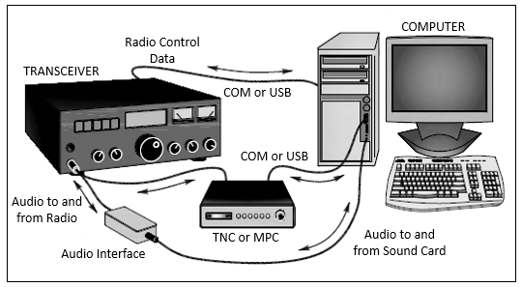
Setting Up For Digital Modes
Data interfaces are connected between the transceiver’s audio inputs and outputs and the computer’s data connections (USB or COM ports) or sound card jacks. A TNC or MPC (multiprotocol controller) converts between data and audio. An audio interface isolates the computer sound card from the radio to prevent hum.
Figure 5.10 … Typical Digital Mode Set Up

Slide 74
Setting Up For Digital Modes (cont.)
A very popular example of a “sound card mode” is FT8
If you use a sound card, you may need a digital communications interface to supply the PTT (push-to-talk) signal for keying the transmitter

Slide 75
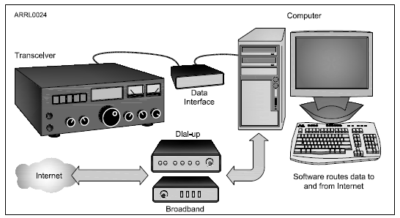
Gateways
An internet gateway station is a regular digital mode station and also runs software that relays data to and from the internet. The most common example of gateway stations are APRS gateways and Winlink RMS stations.
Figure 5.11 … Typical Gateway Set Up

Slide 76
Gateways (cont.)
The gateway shown in Figure 5.11 is a special kind of digital station that provides a connection to the internet via Amateur Radio
Most gateways are set up to forward messages
All of the rules and regulations about commercial and business-related messages and communications apply to internet gateways (follow the Amateur Radio rules)

Slide 77
PRACTICE QUESTIONS

Slide 78
Which of the following is a digital communications mode?
Packet radio
IEEE 802.11
FT8
All these choices are correct
T8D01 D 5-11

Slide 79
Which of the following best describes an amateur radio mesh network?
An amateur-radio based data network using commercial Wi-Fi equipment with modified firmware
A wide-bandwidth digital voice mode employing DMR protocols
A satellite communications network using modified commercial satellite TV hardware
An internet linking protocol used to network repeaters
T8D12 A 5-12

Slide 80
Which of the following operating activities is supported by digital mode software in the WSJT-X software suite?
Earth-Moon-Earth
Weak signal propagation beacons
Meteor scatter
All these choices are correct
T8D10 D 5-12

Slide 81
What is FT8?
A wideband FM voice mode
A digital mode capable of low signal-to-noise operation
An eight channel multiplex mode for FM repeaters
A digital slow-scan TV mode with forward error correction and automatic color compensation
T8D13 B 5-12

Slide 82
Which of the following is included in packet radio transmissions?
A check sum that permits error detection
A header that contains the call sign of the station to which the information is being sent
Automatic repeat request in case of error
All these choices are correct
T8D08 D 5-12

Slide 83
What is an ARQ transmission system?
A special transmission format limited to video signals
A system used to encrypt command signals to an amateur radio satellite
An error correction method in which the receiving station detects errors and sends a request for retransmission
A method of compressing data using autonomous reiterative Q codes prior to final encoding
T8D11 C 5-12

Slide 84
What does the abbreviation “PSK” mean?
Pulse Shift Keying
Phase Shift Keying
Packet Short Keying
Phased Slide Keying
T8D06 B 5-13

Slide 85
What kind of data can be transmitted by APRS?
GPS position data
Text messages
Weather data
All these choices are correct
T8D03 D 5-13

Slide 86
Which of the following is an application of APRS?
Providing real-time tactical digital communications in conjunction with a map showing the locations of stations
Showing automatically the number of packets transmitted via PACTOR during a specific time interval
Providing voice over internet connection between repeaters
Providing information on the number of stations signed into a repeater
T8D05 A 5-13

Slide 87
How are the transceiver audio input and output connected in a station configured to operate using FT8?
To a computer running a terminal program and connected to a terminal node controller unit
To the audio input and output of a computer running WSJT-X software
To an FT8 conversion unit, a keyboard, and a computer monitor
To a computer connected to the FT8converter.com website
T4A04 B 5-14

Slide 88
What signals are used in a computer-radio interface for digital mode operation?
Receive and transmit mode, status, and location
Antenna and RF power
Receive audio, transmit audio, and transmitter keying
NMEA GPS location and DC power
T4A06 C 5-14

Slide 89
Which of the following connections is made between a computer and a transceiver to use computer software when operating digital modes?
Computer “line out” to transceiver push-to-talk
Computer “line in” to transceiver push-to-talk
Computer “line in” to transceiver speaker connector
Computer “line out” to transceiver speaker connector
T4A07 C 5-14

Slide 90
What is an amateur radio station that connects other amateur stations to the internet?
A gateway
A repeater
A digipeater
A beacon
T8C11 A 5-15

Slide 91
Power Supplies
A solid power source is important for a clean, noise-free transmitted signal and better reception
Converts the AC input power to DC current for the radio equipment
Two main ratings:
Output voltage
Amount of current it can supply continuously
Radios that operate from a “12 V” supply may actually work best at the slightly higher voltage of 13.8 V typical of vehicle power systems with the engine running
If you don’t know the amount of current a radio can draw … divide output power by input voltage, then double the resulting current value and round up to the nearest amp (generally, anything above 8A will work for a 50-watt mobile rig)

Slide 92
Power Supplies (cont.)
A supply’s output voltage changes with the amount of output current
A regulated supply uses a regulator circuit to minimize the amount of voltage change
If more than just one piece of equipment is hooked up to the supply and turned on at the same time, add all of the equipment maximum current needs together

Slide 93
Mobile Power Wiring
Radio equipment can draw large currents when transmitting
If wire is too thin, its resistance (R) will create a voltage drop (V = I × R)
The resulting lower voltage at the radio can cause it to operate improperly (distorting output signal or creating interference)
General guidelines for mobile wiring …
Fuse should be present in both the positive and negative leads of your radio
Connect the radio’s negative lead to the negative battery terminal or where the battery ground lead is connected to the vehicle body
Use grommets or sleeves to protect wiring from chafing or rubbing on exposed metal
Don’t assume all metal is connected to the battery’s negative terminal

Slide 94
Batteries
Batteries are made up of one or more cells
How long will a fully-charged battery power your equipment? Check out Table 5.3 (next slide) …
Divide the energy rating in ampere-hours (Ah) by the total current needs of the equipment. Remember to use average current draw for transceivers since you won’t be transmitting all the time.
Storage batteries are often used as an emergency power source … cautions:
Contain strong acids that can be hazardous if spilled or allowed to leak
Can release or vent flammable hydrogen gas, that can cause an explosion
Accidentally short-circuiting a storage battery with a tool or faulty wiring can easily cause a fire and damage the battery

Slide 95
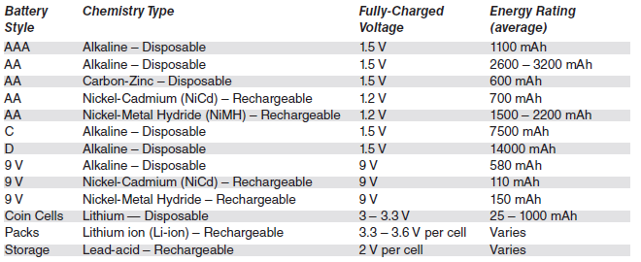
Table 5.3: Battery Types and Characteristics
(most common types used by hams)

Slide 96
PRACTICE QUESTIONS

Slide 97
Which of the following is an appropriate power supply rating for a typical 50 watt output mobile FM transceiver?
24.0 volts at 4 amperes
13.8 volts at 4 amperes
24.0 volts at 12 amperes
13.8 volts at 12 amperes
T4A01 D 5-16

Slide 98
What type of circuit controls the amount of voltage from a power supply?
Regulator
Oscillator
Filter
Phase inverter
T6D05 A 5-16

Slide 99
Why are short, heavy-gauge wires used for a transceiver’s DC power connection?
To minimize voltage drop when transmitting
To provide a good counterpoise for the antenna
To avoid RF interference
All these choices are correct
T4A03 A 5-17

Slide 100
Where should the negative power return of a mobile transceiver be connected in a vehicle?
At the 12 volt battery chassis ground
At the antenna mount
To any metal part of the vehicle
Through the transceiver’s mounting bracket
T4A11 A 5-17

Slide 101
What hazard is caused by charging or discharging a battery too quickly?
Overheating or out-gassing
Excess output ripple
Half-wave rectification
Inverse memory effect
T0A10 A 5-17

Slide 102
How can you determine the length of time that equipment can be powered from a battery?
Divide the watt-hour rating of the battery by the peak power consumption of the equipment
Divide the battery ampere-hour rating by the average current draw of the equipment
Multiply the watts per hour consumed by the equipment by the battery power rating
Multiply the square of the current rating of the battery by the input resistance of the equipment
T4A09 B 5-17

Slide 103
Which of the following battery chemistries is rechargeable?
Nickel-metal hydride
Lithium-ion
Lead-acid
All these choices are correct
T6A10 D 5-17

Slide 104
Which of the following battery chemistries is not rechargeable?
Nickel-cadmium
Carbon-zinc
Lead-acid
Lithium-ion
T6A11 B 5-17

Slide 105
END OF MODULE 5

