Slide 1
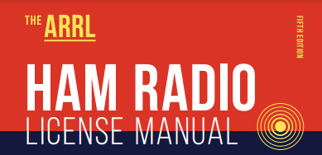
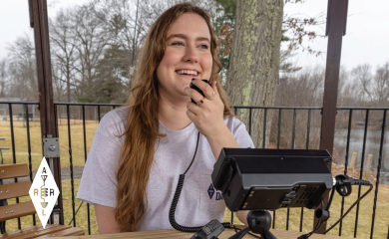
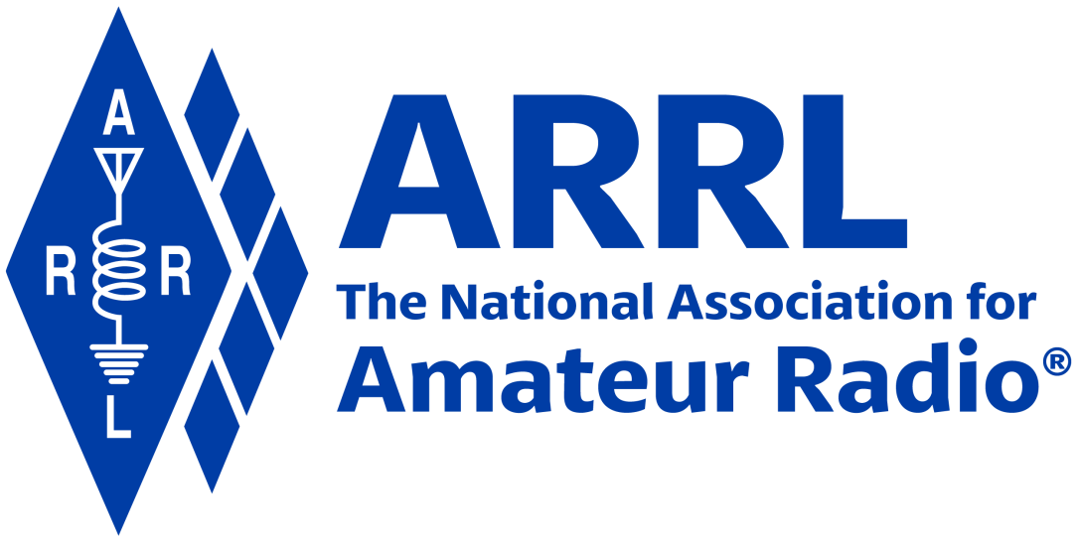
Amateur Radio Technician Exam Preparation Course

Slide 2
Amateur Radio Technician Exam Prep Course
Module 7
Licensing Regulations
7.1 Licensing Terms
7.2 Bands and Privileges
7.3 International Rules
7.4 Call Signs

Slide 3
Licensing Terms
The Federal Communications Commission or FCC makes and enforces the rules for the Amateur Radio service in the United States
Detailed list of rules & regulations at …
http://www.arrl.org/part-97-amateur-radio
Amateur radio is non-commercial … hams aren’t allowed to be paid for their services (with a few exceptions) … voluntary
Hams use various events to train to operate radio equipment in useful ways and to keep their emergency response skills sharp, such as …
Competitive operating events, chasing awards, and station-building

Slide 4
Types and Classes of Licenses
An Amateur Radio license consists of two parts — an operator license and a station license
Operator license gives you permission to operate an amateur station
Station license authorizes you to have an amateur station
Each person can have only ONE such license
There are three classes of Amateur Radio licenses being granted today: Technician, General, and Amateur Extra
Each carries a different set of frequency and operating privileges
Clubs can also be license holders
Clubs must have at least FOUR members to be organized … see rule 97.5 (b)

Slide 5
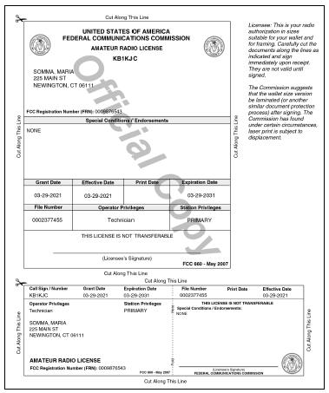
Sample license
Figure 7.1 — An FCC Amateur Radio license is both an operator and a station license. The printed license shown here has two sections: one for posting in your station and one to carry with you. For information on obtaining a copy of your license, see www.arrl.org/obtain-license-copy.

Slide 6
Examinations
Amateur volunteers run their own exam sessions
Volunteer Examiner Coordinators (VEC): An organization or group that administers exams
Volunteer Examiner (VE): An individual amateur radio operator that actually gives the exam (reports to a VEC) … General class or higher (however, Technicians can assist)
Exams are referred to by elements …
Element 2 … Technician (35 questions, 26 required to pass)
Element 3 … General (35 questions, 26 required to pass)
Element 4 … Extra (50 questions, 37 required to pass)
Test forms are filed with the FCC by the VEC administering the exam
Once your information shows up in the FCC ULS database, you are fully authorized to operate

Slide 7
Term of License and Renewal
Amateur licenses are good for a 10-year term, renewable without reexamination
If your license expires, you are supposed to stop transmitting because your license is no longer valid
You have a two-year grace period to apply for a new license
To find an exam location …
https://www.arrl.org/find-an-amateur-radio-license-exam-session
Bring to the exam …
Two forms of ID (one a photo ID)
FCC Registration Number (FRN) …
https://apps2.fcc.gov/fccUserReg/pages/createAccount.htm

Slide 8
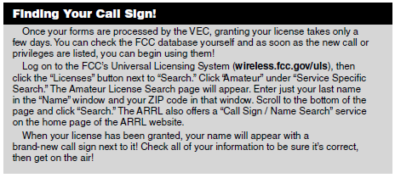
After Examination!

Slide 9
Your Responsibilities
The FCC requires you to provide and maintain a valid current mailing and email address in their database at all times
Your license can be suspended or revoked and removed from the database
You are obligated to make your station available for inspection upon request by an FCC representative
Keep your original license available for inspection

Slide 10
Bands and Privileges
There are hundreds of bands and dozens of different types of radio spectrum users
The frequency privileges granted to the various services are called allocations
Most common bands used by Technicians …
6 meters (50 – 54 MHz)
2 meters (144 – 148 MHz)
70 cm (420 – 450 MHz)
See Table 7.2, Table 7.3, and Figure 7.3 in your text
Technician privileges at …
http://www.arrl.org/files/file/Tech%20Band%20Chart/US%20Amateur%20Radio%20Technician%20Privileges.pdf

Slide 11
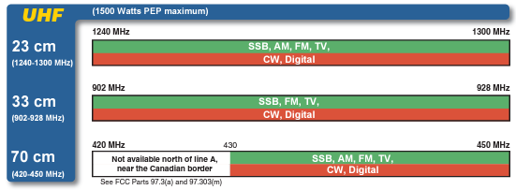
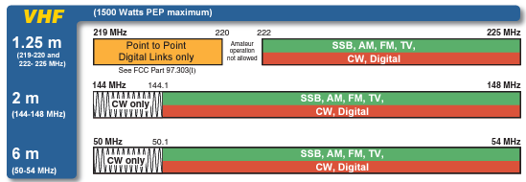
Technician Privileges

Slide 12
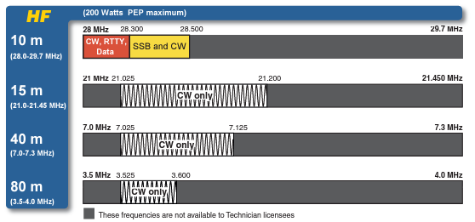
Technician Privileges (cont.)

Slide 13
Emission Privileges
Emission is the formal name for any radio signal from a transmitter
An emission privilege is permission to communicate using a particular mode (phone, CW, data, image, etc.)
Beacons are found on 10 meters between 28.2 and 28.3 MHz and in the lower segments of the VHF, UHF, and microwave bands

Slide 14
Power Limits
Output power from a transmitter or amplifier is defined in terms of peak envelope power (PEP)
Amateurs are allowed the full legal limit of 1500 watts PEP output (some exceptions)
Below 30 MHz, Novice and Technician licensees are limited to 200 watts PEP on HF bands

Slide 15
Primary and Secondary Allocations
Many amateur bands are exclusively allocated to hams
Occasionally two services receive shared allocations (even ham bands)
One group is generally given priority … called primary allocation
Lower priority is called secondary allocation
The primary service is protected from harmful interference by signals from secondary services
For example, amateurs have a secondary allocation in the 70 cm band and must avoid interfering with radiolocation stations that have primary status
Part 97.303 lists all of the frequency-sharing requirements for US hams (see www.arrl.org)

Slide 16
Repeater Coordination (includes Auxiliary Stations)
Hams have developed a system of regional frequency coordination to ensure that repeaters use amateur bands wisely and avoid interference to the greatest degree possible (not FCC controlled)
Repeaters’ input and output frequency pairs are fixed and have a common offset in each region
A committee of volunteers known as a frequency coordinator recommends transmit and receive frequencies
Frequency coordinator representatives are selected by local or regional amateurs whose stations are eligible to be repeater stations
Uncoordinated repeaters are strongly discouraged because they often cause interference

Slide 17
PRACTICE QUESTIONS

Slide 18
Which agency regulates and enforces the rules for the Amateur Radio Service in the United States?
FEMA
Homeland Security
The FCC
All these choices are correct
T1A02 C 97.1 7-1

Slide 19
Which of the following is part of the Basis and Purpose of the Amateur Radio Service?
Providing personal radio communications for as many citizens as possible
Providing communications for international non-profit organizations
Advancing skills in the technical and communication phases of the radio art
All these choices are correct
T1A01 C 97.1 7-2

Slide 20
How many operator/primary station license grants may be held by any one person?
One
No more than two
One for each band on which the person plans to operate
One for each permanent station location from which the person plans to operate
T1A04 A 97.5(b)(1) 7-3

Slide 21
For which license classes are new licenses currently available from the FCC?
Novice, Technician, General, Amateur Extra
Technician, Technician Plus, General, Amateur Extra
Novice, Technician Plus, General, Advanced
Technician, General, Amateur Extra
T1C01 D 97.9(a), 97.17(a) 7-3

Slide 22
Which of the following is a requirement for the issuance of a club station license grant?
The trustee must have an Amateur Extra Class operator license grant
The club must have at least four members
The club must be registered with the American Radio Relay League
All these choices are correct
T1F11 B 97.5(b)(2) 7-3

Slide 23
What proves that the FCC has issued an operator/primary license grant?
A printed copy of the certificate of successful completion of examination
An email notification from the NCVEC granting the license
The license appears in the FCC ULS database
All these choices are correct
T1A05 C 97.7 7-5

Slide 24
How soon after passing the examination for your first amateur radio license may you transmit on the amateur radio bands?
Immediately on receiving your Certificate of Successful Completion of Examination (CSCE)
As soon as your operator/station license grant appears on the ARRL website
As soon as your operator/station license grant appears in the FCC’s license database
As soon as you receive your license in the mail from the FCC
T1C10 C 97.5a 7-5

Slide 25
What is the normal term for an FCC-issued amateur radio license?
Five years
Life
Ten years
Eight years
T1C08 C 97.25 7-5

Slide 26
What is the grace period for renewal if an amateur license expires?
Two years
Three years
Five years
Ten years
T1C09 A 97.21(a)(b) 7-5

Slide 27
If your license has expired and is still within the allowable grace period, may you continue to transmit on the amateur radio bands?
Yes, for up to two years
Yes, as soon as you apply for renewal
Yes, for up to one year
No, you must wait until the license has been renewed
T1C11 D 97.21(b) 7-5

Slide 28
What may happen if the FCC is unable to reach you by email?
Fine and suspension of operator license
Revocation of the station license or suspension of the operator license
Revocation of access to the license record in the FCC system
Nothing; there is no such requirement
T1C04 B 97.23 7-8

Slide 29
Which of the following can result in revocation of the station license or suspension of the operator license?
Failure to inform the FCC of any changes in the amateur station following performance of an RF safety environmental evaluation
Failure to provide and maintain a correct email address with the FCC
Failure to obtain FCC type acceptance prior to using a home-built transmitter
Failure to have a copy of your license available at your station
T1C07 B 97.23 7-8

Slide 30
Which of the following frequency ranges are available for phone operation by Technician licensees?
28.050 MHz to 28.150 MHz
28.100 MHz to 28.300 MHz
28.300 MHz to 28.500 MHz
28.500 MHz to 28.600 MHz
T1B01 C 97.301 (e) 7-9

Slide 31
Which frequency is in the 6 meter amateur band?
49.00 MHz
52.525 MHz
28.50 MHz
222.15 MHz
T1B03 B 97.301(a) 7-9

Slide 32
Which amateur band includes 146.52 MHz?
6 meters
20 meters
70 centimeters
2 meters
T1B04 D 97.301(a) 7-9

Slide 33
On which HF bands does a Technician class operator have phone privileges?
None
10 meter band only
80 meter, 40 meter, 15 meter, and 10 meter bands
30 meter band only
T1B06 B 97.301(e), 97.305 7-9

Slide 34
How may amateurs use the 219 to 220 MHz segment of 1.25 meter band?
Spread spectrum only
Fast-scan television only
Emergency traffic only
Fixed digital message forwarding systems only
T1B05 D 97.305(c) 7-11

Slide 35
Which of the following VHF/UHF band segments are limited to CW only?
50.0 MHz to 50.1 MHz and 144.0 MHz to 144.1 MHz
219 MHz to 220 MHz and 420.0 MHz to 420.1 MHz
902.0 MHz to 902.1 MHz
All these choices are correct
T1B07 A 97.305(a), (c) 7-11

Slide 36
What is the maximum peak envelope power output for Technician class operators in their HF band segments?
200 watts
100 watts
50 watts
10 watts
T1B11 A 97.313 7-12

Slide 37
Except for some specific restrictions, what is the maximum peak envelope power output for Technician class operators using frequencies above 30 MHz?
50 watts
100 watts
500 watts
1500 watts
T1B12 D 97.313(b) 7-12

Slide 38
How are US amateurs restricted in segments of bands where the Amateur Radio Service is secondary?
U.S. amateurs may find non-amateur stations in those segments, and must avoid interfering with them
U.S. amateurs must give foreign amateur stations priority in those segments
International communications are not permitted in those segments
Digital transmissions are not permitted in those segments
T1B08 A 97.303 7-13

Slide 39
Which of the following entities recommends transmit/receive channels and other parameters for auxiliary and repeater stations?
Frequency Spectrum Manager appointed by the FCC
Volunteer Frequency Coordinator recognized by local amateurs
FCC Regional Field Office
International Telecommunication Union
T1A08 B 97.3(a)(22) 7-13

Slide 40
Who selects a Frequency Coordinator?
The FCC Office of Spectrum Management and Coordination Policy
The local chapter of the Office of National Council of Independent Frequency Coordinators
Amateur operators in a local or regional area whose stations are eligible to be repeater or auxiliary stations
FCC Regional Field Office
T1A09 C 97.3(a)(22) 7-13

Slide 41
International Rules
Every country has its equivalent agency to the FCC
The International Telecommunication Union (ITU) coordinates allocations across international borders
The ITU divides the world into the three regions … US is region 2 (except for some territories in the Pacific … region 3)
Unless specifically prohibited by the government of either country, any ham can talk to any other ham
International communications must be limited to the purposes of the amateur service or remarks of a personal nature
The FCC can prohibit contacts between US citizens and those of specific other countries by notifying the ITU of its objections (uncommon!)

Slide 42
International Operating
The foreign country must permit amateur operation (some don’t)
You must have permission when you are inside a country’s national boundaries (and territorial waters)
You are required to operate according to their rules
You may also operate from any vessel or craft that is documented or registered in the United States
If the vessel is in territorial waters, regulations of the host country and those of the vessel’s registry both apply

Slide 43
Call Signs
Amateur call signs have a prefix and suffix
Prefix: One or two letters and one numeral
Suffix: One to three letters
Technician class license holders may choose their own vanity call sign (from Groups C or D)
US Amateur Call Sign Formats

Slide 44
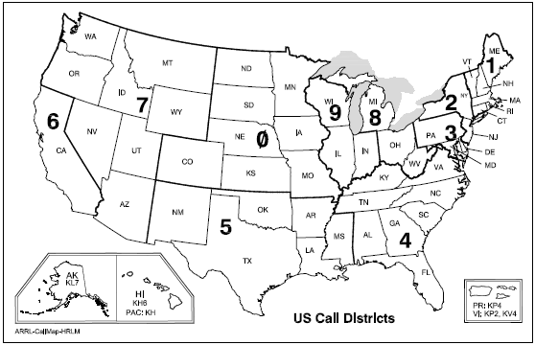
US Call Districts
You are assigned the numeral part of your call by the FCC, based upon where you live. If you move, this number stays with you. HOWEVER, you may request (and obtain) a vanity call outside your district!

Slide 45
PRACTICE QUESTIONS

Slide 46
What types of international communications are an FCC-licensed amateur radio station permitted to make?
Communications incidental to the purposes of the Amateur Radio Service and remarks of a personal character
Communications incidental to conducting business or remarks of a personal nature
Only communications incidental to contest exchanges; all other communications are prohibited
Any communications that would be permitted by an international broadcast station
T1C03 A 97.117 7-15

Slide 47
With which countries are FCC-licensed amateur radio stations prohibited from exchanging communications?
Any country whose administration has notified the International Telecommunication Union (ITU) that it objects to such communications
Any country whose administration has notified the American Radio Relay League (ARRL) that it objects to such communications
Any country banned from such communications by the International Amateur Radio Union (IARU)
Any country banned from making such communications by the American Radio Relay League (ARRL)
T1D01 A 97.111(a)(1) 7-15

Slide 48
From which of the following locations may an FCC-licensed amateur station transmit?
From within any country that belongs to the International Telecommunication Union
From within any country that is a member of the United Nations
From anywhere within International Telecommunication Union (ITU) Regions 2 and 3
From any vessel or craft located in international waters and documented or registered in the United States
T1C06 D 97.5(a)(2) 7-15

Slide 49
Who may select a desired call sign under the vanity call sign rules?
Only a licensed amateur with a General or Amateur Extra Class license
Only a licensed amateur with an Amateur Extra Class license
Only a licensed amateur who has been licensed continuously for more than 10 years
Any licensed amateur
T1C02 D 97.19 7-17

Slide 50
Which of the following is a valid Technician class call sign format?
KF1XXX
KA1X
W1XX
All these choices are correct
T1C05 A 7-17

Slide 51
END OF MODULE 7

