Slide 1
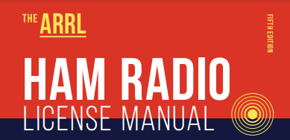
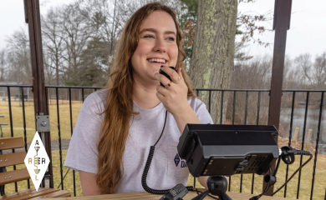
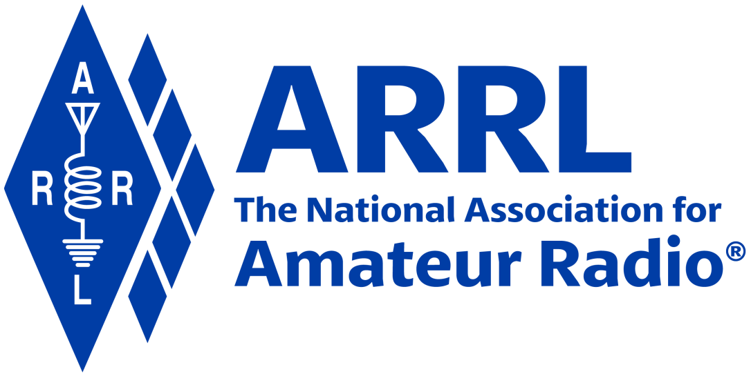
Amateur Radio Technician Exam Preparation Course

Slide 2
Amateur Radio Technician Exam Prep Course
Module 8
Operating Regulations
8.1 Control Operators
8.2 Identification
8.3 Interference
8.4 Third-party Communications
8.5 Remote and Automatic Operation
8.6 Prohibited Transmissions

Slide 3
Control Operators
The control operator is a licensed operator who is responsible for making sure all FCC rules are followed
The control point is wherever the control operator operates the transmitter
The station licensee is responsible for designating the control operator
All transmissions must be made under the supervision of a control operator
The control point can be remotely located and connected by phone lines, the internet or a radio link

Slide 4
Privileges and Guest Operating
A control operator may operate the station in any way permitted by the privileges of their license class
Regardless of the station owner’s privileges
You may allow another amateur to use your station (guest operator)
The guest may operate under your privileges as long as you’re present
If you walk away, the guest may operate only under his/her privileges (if unlicensed, they have no privileges)
If you’re the guest, and have a higher license class than the station owner, you may operate under your privileges
Both the guest operator and station owner are responsible for proper operation of the station
The control operator is responsible for the station’s transmissions
The station owner is responsible for limiting access to the station only to responsible licensees who will follow the FCC rules

Slide 5
Identification
Your call sign is your identity on the air
Identification rules apply at all times
Unidentified transmissions (that is, no call sign) are not allowed
Exception … controlling a model craft
To make a short transmission to test an antenna or make adjustments to your radio, just state/send your call sign
Don’t key the microphone and listen for the repeater’s signal (kerchunking)
Give your call sign at least once every 10 minutes during a contact and when the communication is finished
If you are using phone, you are required to identify in English, even if communicating in another language
FCC recommends the use of phonetics when you identify by voice
You may give call sign by CW when communicating by voice

Slide 6
Tactical Calls
Tactical call signs (or tactical IDs) help identify where a station is and what it is doing
Can be used at any time, but are usually used in emergency and public service operation
Allow consistent identification that streamlines communication based on function
Regular identification rules apply … give your FCC-assigned call sign every 10 minutes and at the end of the communication
When a new operator takes over a tactical station, he/she gives their FCC-assigned call sign along with the tactical call

Slide 7
Self-Assigned Indicators
When operating away from your home station, add information to your call sign so other stations are aware of your location
FCC Part 97.119(c) says …
One or more indicators may be included with the call sign. Each indicator must be separated from the call sign by the slant mark (/) or by any suitable word that denotes the slant mark. If an indicator is self-assigned, it must be included before, after, or both before and after, the call sign.
For example, on phone, KL7CC could identify as W3/KL7CC or KL7CC/W3, using “stroke,” “slash” or “portable” between the indicator and the call sign
Indicator may not conflict with some other indicator specified in the FCC rules, such as /KT, /AG and /AE (upgraded license class)
Indicator may not conflict with a prefix assigned to some other country

Slide 8
Test Transmissions
Identification rules apply to on-the-air test transmissions
Call sign must be given once every 10 minutes and at the end of transmissions
Keep test transmissions brief to …
Avoid causing interference
Keep from occupying an otherwise useful frequency
Usual method of identifying during a test transmission …
Voice: Say KØILP testing
CW / Morse Code: Send KØILP VVV

Slide 9
PRACTICE QUESTIONS

Slide 10
When may an amateur station transmit without a control operator?
When using automatic control, such as in the case of a repeater
When the station licensee is away and another licensed amateur is using the station
When the transmitting station is an auxiliary station
Never
T1E01 D 97.7(a) 8-1

Slide 11
Who may be the control operator of a station communicating through an amateur satellite or space station?
Only an Amateur Extra Class operator
A General class or higher licensee with a satellite operator certification
Only an Amateur Extra Class operator who is also an AMSAT member
Any amateur allowed to transmit on the satellite uplink frequency
T1E02 D 97.301, 97.207(c) 8-1

Slide 12
Who must designate the station control operator?
The station licensee
The FCC
The frequency coordinator
Any licensed operator
T1E03 A 97.103(b) 8-1

Slide 13
What determines the transmitting frequency privileges of an amateur station?
The frequency authorized by the frequency coordinator
The frequencies printed on the license grant
The highest class of operator license held by anyone on the premises
The class of operator license held by the control operator
T1E04 D 97.103(b) 8-2

Slide 14
What is an amateur station’s control point?
The location of the station’s transmitting antenna
The location of the station’s transmitting apparatus
The location at which the control operator function is performed
The mailing address of the station licensee
T1E05 C 97.3(a)(14) 8-1

Slide 15
When, under normal circumstances, may a Technician class licensee be the control operator of a station operating in an Amateur Extra Class band segment?
At no time
When designated as the control operator by an Amateur Extra Class licensee
As part of a multi-operator contest team
When using a club station whose trustee holds an Amateur Extra Class license
T1E06 A 97.103(b) 8-2

Slide 16
When the control operator is not the station licensee, who is responsible for the proper operation of the station?
All licensed amateurs who are present at the operation
Only the station licensee
Only the control operator
The control operator and the station licensee
T1E07 D 97.103(a) 8-2

Slide 17
Who does the FCC presume to be the control operator of an amateur station, unless documentation to the contrary is in the station records?
The station custodian
The third party participant
The person operating the station equipment
The station licensee
T1E11 D 97.103(a) 8-2

Slide 18
What do the FCC rules state regarding the use of a phonetic alphabet for station identification in the Amateur Radio Service?
It is required when transmitting emergency messages
It is encouraged
It is required when in contact with foreign stations
All these choices are correct
T1A03 B 97.119(b)(2) 8-3

Slide 19
When may an amateur station transmit without identifying on the air?
When the transmissions are of a brief nature to make station adjustments
When the transmissions are unmodulated
When the transmitted power level is below 1 watt
When transmitting signals to control model craft
T1D11 D 97.119(a) 8-3

Slide 20
When are you required to transmit your assigned call sign?
At the beginning of each contact, and every 10 minutes thereafter
At least once during each transmission
At least every 15 minutes during and at the end of a communication
At least every 10 minutes during and at the end of a communication
T1F03 D 97.119(a) 8-3

Slide 21
What language may you use for identification when operating in a phone sub-band?
Any language recognized by the United Nations
Any language recognized by the ITU
English
English, French, or Spanish
T1F04 C 97.119(b)(2) 8-3

Slide 22
What method of call sign identification is required for a station transmitting phone signals?
Send the call sign followed by the indicator RPT
Send the call sign using a CW or phone emission
Send the call sign followed by the indicator R
Send the call sign using only a phone emission
T1F05 B 97.119(b)(2) 8-3

Slide 23
How often must you identify with your FCC-assigned call sign when using tactical call signs such as “Race Headquarters”?
Never, the tactical call is sufficient
Once during every hour
At the end of each communication and every ten minutes during a communication
At the end of every transmission
T1F02 C 97.119 (a) 8-4

Slide 24
Which of the following self-assigned indicators are acceptable when using a phone transmission?
KL7CC stroke W3
KL7CC slant W3
KL7CC slash W3
All these choices are correct
T1F06 D 97.119(c) 8-4

Slide 25
Which of the following is required when making on-the-air test transmissions?
Identify the transmitting station
Conduct tests only between 10 p.m. and 6 a.m. local time
Notify the FCC of the transmissions
All these choices are correct
T2A06 A 8-5

Slide 26
Interference
Interference is caused by noise and by signals
Interference from natural sources or unintentionally radiated signals from appliances, industrial equipment, and computing equipment is called QRN
Interference from nearby signals is called QRM
Harmful interference is a transmission signal that seriously degrades, obstructs, or interrupts communications of a regulated service
No one has an absolute right to any frequency
Willful interference is intentionally creating harmful interference, and is never allowed

Slide 27
Third-Party Communications
Ham radio is frequently used to send messages on behalf of unlicensed persons or organizations
Third-Party Communications definition: A message from an amateur station control operator to another amateur station control operator on behalf of another person … the other person is the third party
Rules change when signals cross international borders … only certain countries allow third-party communications with US hams … called third-party agreements
List of countries with third-party agreements with the US is in Table 8.1 in your text

Slide 28
Remote and Automatic Operation
Stations such as repeaters and beacons operate without a human control operator present
Must be operated in compliance with FCC rules, no matter where the control point is located
Local control — a control operator is physically present at the transmitter
Remote operation — the control point is located away from the transmitter
Control operator operates the transmitter indirectly via some kind of control link
Control operator must be present at the control point during all transmission
Automatic operation — the station operates under the control of devices and procedures that ensure compliance with FCC rules
Control operator is required, but need not be at the control point when the station is transmitting
Repeaters, beacons, space stations, and digipeaters (that relay messages) are allowed to be automatically controlled

Slide 29
Responsibilities
No matter what type of control is asserted, the station must operate in compliance with FCC rules at all times
Repeater owners must install the necessary equipment and procedures for automatic control that ensures the repeater operates in compliance with FCC rules
Even if a repeater is on remote control, repeater users are still responsible for proper operation via the repeater

Slide 30
Prohibited Transmissions
Four types of prohibited communications …
Unidentified transmissions (no call sign)
False or deceptive signals (using someone else’s call sign)
False distress or emergency signals
Obscene or indecent speech
Regular communications that could reasonably be performed through some other radio service are prohibited (such as directing boat traffic that should be done on marine VHF channels)
Communications in return for some kind of compensation is prohibited

Slide 31
Business Communications
No transmissions related to conducting your business or employer’s activities are permitted
You can order things over the air, as long as you don’t do it regularly or as part of your normal income-making activities
You can advertise equipment for sale as long as it pertains to Amateur Radio and it’s not your regular business
You cannot be paid for operating an amateur station
One exception to business prohibition is that teachers may use ham radio as part of their classroom instruction
Must be incidental to their job and can’t be the majority of their duties

Slide 32
Encrypted Transmissions
Encoding that uses codes or ciphers to hide the meaning of the transmitted message is called encryption
Recovering the encrypted information is called decryption
Amateurs may not use encryption techniques except for radio control and control transmissions to space stations

Slide 33
Broadcasting and Retransmission
Broadcasting consists of one-way transmissions intended for reception by the general public
Hams may only broadcast when …
Transmitting code practice
Communicating information bulletins for other amateurs
Necessary for emergency communications
Hams are prohibited from assisting and participating in news gathering by broadcasting organizations
Music can only be rebroadcast as part of an authorized rebroadcast of space station transmissions
Retransmitting the signals of another station is prohibited, except when relaying messages or digital data from another station

Slide 34
PRACTICE QUESTIONS

Slide 35
When is willful interference to other amateur radio stations permitted?
To stop another amateur station that is breaking the FCC rules
At no time
When making short test transmissions
At any time, stations in the Amateur Radio Service are not protected from willful interference
T1A11 B 97.101 (d) 8-5

Slide 36
Which of the following applies when two stations transmitting on the same frequency interfere with each other?
The stations should negotiate continued use of the frequency
Both stations should choose another frequency to avoid conflict
Interference is inevitable, so no action is required
Use subaudible tones so both stations can share the frequency
T2B08 A 8-5

Slide 37
Which of the following restrictions apply when a non-licensed person is allowed to speak to a foreign station using a station under the control of a licensed amateur operator?
The person must be a U.S. citizen
The foreign station must be in a country with which the U.S. has a third party agreement
The licensed control operator must do the station identification
All these choices are correct
T1F07 B 97.115(a)(2) 8-7

Slide 38
What is the definition of third party communications?
A message from a control operator to another amateur station control operator on behalf of another person
Amateur radio communications where three stations are in communications with one another
Operation when the transmitting equipment is licensed to a person other than the control operator
Temporary authorization for an unlicensed person to transmit on the amateur bands for technical experiments
T1F08 A 97.3(a)(47) 8-7

Slide 39
Which of the following are required for remote control operation?
The control operator must be at the control point
A control operator is required at all times
The control operator must indirectly manipulate the controls
All these choices are correct
T1E09 D 97.109(c) 8-9

Slide 40
Which of the following is an example of remote control as defined in Part 97?
Repeater operation
Operating the station over the internet
Controlling a model aircraft, boat, or car by amateur radio
All these choices are correct
T1E10 B 97.3(a)(39) 8-9

Slide 41
Who is accountable if a repeater inadvertently retransmits communications that violate the FCC rules?
The control operator of the originating station
The control operator of the repeater
The owner of the repeater
Both the originating station and the repeater owner
T1F10 A 97.205(g) 8-9

Slide 42
What, if any, are the restrictions concerning transmission of language that may be considered indecent or obscene?
The FCC maintains a list of words that are not permitted to be used on amateur frequencies
Any such language is prohibited
The ITU maintains a list of words that are not permitted to be used on amateur frequencies
There is no such prohibition
T1D06 B 97.113(a)(4) 8-10

Slide 43
When may amateur radio operators use their stations to notify other amateurs of the availability of equipment for sale or trade?
Never
When the equipment is not the personal property of either the station licensee, or the control operator, or their close relatives
When no profit is made on the sale
When selling amateur radio equipment and not on a regular basis
T1D05 D 97.113(a)(3) (ii) 8-10

Slide 44
In which of the following circumstances may the control operator of an amateur station receive compensation for operating that station?
When the communication is related to the sale of amateur equipment by the control operator’s employer
When the communication is incidental to classroom instruction at an educational institution
When the communication is made to obtain emergency information for a local broadcast station
All these choices are correct
T1D08 B 97.113(a)(3) (iii) 8-10

Slide 45
When is it permissible to transmit messages encoded to obscure their meaning?
Only during contests
Only when transmitting certain approved digital codes
Only when transmitting control commands to space stations or radio control craft
Never
T1D03 C 97.211(b), 97.215(b), 97.113(a)(4) 8-11

Slide 46
Under which of the following circumstances are one-way transmissions by an amateur station prohibited?
In all circumstances
Broadcasting
International Morse Code Practice
Telecommand or transmissions of telemetry
T1D02 B 97.113(b), 97.111(b) 8-11

Slide 47
Under what conditions is an amateur station authorized to transmit music using a phone emission?
When incidental to an authorized retransmission of manned spacecraft communications
When the music produces no spurious emissions
When transmissions are limited to less than three minutes per hour
When the music is transmitted above 1280 MHz
T1D04 A 97.113(a)(4), 97.113(c) 8-11

Slide 48
What types of amateur stations can automatically retransmit the signals of other amateur stations?
Auxiliary, beacon, or Earth stations
Earth, repeater, or space stations
Beacon, repeater, or space stations
Repeater, auxiliary, or space stations
T1D07 D 97.113(d) 8-11

Slide 49
When may amateur stations transmit information in support of broadcasting, program production, or news gathering, assuming no other means is available?
When such communications are directly related to the immediate safety of human life or protection of property
When broadcasting communications to or from the space shuttle
Where noncommercial programming is gathered and supplied exclusively to the National Public Radio network
Never
T1D09 A 97.113(5)(b) 8-11

Slide 50
How does the FCC define broadcasting for the Amateur Radio Service?
Two-way transmissions by amateur stations
Any transmission made by the licensed station
Transmission of messages directed only to amateur operators
Transmissions intended for reception by the general public
T1D10 D 97.3(a)(10) 8-11

Slide 51
END OF MODULE 8

