Slide 1
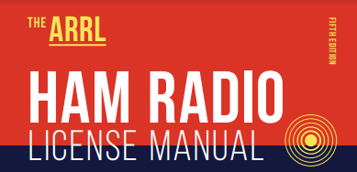
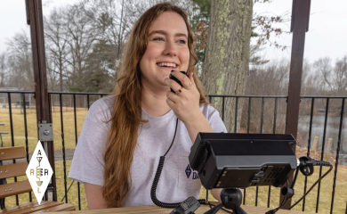
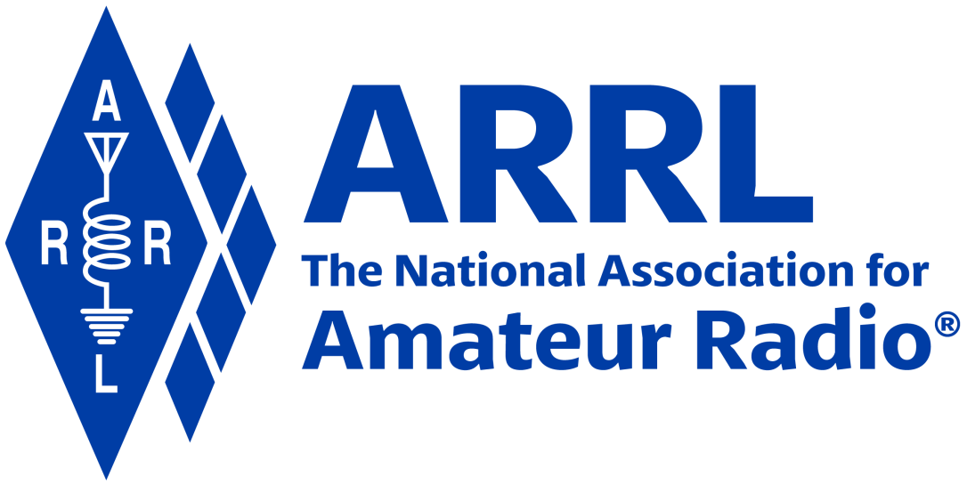
Amateur Radio Technician Exam Preparation Course

Slide 2
Amateur Radio Technician Exam Prep Course
Module 9
Safety
9.1 Electrical Safety
9.2 Managing RF in Your Station
9.3 RF Interference (RFI)
9.4 RF Exposure
9.5 Mechanical Safety

Slide 3
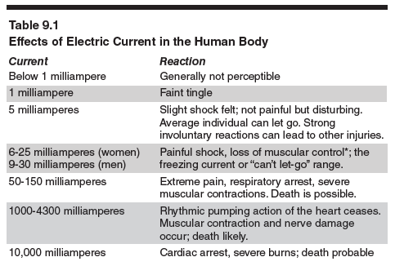
Electrical Injuries
Electrical current through the body can disrupt the electrical function of cells
Can cause involuntary muscle contractions
Large currents can burn the skin and heat tissue

Slide 4
Avoiding Electrical Hazards
Safety tips for working with power ON
Keep one hand in your pocket
Wear insulating shoes
Never bypass a safety interlock during testing
Make sure capacitors are discharged
Keep metal objects clear of storage battery terminals
Avoid working on equipment with the battery connected
Remove unnecessary jewelry from your hands
Avoid working alone

Slide 5
AC Safety Grounding
The safety ground is a connection to the power system’s ground reference connection in your main electrical service box
The ground connection causes a fuse or circuit breaker to remove power from the equipment
Grounding guidelines …
Use three-wire power cords and plugs
Make sure all equipment has a connection to the ground
Use ground fault circuit interrupter (GFCI) circuit breakers/outlets
Verify AC wiring is done properly
Never replace a fuse or circuit breaker with one of a larger size
Don’t overload single outlets

Slide 6
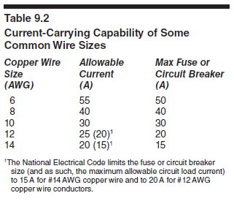
AC Safety Grounding (cont.)
When wiring circuits, be sure to follow the US standard …
Hot — black wire (occasionally red)
Neutral — white wire
Safety or equipment ground — green
Use cable and wire sufficiently rated for the expected current load
Use the proper size fuses and circuit breakers
Be sure fuses or circuit breakers are installed in series with the hot conductor or conductors

Slide 7
Lightning Protection
Lightning protection is intended to provide fire protection for your home
Starting at your antennas, all towers, masts, and antenna mounts should be grounded according to local building and electrical codes
Connections are made at the tower base though a large-diameter wire to a ground rod
Ground connections should be as short and direct as possible — avoid sharp bends
Use lightning arrestors grounded to a common plate that is in turn connected to a nearby external ground
All ground rods and earth connections must be bonded together with heavy wire

Slide 8
PRACTICE QUESTIONS

Slide 9
What health hazard is presented by electrical current flowing through the body?
It may cause injury by heating tissue
It may disrupt the electrical functions of cells
It may cause involuntary muscle contractions
All these choices are correct
T0A02 D 9-2

Slide 10
What hazard exists in a power supply immediately after turning it off?
Circulating currents in the dc filter
Leakage flux in the power transformer
Voltage transients from kickback diodes
Charge stored in filter capacitors
T0A11 D 9-2

Slide 11
In the United States, what circuit does black wire insulation indicate in a three-wire 120 V cable?
Neutral
Hot
Equipment ground
Black insulation is never used
T0A03 B 9-4

Slide 12
What is a good way to guard against electrical shock at your station?
Use three-wire cords and plugs for all AC powered equipment
Connect all AC powered station equipment to a common safety ground
Install mechanical interlocks in high-voltage circuits
All these choices are correct
T0A06 D 9-4

Slide 13
Where should a fuse or circuit breaker be installed in a 120V AC power circuit?
In series with the hot conductor only
In series with the hot and neutral conductors
In parallel with the hot conductor only
In parallel with the hot and neutral conductors
T0A08 A 9-4

Slide 14
Where should a lightning arrester be installed in a coaxial feed line?
At the output connector of a transceiver
At the antenna feed point
At the ac power service panel
On a grounded panel near where feed lines enter the building
T0A07 D 9-5

Slide 15
What should be done to all external ground rods or earth connections?
Waterproof them with silicone caulk or electrical tape
Keep them as far apart as possible
Bond them together with heavy wire or conductive strap
Tune them for resonance on the lowest frequency of operation
T0A09 C 9-5

Slide 16
Which of the following is good practice when installing ground wires on a tower for lightning protection?
Put a drip loop in the ground connection to prevent water damage to the ground system
Make sure all ground wire bends are right angles
Ensure that connections are short and direct
All these choices are correct
T0B01 C 9-5

Slide 17
Which of the following is true when installing grounding conductors used for lightning protection?
Use only non-insulated wire
Wires must be carefully routed with precise right-angle bends
Sharp bends must be avoided
Common grounds must be avoided
T0B10 C 9-5

Slide 18
Which of the following establishes grounding requirements for an amateur radio tower or antenna?
FCC Part 97 rules
Local electrical codes
FAA tower lighting regulations
UL recommended practices
T0B11 B 9-5

Slide 19
Managing RF in Your Station
Your station wiring, feed lines, power connections, and other cables all pick up RF from your transmitted signal
It is not practical to “ground” RF current in the same way as for AC power and lightning protection
Best approach is to bond all of the equipment together
Keeps all of your equipment at the same voltage so that RF current does not flow between the different pieces
RF current on cables and enclosures can cause audio distortion, erratic operation of computer equipment, and even RF “burns”
“RF feedback” via a microphone cable can cause distorted transmitted audio

Slide 20
Bonding Tips
Bond all metal equipment enclosures to a common RF ground bus
Use short, wide conductors such as copper flashing or strap or heavy solid wire
Solid strap is best because it presents the lowest impedance to RF
Keep all connections, straps and wires as short and direct as possible
Connect the ground bus to your AC safety ground and any earth connections
See Figure 9.2 in text

Slide 21
RF Interference (RFI) and Filters
Interference between appliances and ham radio is called radio frequency interference (RFI)
Filters are used to …
Prevent unwanted signals from being radiated
Keep unwanted signals from being received
AC power line filters keep RF signals from passing into or out of equipment via the hot and neutral conductors of the AC power connection
They reject all signals with frequencies greater than a few kHz
Ferrite chokes are also used to reduce RF current on the outside of shielded audio, microphone, and computer cables.

Slide 22
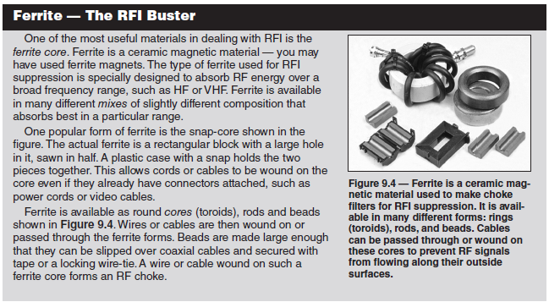
Filters (cont.)

Slide 23
Interference from Amateur Transmissions
The most common causes of RFI from your transmissions are fundamental overload, harmonics, and spurious emissions
Very strong signals may overwhelm a receiver’s ability to reject them
This is called fundamental overload
Consumer equipment is often unable to reject strong signals outside the bands it is intended to receive
A high-pass filter can be connected at antenna input of FM & TV receivers to reject strong lower-frequency signals from amateur HF signals
Broadcast-reject filters attenuate signals from nearby AM, FM, or TV broadcast stations

Slide 24
Harmonics, Spurious Emissions & Leakage
Every transmitter’s RF output signal contains weak harmonics of the desired output signal and other spurious emissions that can cause interference to nearby equipment
A low-pass or band-pass filter can be installed at the transmitter’s connection to the antenna feed line to prevent harmonics
Leakage is another source of interference
The most common cause of leakage is faulty coaxial connectors on the cable feed line
Be sure the connectors are installed correctly and attached tightly

Slide 25
Good Practices in Your Station
Regardless of the source, you can reduce or eliminate much interference by making sure your own station follows good amateur practices for grounding and filtering
Make sure your station is in good working order with appropriate grounding, filtering, and good quality connections
Use shielded wire and shielded cables to prevent coupling with unwanted signals and undesired radiation … be sure to connect the shield properly
Eliminate interference to your own home appliances and televisions first

Slide 26
RFI and Neighbors
Start by making sure it’s really your transmissions that are causing the problem
Offer to help determine the nature of interference
If you’re the recipient of the RFI …
Make sure your station meets the standards of good amateur practices
Offer to help determine the source of interference
You may have to politely explain to the neighbor that FCC rules prohibit them from using a device that causes harmful interference
Be diplomatic in dealing with your neighbors

Slide 27
PRACTICE QUESTIONS

Slide 28
Which of the following conductors is preferred for bonding at RF?
Copper braid removed from coaxial cable
Steel wire
Twisted-pair cable
Flat copper strap
T4A08 D 9-6

Slide 29
What is a symptom of RF feedback in a transmitter or transceiver?
Excessive SWR at the antenna connection
The transmitter will not stay on the desired frequency
Reports of garbled, distorted, or unintelligible voice transmissions
Frequent blowing of power supply fuses
T7B11 C 9-6

Slide 30
Which of the following could you use to cure distorted audio caused by RF current on the shield of a microphone cable?
Band-pass filter
Low-pass filter
Preamplifier
Ferrite choke
T7B04 D 9-7

Slide 31
Which of the following can cause radio frequency interference?
Fundamental overload
Harmonics
Spurious emissions
All these choices are correct
T7B03 D 9-8

Slide 32
What would cause a broadcast AM or FM radio to receive an amateur radio transmission unintentionally?
The receiver is unable to reject strong signals outside the AM or FM band
The microphone gain of the transmitter is turned up too high
The audio amplifier of the transmitter is overloaded
The deviation of an FM transmitter is set too low
T7B02 A 9-8

Slide 33
How can fundamental overload of a non-amateur radio or TV receiver by an amateur signal be reduced or eliminated?
Block the amateur signal with a filter at the antenna input of the affected receiver
Block the interfering signal with a filter on the amateur transmitter
Switch the transmitter from FM to SSB
Switch the transmitter to a narrow-band mode
T7B05 A 9-8

Slide 34
Which of the following can reduce overload of a VHF transceiver by a nearby commercial FM station?
Installing an RF preamplifier
Using double-shielded coaxial cable
Installing bypass capacitors on the microphone cable
Installing a band-reject filter
T7B07 D 9-8

Slide 35
What should be the first step to resolve non-fiber optic cable TV interference caused by your amateur radio transmission?
Add a low-pass filter to the TV antenna input
Add a high-pass filter to the TV antenna input
Add a preamplifier to the TV antenna input
Be sure all TV feed line coaxial connectors are installed properly
T7B09 D 9-10

Slide 36
Which of the following is a reason to use shielded wire?
To decrease the resistance of DC power connections
To increase the current carrying capability of the wire
To prevent coupling of unwanted signals to or from the wire
To couple the wire to other signals
T6D03 C 9-9

Slide 37
Which of the following actions should you take if a neighbor tells you that your station’s transmissions are interfering with their radio or TV reception?
Make sure that your station is functioning properly and that it does not cause interference to your own radio or television when it is tuned to the same channel
Immediately turn off your transmitter and contact the nearest FCC office for assistance
Install a harmonic doubler on the output of your transmitter and tune it until the interference is eliminated
All these choices are correct
T7B06 A 9-9

Slide 38
What should you do if something in a neighbor’s home is causing harmful interference to your amateur station?
Work with your neighbor to identify the offending device
Politely inform your neighbor that FCC rules prohibit the use of devices that cause interference
Make sure your station meets the standards of good amateur practice
All these choices are correct
T7B08 D 9-10

Slide 39
RF Exposure
With its relatively low frequency, RF energy is non-ionizing radiation
RF radiation is not the same as ionizing radiation from radioactivity because the energy in signals at radio frequencies is far too low to cause an electron to leave an atom (can’t cause genetic damage)
Per FCC rules the station licensee is responsible for ensuring that no one is exposed to RF energy above the FCC exposure limits
Heating as a result of exposure to RF fields is caused by the body absorbing RF energy
Absorption varies with frequency because the body absorbs more RF energy at some frequencies than others
RF burns can be eliminated by proper bonding techniques or by preventing access to an antenna

Slide 40
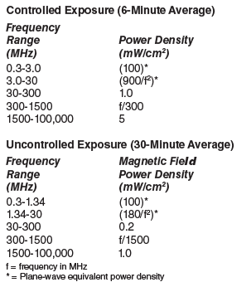
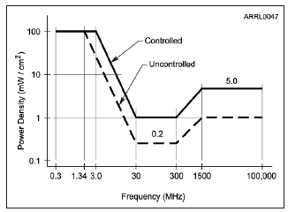
Exposure Limits
Figure 9.5 — Maximum Permissible Exposure (MPE) limits vary with frequency because the body responds differently to energy at different frequencies. The controlled and uncontrolled limits refer to the environment in which people are exposed to the RF energy.

Slide 41
Exposure Limits (refer to previous slide)
People in controlled environments are aware of their exposure and can take the necessary steps to minimize it
People in uncontrolled environments are not aware of their exposure, (areas open to the general public or your neighbor’s property)
Frequencies at which the body has the highest absorption rate are from 30 to 1500 MHz (see graph)

Slide 42
Averaging and Duty Cycle
MPE limits are based on averages, not peak exposure, allowing exposure to be averaged over fixed time intervals
Transmitters only generate RF for a fraction of the time they operate (only when transmitting … they receive or sit idle the remaining time)
This lowers the duty cycle of the emissions … the ratio of the transmitted signal’s on-the-air time to the total operating time
Duty cycle must be considered when evaluating exposure
Because the signal is only present for about ½ the time (50% duty cycle), the signal power can be twice as high and still have the same average power as transmitting continuously with a duty cycle of 100%

Slide 43
Evaluating Exposure
All fixed stations must perform an exposure evaluation … three ways of making this evaluation …
Use the techniques outlined in the FCC’s OET (Office of Engineering Technology) Bulletin 65
Measure the power density of your transmissions
Make computer models of your station
You only need to re-evaluate if you change equipment in your station that affects average output power
The following web page lists resources that make the job a lot easier (http://www.arrl.org/fcc-rf-exposure-regulations-the-station-evaluation)
You’ll need information on the RF signal’s frequency and power level, distance
from the antenna and the antenna’s radiation pattern

Slide 44
Exposure Safety Measures
Locate antennas away from where people can get close to them
Raise the antenna
Avoid pointing beam antennas where people are likely to be
Use a lower gain antenna to reduce radiated power density or reduce transmitter power
Limit the average power of your transmissions
Place mobile antennas on the roof or trunk of the car (maximizes shielding)
Use a remote microphone to hold a handheld transceiver away from your head

Slide 45
PRACTICE QUESTIONS

Slide 46
What type of radiation are radio signals?
Gamma radiation
Ionizing radiation
Alpha radiation
Non-ionizing radiation
T0C01 D 9-11

Slide 47
Why do exposure limits vary with frequency?
Lower frequency RF fields have more energy than higher frequency fields
Lower frequency RF fields do not penetrate the human body
Higher frequency RF fields are transient in nature
The human body absorbs more RF energy at some frequencies than at others
T0C05 D 9-11

Slide 48
What hazard is created by touching an antenna during a transmission?
Electrocution
RF burn to skin
Radiation poisoning
All these choices are correct
T0C07 B 9-11

Slide 49
How does RF radiation differ from ionizing radiation (radioactivity)?
RF radiation does not have sufficient energy to cause chemical changes in cells and damage DNA
RF radiation can only be detected with an RF dosimeter
RF radiation is limited in range to a few feet
RF radiation is perfectly safe
T0C12 A 9-11

Slide 50
Who is responsible for ensuring that no person is exposed to RF energy above the FCC exposure limits?
The FCC
The station licensee
Anyone who is near an antenna
The local zoning board
T0C13 B 9-11

Slide 51
At which of the following frequencies does maximum permissible exposure have the lowest value?
3.5 MHz
50 MHz
440 MHz
1296 MHz
T0C02 B 9-12

Slide 52
How does the allowable power density for RF safety change if duty cycle changes from 100 percent to 50 percent?
It increases by a factor of 3
It decreases by 50 percent
It increases by a factor of 2
There is no adjustment allowed for lower duty cycle
T0C03 C 9-13

Slide 53
Why is duty cycle one of the factors used to determine safe RF radiation exposure levels?
It affects the average exposure to radiation
It affects the peak exposure to radiation
It takes into account the antenna feed line loss
It takes into account the thermal effects of the final amplifier
T0C10 A 9-13

Slide 54
What is the definition of duty cycle during the averaging time for RF exposure?
The difference between the lowest power output and the highest power output of a transmitter
The difference between the PEP and average power output of a transmitter
The percentage of time that a transmitter is transmitting
The percentage of time that a transmitter is not transmitting
T0C11 C 9-13

Slide 55
What factors affect the RF exposure of people near an amateur station antenna?
Frequency and power level of the RF field
Distance from the antenna to a person
Radiation pattern of the antenna
All these choices are correct
T0C04 D 9-14

Slide 56
Which of the following is an acceptable method to determine whether your station complies with FCC RF exposure regulations?
By calculation based on FCC OET Bulletin 65
By calculation based on computer modeling
By measurement of field strength using calibrated equipment
All these choices are correct
T0C06 D 9-14

Slide 57
How can you make sure your station stays in compliance with RF safety regulations?
By informing the FCC of any changes made in your station
By re-evaluating the station whenever an item in the transmitter or antenna system is changed
By making sure your antennas have low SWR
All these choices are correct
T0C09 B 9-14

Slide 58
Which of the following actions can reduce exposure to RF radiation?
Relocate antennas
Relocate the transmitter
Increase the duty cycle
All these choices are correct
T0C08 A 9-14

Slide 59
Mechanical Safety … Antennas & Supports
Make sure your plans satisfy any local zoning codes or covenants or restrictions in your deed or lease
Place all antennas and feed lines well clear of power lines
A good guideline is to separate the antenna from the nearest power line by 150% of total height of tower or mast plus antenna
A minimum of 10 feet of clearance during a fall is required
Never attach an antenna or guy wire to a utility pole
Grounding rules for antennas and supports must be followed according to your local electrical code
Towers should be grounded with separate 8-foot long ground rods for each tower leg, bonded to the tower and each other
Place a safety wire through any turnbuckles used to tension guy lines (prevents loosening due to vibration and twisting)

Slide 60
Tower Work and Climbing Safety
Climbers and ground crew should wear appropriate protective gear any time work is under way on the tower
Be sure to get sufficient training on safe tower climbing techniques before beginning, use appropriate tie-off to the tower at all times, and always wear an approved climbing harness
Never climb a crank-up tower supported only by the cable that supports the sections
Double-check all climbing belts and lanyards before climbing
Make sure all ropes and load-bearing hardware are in good condition before placing them in service
Use a gin pole so that you do not have to hoist things directly
Double-check the latest weather report
Avoid climbing alone

Slide 61
PRACTICE QUESTIONS

Slide 62
Which of the following is an important safety precaution to observe when putting up an antenna tower?
Wear a ground strap connected to your wrist at all times
Insulate the base of the tower to avoid lightning strikes
Look for and stay clear of any overhead electrical wires
All these choices are correct
T0B04 C 9-17

Slide 63
What is the purpose of a safety wire through a turnbuckle used to tension guy lines?
Secure the guy line if the turnbuckle breaks
Prevent loosening of the turnbuckle from vibration
Provide a ground path for lightning strikes
Provide an ability to measure for proper tensioning
T0B05 B 9-17

Slide 64
What is the minimum safe distance from a power line to allow when installing an antenna?
Add the height of the antenna to the height of the power line and multiply by a factor of 1.5
The height of the power line above ground
1/2 wavelength at the operating frequency
Enough so that if the antenna falls, no part of it can come closer than 10 feet to the power wires
T0B06 D 9-17

Slide 65
Which is a proper grounding method for a tower?
A single four-foot ground rod, driven into the ground no more than 12 inches from the base
A ferrite-core RF choke connected between the tower and ground
A connection between the tower base and a cold water pipe
Separate eight-foot ground rods for each tower leg, bonded to the tower and each other
T0B08 D 9-17

Slide 66
Why should you avoid attaching an antenna to a utility pole?
The antenna will not work properly because of induced voltages
The 60 Hz radiations from the feed line may increase the SWR
The antenna could contact high-voltage power lines
All these choices are correct
T0B09 C 9-17

Slide 67
What is required when climbing an antenna tower?
Have sufficient training on safe tower climbing techniques
Use appropriate tie-off to the tower at all times
Always wear an approved climbing harness
All these choices are correct
T0B02 D 9-19

Slide 68
Under what circumstances is it safe to climb a tower without a helper or observer?
When no electrical work is being performed
When no mechanical work is being performed
When the work being done is not more than 20 feet above the ground
Never
T0B03 D 9-19

Slide 69
Which of the following is an important safety rule to remember when using a crank-up tower?
This type of tower must never be painted
This type of tower must never be grounded
This type of tower must not be climbed unless it is retracted, or mechanical safety locking devices have been installed
All these choices are correct
T0B07 C 9-19

Slide 70
END OF MODULE 9

