Slide 1
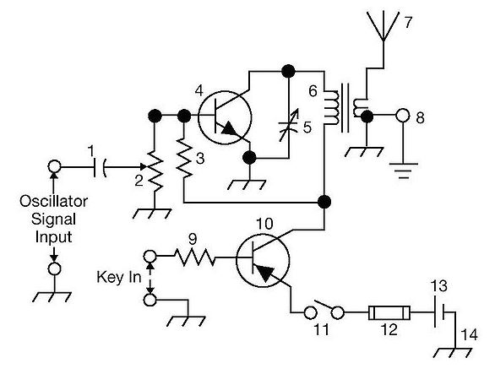
ARRL
TENTH EDITION
THE
GENERAL CLASS
LICENSE COURSE
FOR HAM RADIO
All You Need to Pass Your General Class Exam!

Slide 2
Resource & Reference
www.arrl.org/shop/Licensing-Education-and-Training

Slide 3
Course Overview (book chapters)
Introduction
Procedures & Practices
Rules & Regulations
Components & Circuits
Radio Signals & Equipment
Digital Modes
Antennas
Propagation
Electrical & RF Safety
General Question Pool

Slide 4
General Question Pool Subelements
# | Title | # Exam Questions
G1 | Commission’s Rules | 5
G2 | Operating Procedures | 5
G3 | Radio Wave Propagation | 3
G4 | Amateur Radio Practices | 5
G5 | Electrical Principles | 3
G6 | Circuit Components | 2
G7 | Practical Circuits | 3
G8 | Signals and Emissions | 3
G9 | Antennas and Feed Lines | 4
G0 | Electrical and RF Safety | 2

Slide 5
Let’s Get Started!
Our goal during this class is for you to achieve the General class Amateur Radio license!
This license will authorize you to operate an Amateur Radio (ham radio) transmitter on frequencies well beyond that allowed with a technician class license

Slide 6
Section 1.1 The General Class License and Amateur Radio
Reasons to upgrade
More frequencies (covered in Chapter 3)
More communications options (expanded HF)
New technical opportunities (studying and using effects of the ionosphere & solar conditions, for example)
More fun (DXing, contesting, e.g.)
You can be a Volunteer Examiner

Slide 7
Section 1.2 How to Use the ARRL General Manual
Chapters begin with brief review of Technician material for this topic
Covers exam questions (and correct answer), along with examples
Questions to be covered are listed at the beginning of the section
ARRL General webpage:
www.arrl.org/general-class-license-manual
Includes supplements and clarifications
After completing a chapter/section, review the questions in the Question Pool
Online practice exams at:
www.arrl.org/examreview

Slide 8
Section 1.3 The Upgrade Trail
Primary topics of focus as a General
Operating effectively on HF
Digital modes such as FT8, PSK31, PACTOR, and VARA
Solar effects on HF propagation
Test instruments
Practical electronic circuits
Common antennas used on HF

Slide 9
Section 1.3 The Upgrade Trail (cont.)
Testing
When you pass the General exam, you will have the opportunity to take the Extra exam at the same time … no additional fee
Find a test session
www.arrl.org/exam
Online testing is available: www.arrl.org/online-exam-session
Bring a copy of your license and two forms of ID to the test session (one must be a photo ID)
Once you pass, the VEC will submit your results to the FCC, and the FCC will update you in the database … you’ll be able to use your new General privileges immediately upon passing, even though the FCC database may not be updated … just append /AG to your call sign … KØILP/AG (for voice operation, say KØILP SLASH AG)
Test consists of 35 questions … must answer 26 correctly

Slide 10
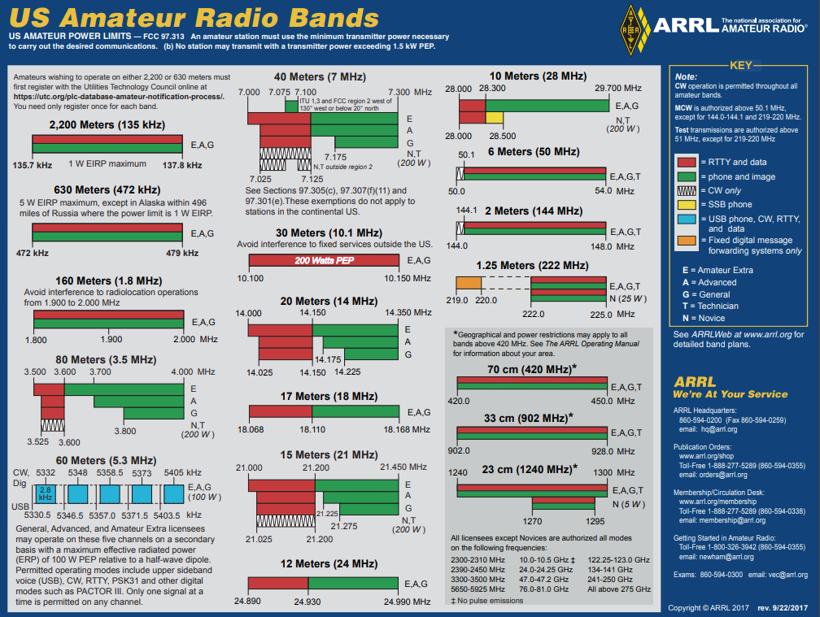
http://www.arrl.org/graphical-frequency-allocations

Slide 11
General Privileges
BAND | FREQUENCIES | MODES | POWER
2200 m | 135.7-137.8 kHz | CW, Phone, Image, RTTY/Data | 1 W EIRP maximum
630 m | 472-479 kHz | CW, Phone, Image, RTTY/Data | 5 W EIRP max (see AK exception)
160 m | 1.800-2.000 MHz | CW, Phone, Image, RTTY/Data | 1500 watts PEP max
80 m | 3.525-3.600 MHz | CW, RTTY/Data | 1500 watts PEP max
80 m | 3.800-4.000 MHz | CW, Phone, Image | 1500 watts PEP max
60 m | 5330.5 kHz | CW, Phone, RTTY/Data | 100 W PEP max
60 m | 5346.5 kHz | CW, Phone, RTTY/Data | 100 W PEP max
60 m | 5357.5 kHz | CW, Phone, RTTY/Data | 100 W PEP max
60 m | 5371.5 kHz | CW, Phone, RTTY/Data | 100 W PEP max
60 m | 5403.5 kHz | CW, Phone, RTTY/Data | 100 W PEP max
40 m | 7.025-7.125 MHz | CW, RTTY/Data | 1500 watts PEP max
40 m | 7.175-7.300 MHz | CW, Phone, Image | 1500 watts PEP max
30 m | 10.100-10.150 MHz | CW, RTTY/Data | 200 watts PEP max

Slide 12
General Privileges (cont.)
BAND | FREQUENCIES | MODES | POWER
20 m | 14.025 -14.150 MHz | CW, RTTY/Data | 1500 watts PEP max
20 m | 14.225 -14.350 MHz | CW, Phone, Image | 1500 watts PEP max
17 m | 18.068-18.110 MHz | CW, RTTY/Data | 1500 watts PEP max
17 m | 18.110-18.168 MHz | CW, Phone, Image | 1500 watts PEP max
15 m | 21.025-21.200 MHz | CW, RTTY/Data | 1500 watts PEP max
15 m | 21.275-21.450 MHz | CW, Phone, Image | 1500 watts PEP max
12 m | 24.890-24.930 MHz | CW, RTTY/Data | 1500 watts PEP max
12 m | 24.930-24.990 MHz | CW, Phone, Image | 1500 watts PEP max
10 m | 28.000-28.300 MHz | CW, RTTY/Data | 1500 watts PEP max
10 m | 28.300-29.700 MHz | CW, Phone, Image | 1500 watts PEP max
6 m | 50.0-50.1 MHz | CW Only | 1500 watts PEP max
6 m | 50.1-54.0 MHz | CW, Phone, Image, MCW, RTTY/Data | 1500 watts PEP max

Slide 13
General Privileges (cont.)
BAND | FREQUENCIES | MODES | POWER
2 m | 144.0-144.1 MHz | CW Only | 1500 watts PEP max
2 m | 144.1-148.0 MHz | CW, Phone, Image, MCW, RTTY/Data | 1500 watts PEP max
1.25 m | 222.00-225.00 MHz | CW, Phone, Image, MCW, RTTY/Data | 1500 watts PEP max
1.25 m | 219-220 MHz | Fixed digital message forwarding systems | 50 watts PEP max
70 cm | 420.0-450.0 MHz | CW, Phone, Image, MCW, RTTY/Data | 1500 watts PEP max
33 cm | 902.0-928.0 MHz | CW, Phone, Image, MCW, RTTY/Data | 1500 watts PEP max
23 cm | 1240-1300 MHz | CW, Phone, Image, MCW, RTTY/Data | 1500 watts PEP max
All modes, 1500 watts PEP max: 2300-2310 MHz, 2390-2450 MHz, 3300-3450 MHz, 5650-5925 MHz, 10.0-10.5 GHz, 24.0-24.25 GHz, 47.0-47.2 GHz, 76.0-81.0 GHz*, 122.25 -123.00 GHz, 134-141 GHz, 241-250 GHz, All above 300 GHz (* Amateur operation at 76-77 GHz has been suspended till the FCC can determine that interference will not be caused to vehicle radar systems)

Slide 14
END OF CHAPTER 1 PART 1 OF 1

Slide 15
Slides created by …
Jerry D. Kilpatrick
KØILP (Amateur Radio)
PGØØØ72373 (Commercial Operator)
K0ILP.NC@gmail.com
Feel free to contact me if you find errors or have suggestions for improvement.

