Slide 1
Diodes, Transistors and Integrated Circuits
(Semiconductors)
Made of material like silicon that are “OK” conductors but not as good as metals
Impurities added to semiconductors create material with more than usual electrons (N-type) and fewer than usual electrons (P-type)
Structures of N and P material can control current flow through the semiconductor
When N- and P-type material are placed in contact with each other, the result is a PN junction that conducts better in one direction than the other

Slide 2
Diodes
Allows current to flow in only one direction
  Two electrodes (Anode, Cathode)
  AC current is changed to varying pulses of DC (called rectification)
  Diodes used to change AC power to DC power are called rectifiers (heavy-duty diodes)
Schematic
Designator (D or CR)
If AC voltage is applied to a diode, the result is a pulsing DC current because current is blocked when the voltage tries to push electrons in the wrong direction
Anode
Cathode
Arrows
indicate light (LED)
Stripe on diode indicates CATHODE

Slide 3
Diodes (cont.)
When current flows through a diode, a small positive voltage develops from the anode to the cathode
  Called forward voltage drop, usually less than 1 V
  Voltage depends on the type of diode and the materials it’s made from
Light-emitting diode or LED gives off light when current flows through it in the forward direction from anode to cathode
  Used as visual indicators (use less power than incandescent bulbs/lamps)
  Material from which the LED is made determines the color of light emitted

Slide 4
Transistors
The function of a transistor is to control large signals with small ones
  An “electronically controlled current valve”
  When used as an amplifier, a transistor produces gain
  Transistors can also be used as a switch
Schematic
Designator (Q)
Bipolar Junction Transistor (BJT)
Field-Effect Transistor (FET)

Slide 5
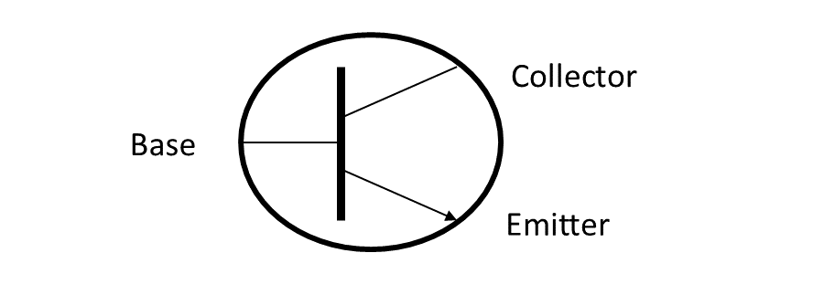
Transistors (cont.)
Two common types of transistors: bipolar junction transistors (BJT) and field effect transistors (FET)
The Bipolar Junction Transistor (BJT) has three layers of N or P material connected to electrodes
Depending on the arrangement of layers, a BJT is either an NPN or PNP transistor
The three electrodes of an FET are the gate, drain, and source
RF power transistors are used as the primary gain-producing component in RF power amplifiers
Bipolar Junction Transistor Schematic
(showing the 3 electrodes)

Slide 6
Transistors (cont.)
The Field-Effect Transistor (FET) has a conducting path or channel of N and P material connected to the drain and source electrodes
Voltage applied to the gate electrode controls current through the channel
Drain
Gate
Source

Slide 7
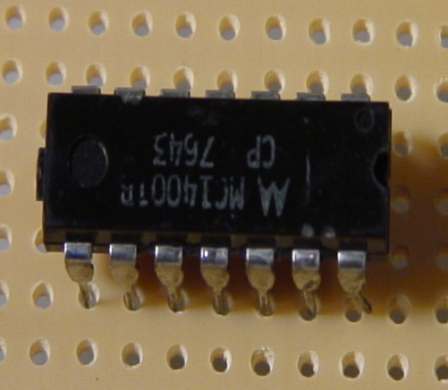
Integrated Circuits
An integrated circuit (IC or chip) is made of many components connected together as a useful circuit and packaged as a single component
Schematic symbol
Designator (IC or U)
D
Q
CLK
Q
_
+

Slide 8
PRACTICE QUESTIONS

Slide 9
Which is true about forward voltage drop in a diode?
It is lower in some diode types than in others
It is proportional to peak inverse voltage
It indicates that the diode is defective
It has no impact on the voltage delivered to the load
T6B01 A 3-10

Slide 10
What electronic component allows current to flow in only one direction?
Resistor
Fuse
Diode
Driven element
T6B02 C 3-10

Slide 11
Which of these components can be used as an electronic switch?
Varistor
Potentiometer
Transistor
Thermistor
T6B03 C 3-10

Slide 12
Which of the following components can consist of three regions of semiconductor material?
Alternator
Transistor
Triode
Pentagrid converter
T6B04 B 3-10

Slide 13
What type of transistor has a gate, drain, and source?
Varistor
Field-effect
Tesla-effect
Bipolar junction
T6B05 B 3-10

Slide 14
How is the cathode lead of a semiconductor diode often marked on the package?
With the word “cathode”
With a stripe
With the letter C
With the letter K
T6B06 B 3-10

Slide 15
What causes a light-emitting diode (LED) to emit light?
Forward current
Reverse current
Capacitively-coupled RF signal
Inductively-coupled RF signal
T6B07 A 3-10

Slide 16
What does the abbreviation FET stand for?
Frequency Emission Transmitter
Fast Electron Transistor
Free Electron Transmitter
Field Effect Transistor
T6B08 D 3-10

Slide 17
What are the names for the electrodes of a diode?
Plus and minus
Source and drain
Anode and cathode
Gate and base
T6B09 C 3-10

Slide 18
Which of the following can provide power gain?
Transformer
Transistor
Reactor
Resistor
T6B10 B 3-11

Slide 19
What is the term that describes a device’s ability to amplify a signal?
Gain
Forward resistance
Forward voltage drop
On resistance
T6B11 A 3-11

Slide 20
What are the names of the electrodes of a bipolar junction transistor?
Signal, bias, power
Emitter, base, collector
Input, output, supply
Pole one, pole two, output
T6B12 B 3-11

Slide 21
Which of the following devices or circuits changes an alternating current into a varying direct current signal?
Transformer
Rectifier
Amplifier
Reflector
T6D01 B 3-11

Slide 22
Which of the following is commonly used as a visual indicator?
LED
FET
Zener diode
Bipolar transistor
T6D07 A 3-11

Slide 23
What is the name of a device that combines several semiconductors and other components into one package?
Transducer
Multi-pole relay
Integrated circuit
Transformer
T6D09 C 3-11

Slide 24
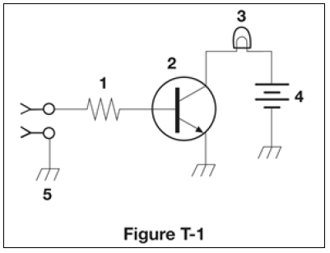
What is the function of component 2 in figure T-1?
Give off light when current flows through it
Supply electrical energy
Control the flow of current
Convert electrical energy into radio waves
T6D10 C 3-11

Slide 25
Protective Components
Protective components (such as fuses and circuit breakers) are used to prevent equipment damage or safety hazards such as fire or electrical shock
Designed to remove power in case of a circuit overload
  Fuses blow – one time protection
  Circuit breakers trip – can be reset and reused
Fuses interrupt current overloads by melting a short length of metal – when the metal melts, the current path is broken and power is removed from circuits
Replacing a fuse or circuit breaker with one with a higher current rating could allow the fault to permanently damage the equipment or start a fire

Slide 26
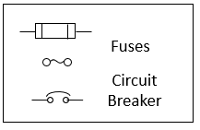
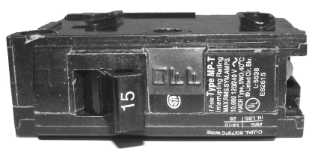
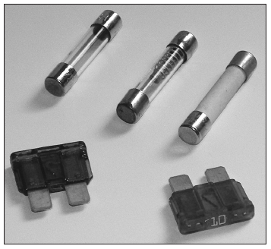
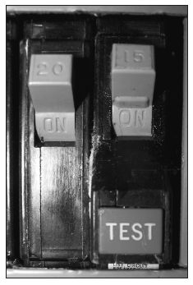
Schematics
Circuit Breaker
Ground Fault Circuit Interrupter (GFCI) circuit breaker
Fuses

Slide 27
PRACTICE QUESTIONS

Slide 28
What electrical component is used to protect other circuit components from current overloads?
Fuse
Thyratron
Varactor
All these choices are correct
T6A09 A 3-12

Slide 29
What is the purpose of a fuse in an electrical circuit?
To prevent power supply ripple from damaging a component
To remove power in case of overload
To limit current to prevent shocks
All these choices are correct
T0A04 B 3-12

Slide 30
Why should a 5-ampere fuse never be replaced with a 20-ampere fuse?
The larger fuse would be likely to blow because it is rated for higher current
The power supply ripple would greatly increase
Excessive current could cause a fire
All these choices are correct
T0A05 C 3-12

Slide 31
Circuit Gatekeepers … Switches & Relays
Switches and relays control current through a circuit by connecting and disconnecting paths for current to follow
Switches and relays are described by their number of poles and the number of throws
  The combination of poles and throws describes the switch
  Each circuit controlled by the switch is a pole
  Each position is called a throw
A switch is operated manually while a relay is a switch controlled by an electromagnet

Slide 32
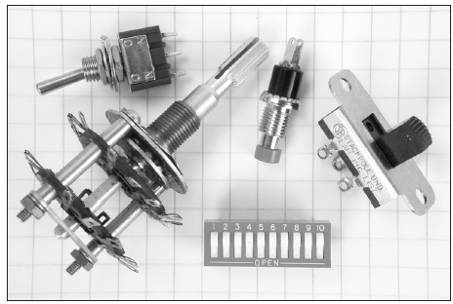
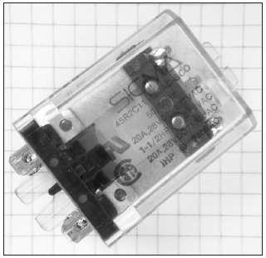
Switch Configurations
SPST
Switches
SPDT
DPDT
Pushbutton
Relay

Slide 33
Indicator, Meters and Displays
Indicators and displays are important components for radio equipment
  An indicator is either ON or OFF
A meter provides information as a value in the form of numbers or on a numeric scale
A display combines indicators, numbers, and labels
  A liquid crystal display or LCD is used on the front panel of many radios and test instruments

Slide 34
PRACTICE QUESTIONS

Slide 35
What is the function of an SPDT switch?
A single circuit is opened or closed
Two circuits are opened or closed
A single circuit is switched between one of two other circuits
Two circuits are each switched between one of two other circuits
T6A08 C 3-13

Slide 36
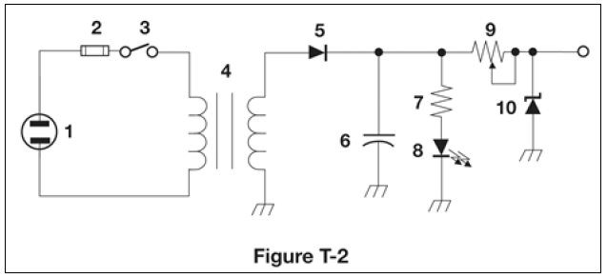
What type of switch is represented by component 3 in figure T-2?
Single-pole single-throw
Single-pole double-throw
Double-pole single-throw
Double-pole double-throw
T6A12 A 3-13

Slide 37
What is a relay?
An electrically-controlled switch
A current controlled amplifier
An inverting amplifier
A pass transistor
T6D02 A 3-13

Slide 38
Which of the following displays an electrical quantity as a numeric value?
Potentiometer
Transistor
Meter
Relay
T6D04 C 3-14

Slide 39
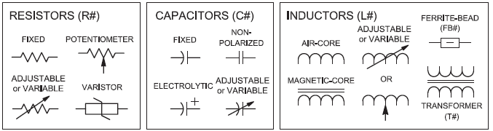
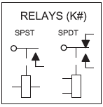
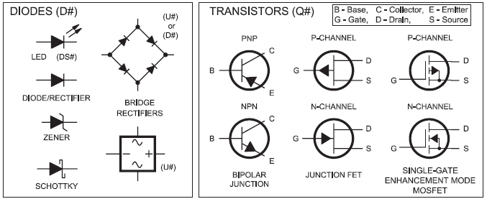
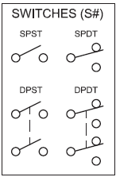
Fig 3.15 – Schematic Symbols (see text)

Slide 40
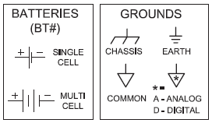
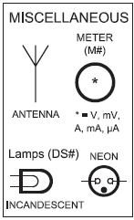
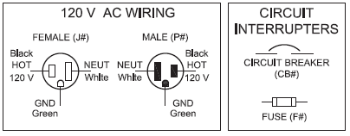
Fig 3.15 – Schematic Symbols (cont., see text)

Slide 41
Schematic Diagrams and Symbols
Symbols are used when drawing a circuit because there are so many types of components
Schematic diagrams are a visual description of a circuit and its components that uses standardized drawings called circuit symbols
  Shows how the components are connected electrically

Slide 42
PRACTICE QUESTIONS

Slide 43
What is the name of an electrical wiring diagram that uses standard component symbols?
Bill of materials
Connector pinout
Schematic
Flow chart
T6C01 C 3-14

Slide 44

What is component 1 in figure T-1?
Resistor
Transistor
Battery
Connector
T6C02 A 3-14

Slide 45
What is component 2 in figure T-1?
Resistor
Transistor
Indicator lamp
Connector
T6C03 B 3-14

Slide 46
What is component 3 in figure T-1?
Resistor
Transistor
Lamp
Ground symbol
T6C04 C 3-14

Slide 47
What is component 4 in figure T-1?
Resistor
Transistor
Ground symbol
Battery
T6C05 D 3-14

Slide 48
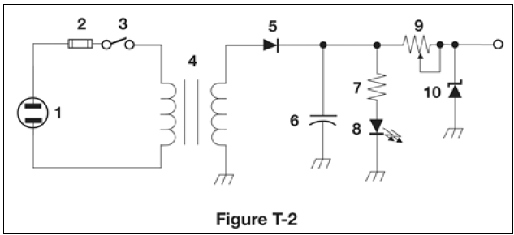
What is component 6 in figure T-2?
Resistor
Capacitor
Regulator IC
Transistor
T6C06 B 3-14

Slide 49
What is component 8 in figure T-2?
Resistor
Inductor
Regulator IC
Light emitting diode
T6C07 D 3-14

Slide 50
What is component 9 in figure T-2?
Variable capacitor
Variable inductor
Variable resistor
Variable transformer
T6C08 C 3-14

Slide 51
What is component 4 in figure T-2?
Variable inductor
Double-pole switch
Potentiometer
Transformer
T6C09 D 3-14

Slide 52
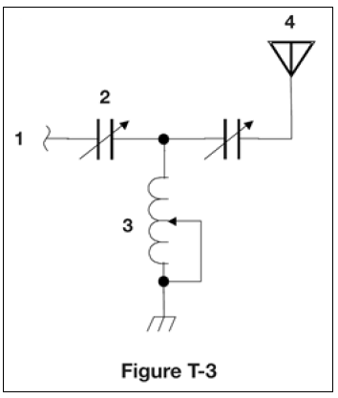
What is component 3 in figure T-3?
Connector
Meter
Variable capacitor
Variable inductor
T6C10 D 3-14

Slide 53
What is component 4 in figure T-3?
Antenna
Transmitter
Dummy load
Ground
T6C11 A 3-14

Slide 54
Which of the following is accurately represented in electrical schematics?
Wire lengths
Physical appearance of components
Component connections
All these choices are correct
T6C12 C 3-14

Slide 55
Radio Circuits
An oscillator produces a steady signal at one frequency
  Used in both receivers and transmitters to determine the operating frequency
The process of combining data or voice signals with an RF signal is modulation
Modulators add the data or voice signal to an RF signal or carrier
  A demodulator circuit extracts the information from a modulated signal
Mixers combine two RF signals and shift one of them to a third frequency (closely related to a modulator)

Slide 56
PRACTICE QUESTIONS

Slide 57
What is the name of a circuit that generates a signal at a specific frequency?
Reactance modulator
Phase modulator
Low-pass filter
Oscillator
T7A05 D 3-17

Slide 58
Which of the following describes combining speech with an RF carrier signal?
Impedance matching
Oscillation
Modulation
Low-pass filtering
T7A08 C 3-17

Slide 59
Which of the following is used to convert a signal from one frequency to another?
Phase splitter
Mixer
Inverter
Amplifier
T7A03 B 3-18

Slide 60

END OF MODULE 3

