Slide 1
Practical Antenna Systems: Dipoles
Simplest type of antenna
Dipole means “two electrical parts”
Made from a straight conductor of wire one-half wavelength (1⁄2 λ) long with a feed point somewhere along the antenna
Most are oriented horizontally, particularly on the lower frequency bands, and radiate a horizontally polarized signal
  Can also be installed vertically, sloping or even drooping from a single support in the middle (inverted-V)
The radiation pattern isolated in space looks like a donut

Slide 2
Ground Plane Antennas
Most common type is one-quarter wavelength long (1⁄4 λ) with the feed point at the base
Acts like one-half of a dipole with the missing portion made up by the electrical mirror formed by the ground plane
Made from sheet metal or a screen of wires called radials that extend out from the base
Extended length of a 5⁄8-λ ground-plane focuses more energy toward the horizon (better range)
To reduce the physical size of the antenna, it is often constructed with some of the radiating conductor wound into a coil or a separate inductor inserted in the antenna … called is called inductive loading

Slide 3
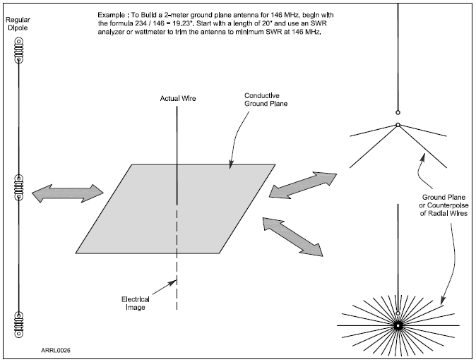
Figure 4.10 — A ground-plane makes up an electrical mirror that creates an image of the missing half of a ground-plane antenna. The result is an antenna that acts very much like a dipole. The ground plane can be made up of a screen of wires (often used at HF) or a metal surface at VHF and UHF. For VHF and UHF antennas mounted on masts, a counterpoise of a few wires serves the same purpose.

Slide 4
Antennas for Handheld Radios
The flexible antenna used with most handheld radios is called a rubber duck (ground-plane antenna shortened by coiling the conductor inside a plastic coating)
  Doesn’t transmit or receive as well as a full-sized ground-plane antenna
  For best performance, hold the transceiver so that the antenna is vertical
  Not very effective inside vehicles … up to 20 time less effective than an external mobile antenna
Easy to connect handhelds to full-sized antennas … uses standard RF connectors … a 5-watt handheld can easily reach 10 miles with a “good” antenna

Slide 5
Calculating Antenna Length (dipole)
To calculate length of a resonant dipole 1⁄2-λ long …
Length (in feet) = 468 / frequency (in MHz) … or
Length = 468 / f
Example: At 50.1 MHz (in the 6 meter band), dipole length is
calculated as 468 / 50.1 = 9.33 feet = 112 inches long
NOTE: The value of the constant used in the formula accounts for effects that cause an antenna to act like it is a little longer electrically than it is physically. The actual resonant length is affected by height above ground, its electrical properties, and nearby conductive objects. So …
Make the dipole a few percent longer at first (use 490 instead of 468), then use an SWR meter or antenna analyzer to determine the resonant frequency. Assuming the resonant frequency is too low because the dipole is too long, shorten it until the dipole is resonant at the desired frequency.

Slide 6
Calculating Ground Plane Length
The length of a ground-plane antenna is half that of a dipole and is often estimated as: length (in feet) = 234 / frequency (in MHz)
Example: At 146 MHz, a λ/4 ground-plane is 234 / 146 = 1.6 feet = 19 ¼ inches long
Length adjustments also apply (similar to previous note about dipoles)

Slide 7
Directional Antennas
Simple dipoles, ground-planes, and loops work well, but they have little gain (radiation patterns don’t have strongly preferred directions)
Use a directional beam antenna get the best reception in one direction
On VHF and UHF, if a direct signal path is blocked, a beam antenna can be used to aim the signal at a reflecting surface to bypass the obstruction
Most widely used type of beam antennas are Yagis
Yagi beam antennas have much more gain than omni-directionals in their preferred direction

Slide 8
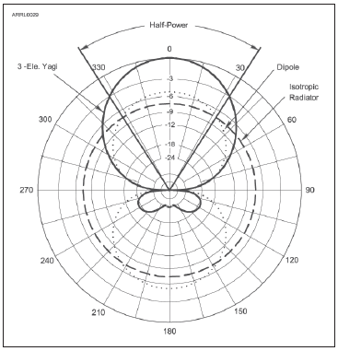
Yagi
Figure 4.13 — The radiation pattern of a typical, three-element Yagi antenna with a driven element, reflector, and director shows that most of the antenna’s energy is focused in one
direction along the boom of the antenna (along the 0-180 axis of the graph.) Smaller amounts are radiated toward the side and back. This
antenna also rejects noise and interference from the side and back. The round pattern of the isotropic antenna and the figure-eight
pattern of a dipole are included for reference.

Slide 9
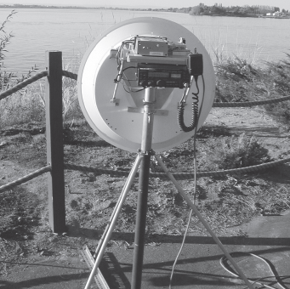
Yagis (cont.)
Horizontally polarized Yagis are usually used for long-distance communications (results in lower ground losses when the wave reflects from or travels along the ground)
As frequency increases and the size of Yagi elements become smaller, it becomes more difficult to construct practical antennas
  Above 1GHz, dish antennas become practical
Figure 4.14 — N7CFO’s dish antenna operates on 10 GHz and is portable enough to be taken on contest outings.
Figure 4.14 — N7CFO’s dish antenna operates on 10 GHz and is portable enough to be taken on contest outings.

Slide 10
PRACTICE QUESTIONS

Slide 11
Which of the following describes a type of antenna loading?
Electrically lengthening by inserting inductors in radiating elements
Inserting a resistor in the radiating portion of the antenna to make it resonant
Installing a spring in the base of a mobile vertical antenna to make it more flexible
Strengthening the radiating elements of a beam antenna to better resist wind damage
T9A02 A 4-12

Slide 12
Which of the following describes a simple dipole oriented parallel to Earth’s surface?
A ground-wave antenna
A horizontally polarized antenna
A travelling-wave antenna
A vertically polarized antenna
T9A03 B 4-12

Slide 13
What is a disadvantage of the short, flexible antenna supplied with most handheld radio transceivers, compared to a full-sized quarter-wave antenna?
It has low efficiency
It transmits only circularly polarized signals
It is mechanically fragile
All these choices are correct
T9A04 A 4-12

Slide 14
Which of the following increases the resonant frequency of a dipole antenna?
Lengthening it
Inserting coils in series with radiating wires
Shortening it
Adding capacitive loading to the ends of the radiating wires
T9A05 C 4-12

Slide 15
What is a disadvantage of using a handheld VHF transceiver with a flexible antenna inside a vehicle?
Signal strength is reduced due to the shielding effect of the vehicle
The bandwidth of the antenna will decrease, increasing SWR
The SWR might decrease, decreasing the signal strength
All these choices are correct
T9A07 A 4-12

Slide 16
What is the approximate length, in inches, of a quarter-wavelength vertical antenna for 146 MHz?
112
50
19
12
T9A08 C 4-12

Slide 17
What is the approximate length, in inches, of a half-wavelength 6 meter dipole antenna?
6
50
112
236
T9A09 C 4-12

Slide 18
In which direction does a half-wave dipole antenna radiate the strongest signal?
Equally in all directions
Off the ends of the antenna
In the direction of the feed line
Broadside to the antenna
T9A10 D 4-12

Slide 19
What is an advantage of a 5/8 wavelength whip antenna for VHF or UHF mobile service?
It has more gain than a 1/4-wavelength antenna
It radiates at a very high angle
It eliminates distortion caused by reflected signals
It has 10 times the power gain of a 1/4 wavelength whip
T9A12 A 4-12

Slide 20
What antenna polarization is normally used for long-distance CW and SSB contacts on the VHF and UHF bands?
Right-hand circular
Left-hand circular
Horizontal
Vertical
T3A03 C 4-15

Slide 21
When using a directional antenna, how might your station be able to communicate with a distant repeater if buildings or obstructions are blocking the direct line of sight path?
Change from vertical to horizontal polarization
Try to find a path that reflects signals to the repeater
Try the long path
Increase the antenna SWR
T3A05 B 4-15

Slide 22
What is a beam antenna?
An antenna built from aluminum I-beams
An omnidirectional antenna invented by Clarence Beam
An antenna that concentrates signals in one direction
An antenna that reverses the phase of received signals
T9A01 C 4-15

Slide 23
Which of the following types of antenna offers the greatest gain?
5/8 wave vertical
Isotropic
J pole
Yagi
T9A06 D 4-15

Slide 24
Practical Feed Lines & Associated Equipment
Table 4.1: Common Types of Coaxial Cable
Loss in dB
TYPE | IMPEDANCE | Loss Per 100’ @ 30 MHz | Loss Per 100’ @ 150 MHz
RG-6 | 75 | 1.4 | 33
RG-8 | 50 | 1.1 | 2.5
RG-8X | 50 | 2.0 | 4.5
RG-58 | 50 | 2.5 | 5.6
RG-59 | 75 | 1.8 | 4.1
RG-174 | 50 | 4.6 | 10.3
RG-213 | 50 | 1.1 | 2.5
LMR-400 | 50 | 0.7 | 1.5
Online calculator: www.timesmicrowave.com/calculator

Slide 25
Coaxial Cable (called COAX)
See Table 4.1
Performance of coaxial cable depends on the integrity of its outer jacket
Moisture contamination is the most common cause of coax failure
Prolonged exposure to the ultraviolet (UV) in sunlight will also cause the plastic in the jacket to degrade … then cracks … then moisture
  Some coax jackets use a pigment to absorb & block UV
Coax should not be bent sharply (can short center conductor to outer braid)

Slide 26
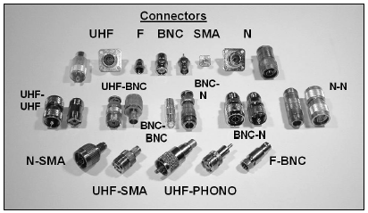
Coaxial Feed Line Connectors
Type of connector to use depends on signal frequency
UHF* series of connectors (PL-259 plugs and SO-239 receptacles) are the most widely-used for HF equipment
Above 400 MHz, the Type N connectors are used
Water in coaxial cable degrades the effectiveness of the braided shield (increases losses)
In low-loss air-core or “open-cell foam” coax, special techniques are required to prevent water absorption
Figure 4.15 — The photo shows a variety of common coaxial connectors that hams use. The larger connectors are used for higher power transmitters and antennas. The most common are the UHF and N styles. Special adapters are used to make connections between cables and equipment that have different styles of connectors.
* UHF in this case is NOT Ultra High Frequency!

Slide 27
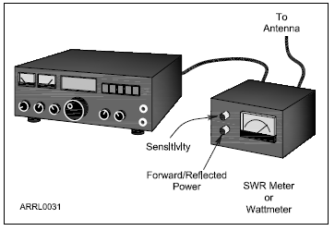
SWR Meters and Wattmeters
SWR Meters measure SWR by placing them in series with the feed line, usually right at the output of the radio
  Many radios include a built-in SWR meter
Alternatively, a directional wattmeter can be used to measure SWR
  Measure power flowing toward the antenna and power reflected from the antenna by rotating a sensing element or turning a switch
Figure 4.16 — The SWR meter measures power flowing toward the antenna (forward) and toward the transmitter (reflected or reverse).

Slide 28
Antenna Tuners
Impedance matchers or transmatches or antenna tuners are used If the SWR at the end of the feed line is too high for the radio to operate properly
  Connected at the output of the transmitter
  Adjusted until the SWR measured at the transmitter output is acceptably close to 1:1 (antenna system’s impedance has been matched to that of the transmitter output)
Most tuners combine the functions of impedance matcher, directional wattmeter and antenna switch
Automatic tuners sense when SWR is high and make the necessary adjustments

Slide 29
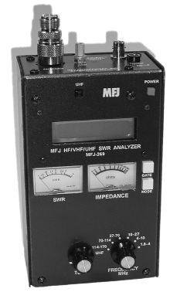
Antenna Analyzers
Used to measure an antenna system without using a transmitter whose signal might cause interference
Figure 4.18 — The popular MFJ series of antenna analyzers are used to adjust and troubleshoot antenna systems. The instrument contains a low-power signal source with an adjustable frequency and an SWR meter. The LCD display shows the operating frequency and information about the antenna impedance. The meters show SWR and feed point impedance.

Slide 30
PRACTICE QUESTIONS

Slide 31
Which of the following causes failure of coaxial cables?
Moisture contamination
Solder flux contamination
Rapid fluctuation in transmitter output power
Operation at 100% duty cycle for an extended period
T7C09 A 4-17

Slide 32
Why should the outer jacket of coaxial cable be resistant to ultraviolet light?
Ultraviolet resistant jackets prevent harmonic radiation
Ultraviolet light can increase losses in the cable’s jacket
Ultraviolet and RF signals can mix, causing interference
Ultraviolet light can damage the jacket and allow water to enter the cable
T7C10 D 4-17

Slide 33
What is a disadvantage of air core coaxial cable when compared to foam or solid dielectric types?
It has more loss per foot
It cannot be used for VHF or UHF antennas
It requires special techniques to prevent moisture in the cable
It cannot be used at below freezing temperatures
T7C11 C 4-17

Slide 34
Which of the following types of solder should not be used for radio and electronic applications?
Acid-core solder
Lead-tin solder
Rosin-core solder
Tin-copper solder
T7D08 A 4-17

Slide 35
What is the characteristic appearance of a cold tin-lead solder joint?
Dark black spots
A bright or shiny surface
A rough or lumpy surface
Excessive solder
T7D09 C 4-17

Slide 36
Which of the following RF connector types is most suitable for frequencies above 400 MHz?
UHF (PL-259/SO-239)
Type N
RS-213
DB-25
T9B06 B 4-17

Slide 37
Which of the following is true of PL-259 type coax connectors?
They are preferred for microwave operation
They are watertight
They are commonly used at HF and VHF frequencies
They are a bayonet-type connector
T9B07 C 4-17

Slide 38
Which of the following is a source of loss in coaxial feed line?
Water intrusion into coaxial connectors
High SWR
Multiple connectors in the line
All these choices are correct
T9B08 D 4-17

Slide 39
What is the electrical difference between RG-58 and RG-213 coaxial cable?
There is no significant difference between the two types
RG-58 cable has two shields
RG-213 cable has less loss at a given frequency
RG-58 cable can handle higher power levels
T9B10 C 4-17

Slide 40
Where should an RF power meter be installed?
In the feed line, between the transmitter and antenna
At the power supply output
In parallel with the push-to-talk line and the antenna
In the power supply cable, as close as possible to the radio
T4A05 A 4-18

Slide 41
Which of the following is used to determine if an antenna is resonant at the desired operating frequency?
A VTVM
An antenna analyzer
A Q meter
A frequency counter
T7C02 B 4-18

Slide 42
Which instrument can be used to determine SWR?
Voltmeter
Ohmmeter
Iambic pentameter
Directional wattmeter
T7C08 D 4-18

Slide 43
What is the major function of an antenna tuner (antenna coupler)?
It matches the antenna system impedance to the transceiver’s output impedance
It helps a receiver automatically tune in weak stations
It allows an antenna to be used on both transmit and receive
It automatically selects the proper antenna for the frequency band being used
T9B04 A 4-18

Slide 44

END OF MODULE 4

