Slide 1
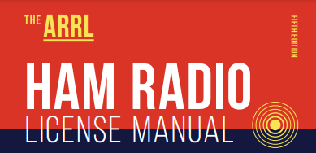
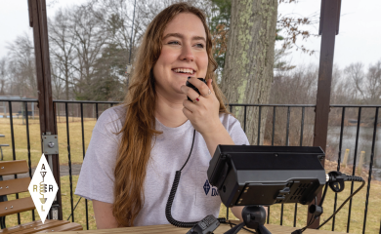

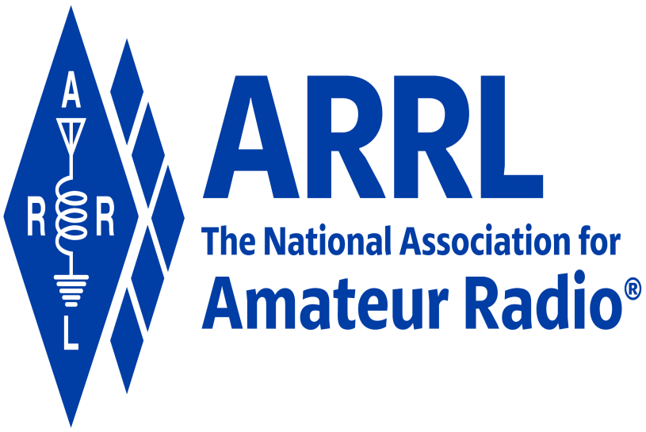
Amateur Radio Technician Exam Preparation Course

Slide 2
Amateur Radio Technician Exam Prep Course
Module 6
Communicating With Other Hams
6.1 Band Plans
6.2 Making Contacts
6.3 Using Repeaters
6.4 Nets
6.5 Communications for Public Service
6.6 Satellite Operating

Slide 3
Band Plans
Band plans are voluntary agreements designed for normal conditions (not regulations)
Amateur Radio is the only service that can tune freely and use multiple modes within their allocations
Amateur Radio Band Plan:
  www.arrl.org/band-plan
See 2 meter band plan on following slide (Table 6.1)

Slide 4
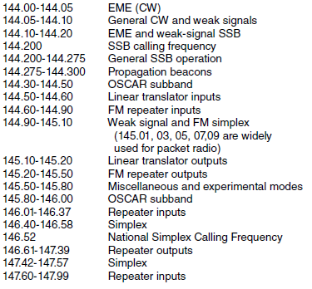
Table 6.1: 2 meter (144-148 MHz) Band Plan
2 meter and 70 cm bands are where many Technician licensees begin operating
Note the variety of activity in just one band

Slide 5
Band Plans (cont.)
HF band plans tend to be simpler than VHF and UHF because there are no repeaters
Other common uses listed in band plans …
  Beacons — Automated transmissions for listeners to tell when the band is “open” to the beacon’s location
  Weak signal — Modes that work better at lower signal strengths (CW, SSB, and some digital modes). Every amateur band from 50 MHz on up has frequencies available for CW and SSB operation.
  Satellite uplinks and downlinks —Segments of bands where signals are sent to (uplink) and received from (downlink) satellites
  Simplex — Transmitting and receiving on the same frequency
  Repeater inputs and outputs
  Control links

Slide 6
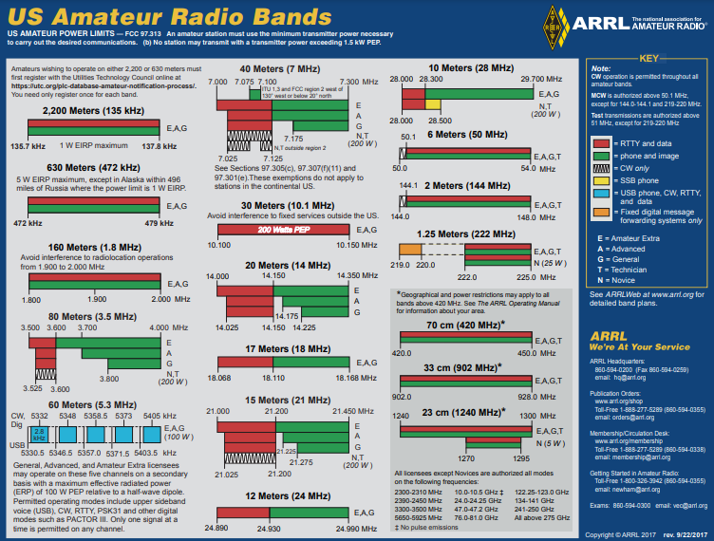
Frequency Bands Chart from arrl.org
See slide INTERPRETING THE BAND PLAN

Slide 7
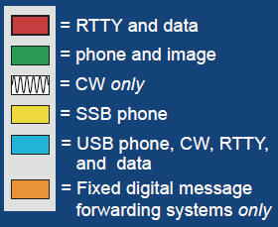
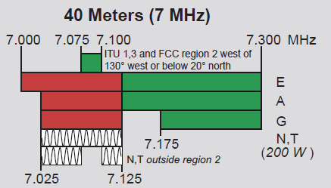
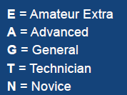
Interpreting the Band Plan
Band (frequency)
Use(s)
An EXTRA may use the 40 meter band for phone or image from 7.125 to 7.300 MHz.
License privilege(s)

Slide 8
Making Contacts on Repeaters
Before you transmit, be sure you are authorized to use that frequency and mode
Typical repeater “manners” …
  Listen so that you are aware of someone using the repeater
  Keep transmissions short
  Identify your station legally
Easiest way to attract listeners … give your call sign followed by “monitoring” … KØILP monitoring
Responding to a station looking for a contact … say the other station’s call sign once, followed by “this is” or “from,” then give your call sign … KX4IU this is KØILP

Slide 9
Making Contacts on Repeaters (cont.)
If you accidentally interrupt someone … just say “Sorry, KØILP clear” and wait for their contact to end or tune to a different repeater
What if you receive a report that your signal’s audio is strong, but distorted?
  You’re slightly off-frequency (radio control knob got bumped)
  Speaking too loudly into the microphone
  Transmitting from a bad location
  Weak or low batteries
Repeaters often add a short courtesy beep to the retransmitted signal when the transmitting station’s signal disappears
  Becomes the “over” cue to other stations to start speaking (although saying OVER is common and acceptable)

Slide 10
Making Contacts on Simplex Channels
Simplex channels are conveniently located between bands of repeater input and output channels
It’s often quite easy to make contact directly, without use of a repeater … avoids occupying or “tying up” a repeater
Many radios have a reverse split function that swaps transmit and receive frequencies, enabling you to listen for the other station on the repeater’s input frequency
The national simplex calling frequency on 2 meters is 146.52 MHz
  70 cm it is 446.00 MHz
  Most amateur bands have a calling frequency (www.arrl.org/band-plan)

Slide 11
Making Contacts: SSB, CW, and DIGITAL
Starting contacts is different on these modes than on repeaters that use fixed channels … call must be long enough to attract attention
Done by calling CQ (means “I am calling any station.”)
  The station calling CQ sends or says “CQ” several times followed by their call sign … CQ CQ CQ, this is KØILP Kilo Zero India Lima Papa calling CQ and standing by
  On CW or Digital: CQ CQ CQ DE KØILP KØILP KØILP K
Before you call CQ you should do three things …
  Be sure the frequency is one your license privileges authorize you to use
  Listen to be sure the frequency is not already in use
  Make a short transmission asking if the frequency is in use
Responding to a station calling CQ …
  Give the CQing station’s call sign (KX4IU) once then yours (KØILP) once (using phonetics) … KX4IU this is Kilo Zero India Lima Papa

Slide 12
Q-Signals
Q-signals are a system of radio shorthand (abbreviations for common information) developed from old telegraphy codes
Although developed for use by Morse operators, their use is also common on phone/voice
Table 6.2 lists the most common Q-signals

Slide 13
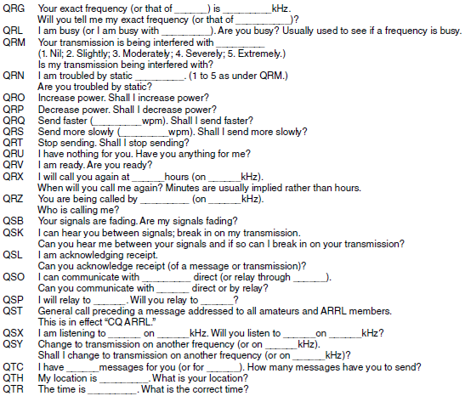
Table 6.2: Q-Signals
Take the form of a question only when followed by a question mark.

Slide 14
DXing and Contesting
DX stands for distant station
  Means thousands of miles on HF (and occasionally 6 meters)
  Beyond the radio horizon on VHF/UHF
Best done on SSB or CW because of the efficiency of those modes
Radio contests are held in which the competitors try to make as many short contacts as possible in a fixed period of time
During contesting send only the minimum information needed to identify your station and complete the exchange
Contesting info available at:
  http://www.arrl.org/contest-calendar

Slide 15
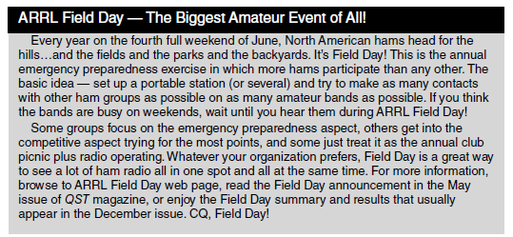
Popular DXing Event
www.arrl.org/field-day

Slide 16
Fox Hunting & Direction Finding
A different and more physical type of contest is known as foxhunting
Involves hiding and finding hidden transmitters
Trains hams to find downed aircraft, lost hikers, and sources of interference or jamming
You can get started with a portable radio with a signal strength indicator and a handheld or portable directional antenna (Yagi)
A similar event is radio direction finding
  A hybrid of the radio fox hunt using orienteering skills to navigate outdoors with map and compass

Slide 17
Video
Two primary means of exchanging pictures or video in real-time
  Amateur television (ATV) on the UHF bands at 430 MHz and higher
  Fast-scan color television signals (NTSC … National Television System Committee)
    Slow-scan television (SSTV) sends still signals
More info on amateur radio imaging at:
  www.arrl.org/atv-fast-scan-amateur-television
  www.hamuniverse.com/atvfastscantv.html

Slide 18
PRACTICE QUESTIONS

Slide 19
Where may SSB phone be used in amateur bands above 50 MHz?
Only in sub-bands allocated to General class or higher licensees
Only on repeaters
In at least some segment of all these bands
On any band if the power is limited to 25 watts
T1B10 C 97.305(c) 6-1

Slide 20
What is a band plan, beyond the privileges established by the FCC?
A voluntary guideline for using different modes or activities within an amateur band
A list of operating schedules
A list of available net frequencies
A plan devised by a club to indicate frequency band usage
T2A10 A 6-1

Slide 21
What term describes an amateur station that is transmitting and receiving on the same frequency?
Full duplex
Diplex
Simplex
Multiplex
T2A11 C 6-1

Slide 22
What is an appropriate way to call another station on a repeater if you know the other station’s call sign?
Say “break, break,” then say the station’s call sign
Say the station’s call sign, then identify with your call sign
Say “CQ” three times, then the other station’s call sign
Wait for the station to call CQ, then answer
T2A04 B 6-4

Slide 23
Which of the following indicates that a station is listening on a repeater and looking for a contact?
“CQ CQ” followed by the repeater’s call sign
The station’s call sign followed by the word “monitoring”
The repeater call sign followed by the station’s call sign
“QSY” followed by your call sign
T2A09 B 6-4

Slide 24
What might be a problem if you receive a report that your audio signal through an FM repeater is distorted or unintelligible?
Your transmitter is slightly off frequency
Your batteries are running low
You are in a bad location
All these choices are correct
T7B10 D 6-4

Slide 25
What is the national calling frequency for FM simplex operations in the 2 meter band?
146.520 MHz
145.000 MHz
432.100 MHz
446.000 MHz
T2A02 A 6-6

Slide 26
How is a VHF/UHF transceiver’s “reverse” function used?
To reduce power output
To increase power output
To listen on a repeater’s input frequency
To listen on a repeater’s output frequency
T2B01 C 6-6

Slide 27
Why are simplex channels designated in the VHF/UHF band plans?
So stations within range of each other can communicate without tying up a repeater
For contest operation
For working DX only
So stations with simple transmitters can access the repeater without automated offset
T2B09 A 6-6

Slide 28
How should you respond to a station calling CQ?
Transmit “CQ” followed by the other station’s call sign
Transmit your call sign followed by the other station’s call sign
Transmit the other station’s call sign followed by your call sign
Transmit a signal report followed by your call sign
T2A05 C 6-6

Slide 29
What is the meaning of the procedural signal “CQ”?
Call on the quarter hour
Test transmission, no reply expected
Only the called station should transmit
Calling any station
T2A08 D 6-6

Slide 30
What should you do before calling CQ?
Listen first to be sure that no one else is using the frequency
Ask if the frequency is in use
Make sure you are authorized to use that frequency
All these choices are correct
T2A12 D 6-6

Slide 31
Which Q signal indicates that you are receiving interference from other stations?
QRM
QRN
QTH
QSB
T2B10 A 6-7

Slide 32
Which Q signal indicates that you are changing frequency?
QRU
QSY
QSL
QRZ
T2B11 B 6-7

Slide 33
What operating activity involves contacting as many stations as possible during a specified period?
Simulated emergency exercises
Net operations
Public service events
Contesting
T8C03 D 6-7

Slide 34
Which of the following is good procedure when contacting another station in a contest?
Sign only the last two letters of your call if there are many other stations calling
Contact the station twice to be sure that you are in his log
Send only the minimum information needed for proper identification and the contest exchange
All these choices are correct
T8C04 C 6-7

Slide 35
What is a grid locator?
A letter-number designator assigned to a geographic location
A letter-number designator assigned to an azimuth and elevation
An instrument for neutralizing a final amplifier
An instrument for radio direction finding
T8C05 A 6-8

Slide 36
What type of transmission is indicated by the term “NTSC?”
A Normal Transmission mode in Static Circuit
A special mode for satellite uplink
An analog fast-scan color TV signal
A frame compression scheme for TV signals
T8D04 C 6-9

Slide 37
Which of the following methods is used to locate sources of noise interference or jamming?
Echolocation
Doppler radar
Radio direction finding
Phase locking
T8C01 C 6-10

Slide 38
Which of these items would be useful for a hidden transmitter hunt?
Calibrated SWR meter
A directional antenna
A calibrated noise bridge
All these choices are correct
T8C02 B 6-10

